Slide 1
Insurance Industry Overview & Outlook: Trends, Challenges and Opportunities
ICAE 2023 Exchange
Hershey, PA
September 26, 2023
Robert P. Hartwig, PhD, CPCU
Clinical Associate Professor of Finance, Risk Management & Insurance
Darla Moore School of Business ♦ University of South Carolina
Robert.Hartwig@moore.sc.edu ♦ 803.777.6782

Slide 2
P/C Insurance Overview & Outlook: Outline
P/C Financial Overview & Outlook in the Post-COVID, High-Inflation Era
Premium Growth
Underwriting Performance
Capacity
Key Line Pressure
CAT Loss Update and Reinsurance Markets
Investment Market Issues
Economic Overview & Outlook—Impacts for Insurers
Growth, Employment, Inflation and Recession
Inflation: Where it Is Headed & What It Means for Insurers
Impacts on claim severities and loss ratios
Long-term inflation considerations
Summary
12/01/09 - 9pm
eSlide – P6466 – The Financial Crisis and the Future of the P/C
Notes:
2

Slide 3
P/C Insurance Industry Financial Overview & Outlook:
Challenges Amid Rising Inflation and Higher Interest Rates
The Current Economic Environment Presents Many Challenges for P/C Insurers
Industry Remains Strong
3

Slide 4
P/C Industry Net Income After Taxes, 1991–2023:Q1
Large underwriting losses, sharp drop in realized capital gains caused Net Income to plummet by 33%
$ Millions
2012 ROAS¹ = 5.9%
2013 ROAS¹ = 10.2%
2014 ROAS¹ = 8.4%
2015 ROAS = 8.4%
2016 ROAS = 6.2%
2017 ROAS =5.0%
2018 ROAS = 8.0%
2019: ROAS = 7.7%
2020: ROAS = 6.9%
2021: ROAS = 6.4%
2022: ROAS = 5.7%
*ROE figures are GAAP; ¹Return on avg. surplus. Excludes Mortgage & Financial Guaranty insurers for years (2009-2014).
Sources: A.M. Best, ISO, APCIA.

Slide 5
ROE: Property/Casualty Insurance by Major Event, 1987–2022*
(Percent)
P/C Profitability Is Influenced Both by Cyclicality and Volatility
Katrina, Rita, Wilma
Harvey, Irma, Maria, CA Wildfires
Low CATs
Sept. 11
2022 5.7%
Hugo
Lowest CAT Losses in 15 Years
4 Hurricanes
Sandy
2020 6.9% Covid-19
Ian
Andrew, Iniki
Financial Crisis* ROE fell by 8.3 pts from 12.7% to 4.4%
Record Tornado Losses
Northridge
*Excludes Mortgage & Financial Guarantee in 2008 – 2014.
Sources: A.M. Best, ISO, Fortune, APCIA; USC RUM Center.

Slide 6
Net Written Premium Growth (All P/C Lines): Annual Change, 1971–2023F
2023F: 8.3%
2022: 8.3%
2021: 9.4%
2020: 2.4%
2019: 3.4%
2018: 10.7%
2017: 4.5%
2016: 2.7%
2015: 3.5%
1975-78
1984-87
2000-03
2020-??
(Percent)
Net Written Premiums Fell 0.7% in 2007 (First Decline Since 1943) by 2.0% in 2008, and 4.2% in 2009, the First 3-Year Decline Since 1930-33.
Sharp recovery in NWP post-COVID. Strong economic recovery and favorable rate environment both powered growth.
Shaded Areas = Hard Markets
COVID: 2.5%
NOTE: Shaded areas denote “hard market” periods.
Sources: A.M. Best (1971-2013, 2023F), ISO (2014-21); Risk & Uncertainty Management Center, Univ. of South Carolina

Slide 7
P/C Insurance Industry Combined Ratio, 2001–2023F*
Pre-COVID 2020 Combined Ratio Est.
99.1 (A.M. Best)
Actual = 98.8
As Recently as 2001, Insurers Paid Out Nearly $1.16 for Every $1 in Earned Premiums
Relatively Low CAT Losses, Reserve Releases
Higher CAT Losses, Shrinking Reserve Releases, Toll of Soft Market
Relatively Low CAT Losses, Reserve Releases
Sharply higher CATs are driving large underwriting losses and pricing pressure
Heavy Use of Reinsurance Lowered Net Losses
COVID-19 has had no discernable net impact on the combined ratio in 2020
Avg. CAT Losses, More Reserve Releases
Lower CAT Losses
Best Combined Ratio Since 1949 (87.6)
Ian Impacts
Sandy Impacts
Q1:23 102.0
*Excludes Mortgage & Financial Guaranty insurers 2008–2014.
Sources: A.M. Best, ISO (2014-2024F).

Slide 8
Combined Ratios by Line: 2019 – 2023F
Inflation will continue to pressure combined ratios in 2023
High CAT losses and inflation are pushing up combined ratios
Commercial MP has struggled amid inflation, CATs
CATS, inflation are hurting personal lines
Source: A.M. Best Review & Preview (2023 forecasts as of Mar. 2023); Univ. of South Carolina, Risk and Uncertainty Management Center.
8
Notes:
8

Slide 9
Homeowners Combined Ratios: Impacted by CATs and Inflation
At 104.8, the average homeowners combined ratio over the past 6 years was more than 16 points higher than the prior 5 years
104.8
Sources: S&P Global Intelligence, A.M. Best.

Slide 10
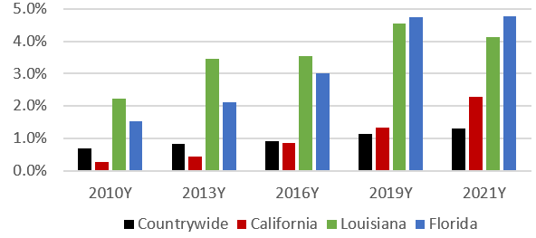
E&S Percent of P/C Industry DPW: Homeowners, 2010 – 2021
An increasing share of the homeowners markets is being written by surplus lines carriers—esp. in CA, FL and LA
Source: APCIA via S&P Global Market Intelligence.
12/01/09 - 9pm
eSlide – P6466 – The Financial Crisis and the Future of the P/C
Notes:
10

Slide 11
Private Passenger Auto Frequency & Severity Trends
Frequency, Severity and Loss Ratio Trends Are Adverse
Inflation is a Major Driver
11

Slide 12
At the Peak of the Pandemic, Frequencies Across All Coverages Plummeted and But Severities Rose: 4 Qtrs. Ending Q1 2021
Year-over-Year Change
The COVID-19 Pandemic Introduced Unparalleled Volatility in the Personal Auto Line
Source: ISO/PCI Fast Track data for 4 quarters ending in Q1 2021; Risk and Uncertainty Management Center, Univ. of South Carolina.

Slide 13
Personal Auto Claim Severities Continue to Trend Upward; Frequency Increase Are Moderating: 4 Qtrs. Ending Q1 2023
Year-over-Year Change
Auto Claim Frequencies Fell Sharply During the Pandemic, though Claim Severities Rose Materially
Recall: PD Liability claims were down 32.2% for the 4 qtrs. ending Q1 2021
Source: ISO/PCI Fast Track data for Q1 2023; Risk and Uncertainty Management Center, Univ. of South Carolina.

Slide 14
Collision Claim Severity: Rising to New Record Highs
Collision claim severity reached another record high in 2023:Q1, up 42.6% from 2020:Q1
Average Loss, 2018:Q1 through 2023:Q1
Severities Are Up Sharply—Inflation Is a Major Factor
Source: ISO/PCI Fast Track data; Center for Risk and Uncertainty Management, Univ. of South Carolina.

Slide 15
US: Collision Loss Ratios, Personal Auto, 2019:Q1 – 2023:Q1
The Personal Auto collision loss ratio is up by approximately 20 pts. compared to pre-pandemic levels. The upward trend has put significant pressure on rates.
Loss Ratio
Collision Loss Ratios Are Rising Rapidly and Are Now Far Above Pre-Covid Levels
Source: Fast Track data; University of South Carolina, Risk & Uncertainty Management Center.

Slide 16
US Collision Claim Frequency Trend: Returning to Pre-Pandemic Levels?
Paid Claim Frequency, 2019:Q1 through 2023:Q1*
Collision claim frequency remains below pre-pandemic levels
Pandemic-Induced Frequency Decline Has Ended and Has Nearly Normalized
*Number of claims per 100 earned car years.
Source: ISO/PCI Fast Track data; Center for Risk and Uncertainty Management, Univ. of South Carolina.

Slide 17
Price Index Changes for Used Cars & Trucks, Jan. 2020 – August 2023
Used car prices in recent months have begun to fall, albeit very modestly, and still remain far above pre-Covid levels, +40% as of Aug. 2023
New and Used Vehicle prices surged during the pandemic, +52.3% from Jan. 2020 before peaking in Jan. 2022—putting significant pressure on the overall CPI (new and used vehicles account for 7.5% of the index and gasoline 2.8% — auto insurance is 1.6% )
Realistically, used vehicle prices will likely never return to pre-pandemic levels
Sources: US Bureau of Labor Statistics; Risk and Uncertainty Management Center, University of South Carolina.

Slide 18
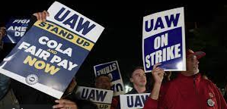
Price Index Changes for New Vehicles, Jan. 2020 – Aug. 2023
New car prices rising at a more modest pace—UAW strike could change that
New vehicle prices surged during the pandemic, +22.0% from Jan. 2020 through Aug. 2023 and seem to have peaked but are unlikely to fall, keeping pressure on auto claims severities (new and used vehicles account for 7.5% of the index and gasoline 2.8% — auto insurance is 1.6% )
Realistically, new vehicle prices will likely never return to pre-pandemic levels—supply/demand imbalances, technology, higher labor costs, EV transition will support an upward trend
Sources: US Bureau of Labor Statistics; Risk and Uncertainty Management Center, University of South Carolina.

Slide 19
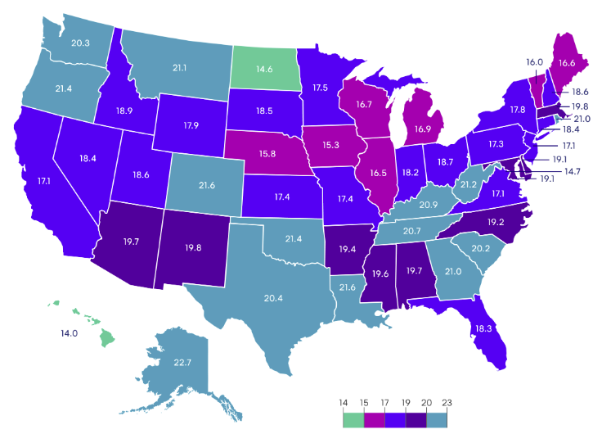
Length of Collision Replacement Rentals by State (Days), 2023:Q1
Avg. Length of Rental
2023:Q1: 18.7 days
2022:Q4: 18.7 days
2022:Q2: 17.7 days
2022:Q1: 18.2 days
2021:Q4: 17.0 days
2021:Q2: 13.2 days
CHANGE: +0.5 Days (22:Q1 – 23:Q1)
CHANGE: +5.5 Days (21:Q2 – 22:Q1)
RANGE: 14.0 (HI) to 22.7 (AK)
The increase in length of rental was referred to as “striking” by Enterprise and is a key driver of auto claim severity. The increase in the cost of rentals materially exacerbates the problem.
Source: Enterprise Rental-A-Car U.S. Length of Rental Report accessed via Mitchell.com at: https://www.mitchell.com/insights/auto-physical-damage/article/average-length-rental-repairable-vehicles-q1-2023.

Slide 20
Traffic Fatalities in the U.S., 2000-2022
During COVID, fatalities surged by 7.3% in 2020 and 10.1% in 2021 (up 18.1% since 2019)
Fatalities remained elevated in 2022 but fell slightly, by 0.3%
Financial Crisis/ ”Great Recession” –fatalities fell 25.4%
Extraordinary Increase in Poor Driving Behaviors in 2020, 2021 and 2022 Contributed to Sharply Higher Auto Fatalities
*2022 figure is annualized based on actual of 31,785 through Sept. 30 (a decline of 0.2% from the same period in 2021).
Source: Insurance Institute for Highway Safety and Highway Loss Data Institute: https://www.iihs.org/iihs/topics/t/general-statistics/fatalityfacts/overview-of-fatality-facts and NHTSA: https://www.nhtsa.gov/press-releases/traffic-crash-death-estimates-2022; Risk and Uncertainty Management Center, University of South Carolina.

Slide 21
Commercial Lines Growth
& Pricing Cyclicality
Economic and Tort Environment Create Pricing Pressure
21

Slide 22
CIAB: Average Commercial Rate Change, All Lines, 2011:Q1–2023:Q2
Rate increases peaked in 2020 but continued throughout 2021/2022 and into 2023
(Percent)
Renewals turned positive in late 2011 in the wake of record tornado losses and Superstorm Sandy
High CAT losses and poor underwriting results in recent years combined with inflation, litigation, reduced capacity, higher reinsurance costs, lower interest rates (until 2022) and increased uncertainty have exerted significant pressure on markets with overall rates up materially
Note: CIAB data cited here are based on a survey. Rate changes earned by individual insurers can and do vary, potentially substantially.
Source: Council of Insurance Agents & Brokers; Center for Risk and Uncertainty Management, Univ. of South Carolina.

Slide 23
Change in Commercial Rate Renewals, by Line: 2023:Q2
Commercial property and Business Interruption are experiencing sharp increases due to high CAT losses, inflation and expensive reinsurance
(Percent Change)
All major commercial lines except WC experienced increases in Q2 2023
WC rates have been basically flat or slightly down for several years, due to strong underwriting results
Note: CIAB data cited here are based on a survey. Rate changes earned by individual insurers can and do vary, potentially substantially.
Source: Council of Insurance Agents and Brokers; USC Center for Risk and Uncertainty Management.

Slide 24
Investments: Wall Steet’s Wild Ride Continues
Investment Performance Is a Key Driver of Insurer Profitability
How Has the Hawkish Fed Impacted Insurer Portfolios?

Slide 25
Property/Casualty Insurance Industry Investment Income: 2000–2023F*
Higher interest rates are pushing investment income sharply upward
($ Billions)
Aggressive Fed actions in response to COVID and recession pushed interest rates lower in 2020, adversely impacting investment income
Due to persistently low interest rates, investment income remained below pre-crisis levels for a decade. Lower interest rates during COVID drove investment income down once again. Fed rate hikes in 2022-23 are reversing this trend.
*2023 is annualized figure based on Q1 actual of $15.4B. 2018-19 figures are distorted by provisions of the TCJA of 2017. Increase reflects such items as dividends from foreign subsidiaries.
¹ Investment gains consist primarily of interest and stock dividends. Sources: A.M. Best Review & Preview (March 2023); ISO; University of South Carolina, Center for Risk and Uncertainty Management.

Slide 26
Net Investment Yield on Property/Casualty Insurance Invested Assets, 2007–2023P
Investment yields in 2021 were depressed--down about 200 BP from pre-crisis (and 50-80BP from pre-COVID) but are now rising. Yields in 2021 were the lowest since at least 1960.
(Percent)
The yield on invested assets remains depressed relative to pre-financial crisis and pre-COVID yields. Fed rate hikes in 2022-23 are lifting yields and investment income.
Average: 1960-2019 = 4.9%
Low: 2.8% (1961)
High: 8.2% (1984/85)
Sources: NAIC data, sourced from S&P Global Market Intelligence; 2017-19 figures are from ISO. 2020-21 data from the APCIA. 2022E-23P from A.M. Best Review & Preview (March 2023). Risk and Uncertainty Management Center, Univ. of South Carolina.

Slide 27
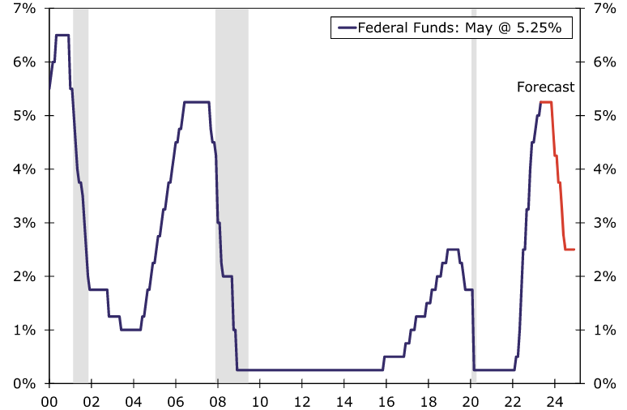
Federal Funds Target Rate: Up, Up and Away!
Upper Bound, Quarter-End
The Fed hiked short-term rates in July 2023 by 25 basis points to a target range of between 5.25% and 5.50%
July @ 5.5%
July 2007 5.25%
Fed Funds Rate as of July 2023
The cycle of rate increases is likely over. The Fed is now expected to hold rates steady until early 2024, before beginning to ease, assuming inflation slows amid a weakening economy.
Source: Federal Reserve Board and Wells Fargo Economics (6/23); Risk and Uncertainty Management Center, University of South Carolina.
12/01/09 - 9pm
eSlide – P6466 – The Financial Crisis and the Future of the P/C
Notes:
27

Slide 28
US Treasury Security Yields: A Long Downward Trend, 1990–2023*
The 2-year Treasury is at its highest yield since mid-2006 and currently exceed the 10-yr. yield by about 70BP
Yields on 10-Year US Treasury Notes have been essentially below 5% for 20 years
Since roughly 80% of P/C bond/cash investments are in 10-year or shorter durations, Fed rate hikes should over time provide a modest boost to P/C insurer portfolio yields
*Monthly, constant maturity, nominal rates, through August 2023.
Sources: Federal Reserve Bank at http://www.federalreserve.gov/releases/h15/data.htm. National Bureau of Economic Research (recession dates); Risk and Uncertainty Management Center, University of South Carolina.
12/01/09 - 9pm
eSlide – P6466 – The Financial Crisis and the Future of the P/C
Notes:
28

Slide 29
Interest Rate Forecasts: 2019 – 2025F: Higher for Longer
Yield (%)
3-Month Treasury
10-Year Treasury
Persistently low yields had been a challenge for insurers for many years. Fed rate hikes in 2022/23 boosted yields on invested assets
Fed rate hikes have pushed up longer-term yields from 2020’s record lows
Rising interest rates will provide a modest tailwind for insurers as the Fed raises interest rates. This will be especially beneficial to longer-tailed lines such as Workers Comp.
Sources: Wells Fargo Securities (9/23); Risk and Uncertainty Management Center, University of South Carolina.

Slide 30
Capital, Capacity & Reinsurance
P/C Insurance: Capital Crunch?
Will Industry Capacity Recover?
Reinsurance Markets Remain Under Pressure

Slide 31
Policyholder Surplus (Capacity), 2006:Q4 – 2023F
The P/C insurance industry entered the COVID-19 pandemic from a position of strength and was able to withstand the 9.0% surplus decline in Q1 2020 (far less than during the Financial Crisis). 2020 ended with record surplus. 2021 set another new record, exceeding $1 trillion for the first time. Unrealized losses caused surplus to drop sharply in 2022.
2022E (-9.4%)
($ Billions)
Drop due to near-record 2011 CAT losses (-4.9%)
Financial Crisis (-16.2%)
Policyholder Surplus is the industry’s financial cushion against large insured events, periods of economic stress and financial market volatility. It is also a source of capital to underwrite new risks.
Sources: ISO, A.M .Best, NAIC. Risk and Uncertainty Management Center, University of South Carolina.
31
12/01/09 - 9pm
eSlide – P6466 – The Financial Crisis and the Future of the P/C
Notes:
31

Slide 32
US Property Catastrophe Rate-on-Line Index: 1990 – 2023*
Record CAT activity in the US pressured US reinsurance prices in recent years (+30.1 in 2023,+14.8% in 2022, +6.4% in 2021, +9.0% in 2020, +2.6% in 2019, +7.5% in 2018)
(Percent)
+76%
+68%
+35.0%**
Post Katrina, Rita, Wilma period
+30.1%
2023 RoLs
US: +30.1%* (1/1)
US: +35.0%** (7/1)
Europe: +30.0%
Global: +27.5%
Post-Ike adjustment
Post-Andrew surge
Adjustment following record tornado losses in 2011 and Sandy in 2012
Post-9/11 Adjustment
US Property-CAT Reinsurance Pricing Is Sensitive to CAT Activity and Ultimately Impacts Primary Insurance Pricing, Terms and Conditions.
*As of January 1 each year.
**35.0% figure is the change in reinsurance rate for period from January through July 2023 relative to Jan. 1, 2022.
Source: Guy Carpenter; Artemis.bm accessed at: http://www.artemis.bm/us-property-cat-rate-on-line-index
32
Notes:
32

Slide 33
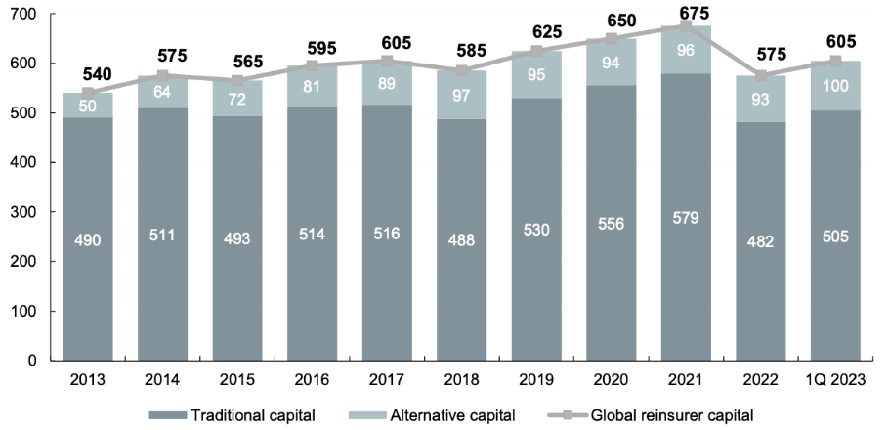
Global Reinsurance Capital, 2013 – 2023:Q1
$ Billions
Global reinsurance capital fell by $100B or 14.8% in 2022, contributing to today’s property insurance challenges. Some recovery evident in 2023.
Source: Aon Reinsurance Solutions/Aon Securities from Artemis.bm, accessed at: https://www.artemis.bm/news/alternative-reinsurance-capital-grows-to-new-100bn-high-aon/.
12/01/09 - 9pm
eSlide – P6466 – The Financial Crisis and the Future of the P/C
Notes:
33

Slide 34
Catastrophe Loss Trends
The Rise in CAT Losses Shows No Signs of Easing
The 2020s Are Off to an Ominous Beginning

Slide 35
U.S. Inflation-Adjusted Insured CAT Losses: 1980 – 2023:H1
Harvey, Irma, Maria
Ida ($36B)
TX Freeze ($15B)
99
Ian 2022 became the 2nd costliest insured CAT loss ever
Ian ($52.5B)
85
70
52
28
20
22
19
21
23:H1
Average Insured Loss per Year*
1980-2021: $23.8 Billion
2012-2021: $44.1 Billion
The 2020s are off to an ominous start with $85B in average annual insured losses (2020-22)
*Stated in 2021 dollars except 2022 and 2023 (2022/23 dollars).
Sources: Property Claims Service, a Verisk Analytics business (1980-2019); 2020-21 figures from Munich Re; 2023 YTD data from Gallagher Re, Insurance Information Institute; University of South Carolina, Risk & Uncertainty Management Center.

Slide 36
Top 22 Most Costly Disasters in U.S. History
(Insured Losses, 2020 Dollars, $ Billions)
Hurricane Ian in 2022 became the 2nd costliest insured CAT loss ever
12 of the top 22 mostly costly insured events in US history occurred between 2010 and 2022 (inclusive)
18 of the 22 Most Expensive Insurance Events in US History Have Occurred Since 2004.
*2021 dollars; **2022 dollars (Aon insured loss estimate as of 1/25/23).
Sources: PCS, RMS, Aon, Karen Clark & Co; USC Center for Risk and Uncertainty Management adjustments to 2020 dollars using the CPI.

Slide 37
U.S. Total Wildland Acres Burned, 1983–2022
Wildfires are becoming more severe, particularly since 2000
Millions of Acres Burned
*2004 figures do not include data for North Carolina
Sources: National Interagency Fire Center at: https://www.nifc.gov/fire-information/statistics/wildfires.

Slide 38
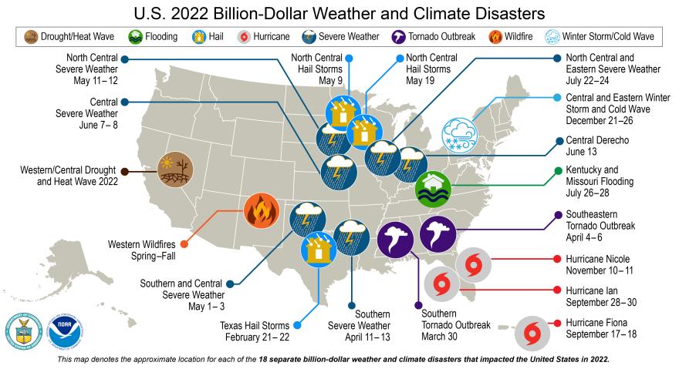
US Billion-Dollar Weather and Climate Disaster Events, Economic Costs, 2022
There were 18 events in the US in 2022 that caused at least $1B in economic damage
Source: NOAA, accessed at: https://www.ncei.noaa.gov/access/billions/time-series.
12/01/09 - 9pm
eSlide – P6466 – The Financial Crisis and the Future of the P/C
Notes:
38

Slide 39
Economic Overview The Defiant US Economy
Inflation, Geopolitical Conflicts and Rising Interest Rates and Weighing Heavily on Business and Consumer Sentiment but the Economy Remains Resilient
Can the Fed “Thread the Needle” and Achieve a “Soft Landing”?
39

Slide 40
US Real GDP Growth*
Consensus building that aggressive Fed rate hikes, tighter lending standards and heightened economic uncertainty will result in a mild recession by H1 2024
Real GDP Growth (%)
Financial Crisis
COVID CRASH
Q2 2020 plunged by 31.2%
“Great Recession” began in Dec. 2007
Demand for Insurance Increased Materially in 2021/22 During Recovery from the Pandemic—Particularly in Economically Sensitive Commercial Lines Such as WC. Premium growth will likely slow in 2023/24 as Economy Slows.
* Estimates/Forecasts from Wells Fargo Securities.
Source: US Department of Commerce, Wells Fargo Securities (9/23); Center for Risk and Uncertainty Management, University of South Carolina.

Slide 41
The Economy Drives P/C Insurance Industry Premiums: 2006:Q1–2023F* Direct Premium Growth (All P/C Lines) vs. Nominal GDP: Quarterly Y-o-Y Pct. Change
+8.3%
+5.3%
2023F
Direct written premiums track nominal GDP fairly tightly over time, suggesting the P/C insurance industry’s growth prospects inextricably linked to economic performance.
*2020-23F figures are annual.
Sources: SNL Financial; U.S. Commerce Dept., Bureau of Economic Analysis; ISO; I.I.I.; Risk and Uncertainty Management Center, University of South Carolina.

Slide 42
US Unemployment Rate Forecast: 2007:Q1–2025:Q4
Great Recession
Rising unemployment eroded payrolls and WC’s exposure base.
Unemployment peaked at 10% in late 2009.
1.807M jobs added in Jan-Jul. 2023. Strong reports indicative of labor market resilience
US unemployment rate peaked at 14.7% in April 2020 (13.1% Q2 avg.)
At 3.8% in Aug. 2023, the unemployment rate remains near historic lows
Unemployment rate returned to pre-COVID levels in early 2022 and remains low in 2023, but is expected to rise as Fed rate hikes slow the economy
= forecasts ; = actuals
Sources: US Bureau of Labor Statistics; Wells Fargo Securities (9/23 edition); Risk and Uncertainty Management Center, University of South Carolina.

Slide 43
Probability the U.S. Is in a Recession Within Next 12 Months: Jan. 2017 – July 2023*
Recession is increasingly likely, but still not inevitable
COVID: 96% chance of recession
Oct. 2022
Probability of recession peaked at 64%
Before COVID, economists typically assessed the risk of recession within the next 12 months at 15% -18%
July 2023
Probability of recession was 54% in July, down from 61% in April and January
July 2021
Probability of recession falls to just 12%
No Recession?
In Mar. 2023, Goldman Sachs increased its estimated probability of recession over the next 12 months to 35% from 25% in February.
*July 2023 survey included the responses of 76 economists. Range was 12% to 96%.
Source: Wall Street Journal surveys of economists: https://www.wsj.com/articles/despite-easing-price-pressures-economists-in-wsj-survey-still-see-recession-this-year-11673723571; Risk and Uncertainty Management Center, University of South Carolina.

Slide 44
Not All Recessions Are Created the Same – What Are the Possibilities Over the Next 12 Months?
In a “no landing” scenario, the economy averts a recession altogether.
Soft Landing
Hard Landing
No Landing
Source: Public Mutual; Univ. of South Carolina, Risk and Uncertainty Management Center.
44
Notes:
44

Slide 45
The Inflation Threat
Inflation is the #1 Concern of U.S. Consumers and Corporations…
It’s Also a Major Concern of Insurers

Slide 46
U.S. Inflation Rate: 2009-2025F*
Inflation accelerated sharply in 2021 before peaking at 9.1% in June 2022. Inflation should moderate through 2023/24; Forecast is highly dependent of trajectory of energy prices, Fed rate hikes and labor market tightness
Percentage Change (%)
There’s concern that the Fed may need to keep rates higher for longer to achieve its 2% inflation target
Insurer Concerns About Inflation
Rate Inadequacy
Reserve Inadequacy
Insurance-to-Value
*Annual change in Consumer Price Index for All Urban Consumers (CPI-U).
Source: U.S. Bureau of Labor Statistics; Wells Fargo Securities (9/23); USC Center for Risk and Uncertainty Management.

Slide 47
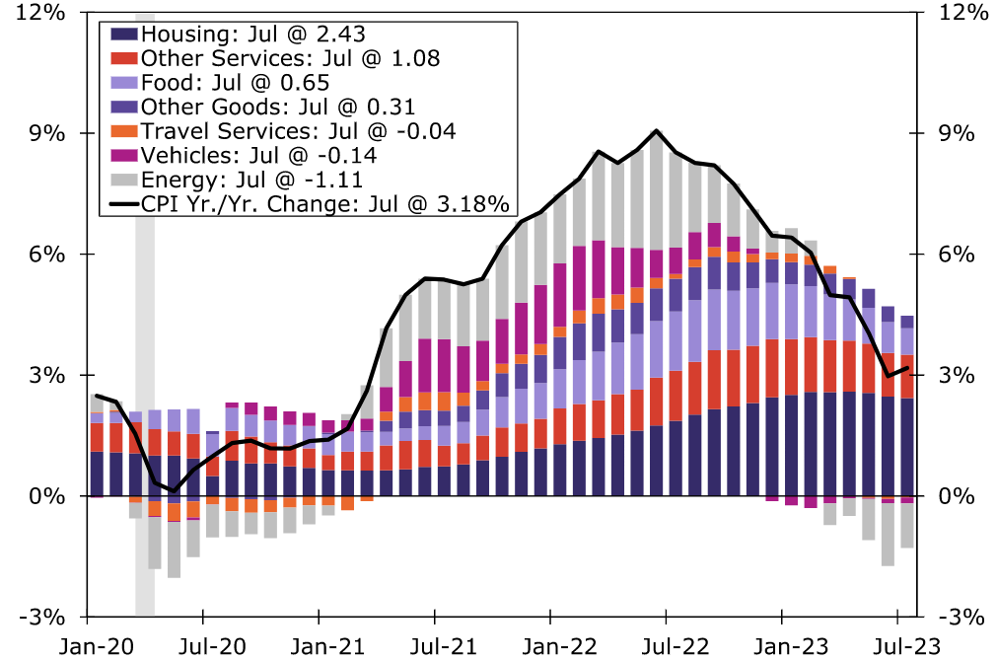
Contribution to CPI by Category: July 2023
Prices were up 3.2% in July 2023 vs. a year ago—and down from the June 2022 peak of 9.1%. Even as energy prices recede from their 2022 peak, increases in Shelter (Housing), Travel and Food are the major obstacles to bringing inflation down to the Fed’s 2% goal
Peak = June 2022 9.1%
Mar. 2021 2.6%
3.2%
Housing (Shelter) accounted for about 60% of the 3% increase in the CPI in mid-2023. The impact of this CPI component is beginning to diminish.
Source: U.S. Department of Commerce and Wells Fargo Economics.
Notes:
47

Slide 48
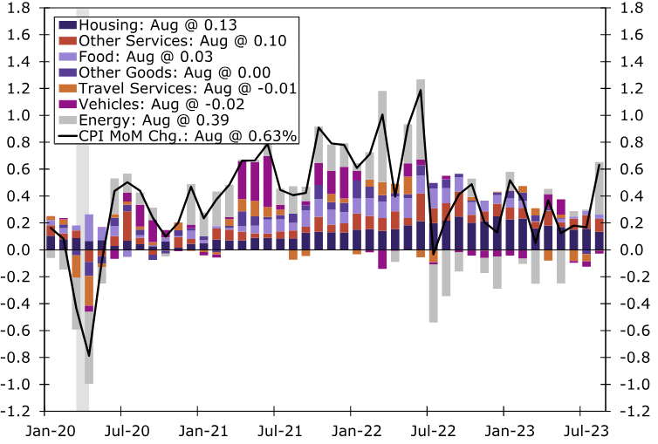
Contribution to CPI Monthly Change: Aug. 2023
Peak = June 2022 9.1%
Surging gasoline prices sent the CPI back up to 3.7% in August
The path to the Fed’s 2% inflation target is not a linear one
Source: U.S. Department of Commerce and Wells Fargo Economics.
Notes:
48

Slide 49
Change in Cost Indicators for Selected Construction Inputs, Jan. 2020 – Dec. 2022
The rapid increase in and still-elevated cost of building materials has immediate and long-er-term implications for property insurers and reinsurers
Source: U.S. Bureau of Labor Statistics.
Notes:
Fig 2-P

Slide 50
Cost Indicators: Homeowners Insurance, Price Index Changes, Jan. 2020 – June 2023
Drivers of Residential (and commercial) construction and repair costs have surged since 2020—far above the overall pace of inflation
Source: U.S. Bureau of Labor Statistics.
Notes:
Fig 2-P

Slide 51
Medical Cost Inflation vs. Overall CPI Since COVID, Jan. 2020 – July 2023 (Percent Change from Year Ago)
Jan 2020 – Dec 2022
Healthcare: 3.1
Overall: 4.6%
COVID has completely flipped the historical relationship between overall and medical inflation
All Items CPI
July 2023: 3.2%
Medical Inflation
July 2023: -0.5%
Jan 2020 – Feb 2021
Healthcare: 3.8% Overall: 1.3%
Mar 2021 – Nov 2022
Healthcare: 2.6%
Overall: 6.8%
Sources: US Bureau of Labor Statistics; Risk and Uncertainty Management Center, University of South Carolina.

Slide 52
Cumulative Percent Change in Overall CPI vs. Medical Care, Jan. 2020 – June 2023
From Jan. 2000 through June 2023, medical inflation has far exceeded that of the overall CPI, but there has been a material reversal since mid-2022. Can this trend continue?
Source: Kaiser Family Foundation analysis of BLS CPI data: https://www.healthsystemtracker.org/brief/how-does-medical-inflation-compare-to-inflation-in-the-rest-of-the-economy/.
12/01/09 - 9pm
eSlide – P6466 – The Financial Crisis and the Future of the P/C
Notes:
52

Slide 53
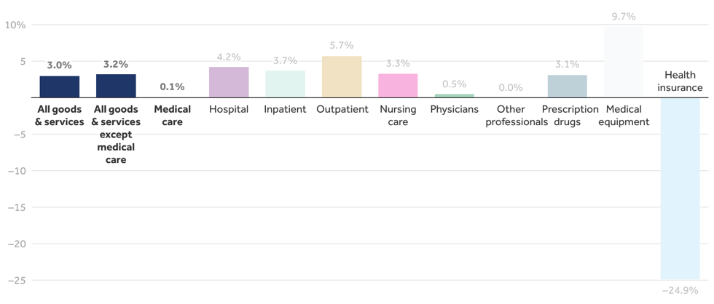
Annual Percent Change in CPI for Medical Care, by Category, June 2023
“All Medical Care” includes medical services as well as commodities such as equipment and drugs. CPI for medical care is generally lagged farther than other categories. Health insurance CPI data are lagged by nearly a year.
Source: Kaiser Family Foundation analysis of BLS CPI data: https://www.healthsystemtracker.org/brief/how-does-medical-inflation-compare-to-inflation-in-the-rest-of-the-economy/.
12/01/09 - 9pm
eSlide – P6466 – The Financial Crisis and the Future of the P/C
Notes:
53

Slide 54
Average Jury Awards, 1999 – 2020 (latest available)
($000)
The average jury award reached an all-time record high of $2.5M in 2020, up 39% from 2019 and 274% since 2010
Median Award in 2020 = $125,366 (a record)
Source: Jury Verdict Research; Current Award Trends in Personal Injury (61st Edition), Thomson Reuters; Risk and Uncertainty Management Center, Univ. of South Carolina.
Notes:
Fig 2-P

Slide 55
SUMMARY
The P/C Insurance Industry Remains Strong, Stable, Sound and Secure
Auto lines, property and reinsurance segments are stressed but not impaired
Odds of a “Soft Landing” Increasing but Shallow Recession is Still Likely in Early 2024
Asset Price Volatility Will Persist as Inflation Uncertainty
Interest Rates Will Remain “Higher for Longer”
Higher Interest Rates Provide a Modest Tailwind for Investment Income
Inflationary Pressures Persist in 2023, But Are Subsiding (Peak Reached in June 2022)
Loss Cost Challenges Remain but Should Ease in 2023/24—Inflation, Supply Chain
Legal System Abuse Issues Remain a Long-Term Challenge
55
12/01/09 - 9pm
eSlide – P6466 – The Financial Crisis and the Future of the P/C
Notes:
55

Slide 56
Thank you for your time and your attention!
Twitter: twitter.com/bob_hartwig
For a copy of this presentation, email me at robert.hartwig@moore.sc.edu or
Download at www.uscriskcenter.com

