Slide 1
Working Together in a Chaotic Insurance World
Patrick Devlin, Vice President, Sr. Corporate Counsel & Manager
Liberty Mutual Insurance

Slide 2
The Industry and Regulators: Can we improve how we work together?
Insurance Company
Department of Insurance
Focused on making money
Denying Claims
Policing the industry
Challenging to work with
Perception

Slide 3
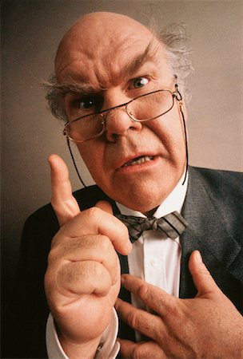
What does industry think of regulators?
What do regulators think of the industry ?

Slide 4
The Industry and Regulators: Can we improve how we work together?
Insurance Company
Department of Insurance
Protect our customers
Meet our customers where they are
Protect consumers
Validate business practices to ensure compliance
Reality
Both have goals centered around the consumer and doing what’s right

Slide 5
Aligned
Chaotic/Opposed

Slide 6
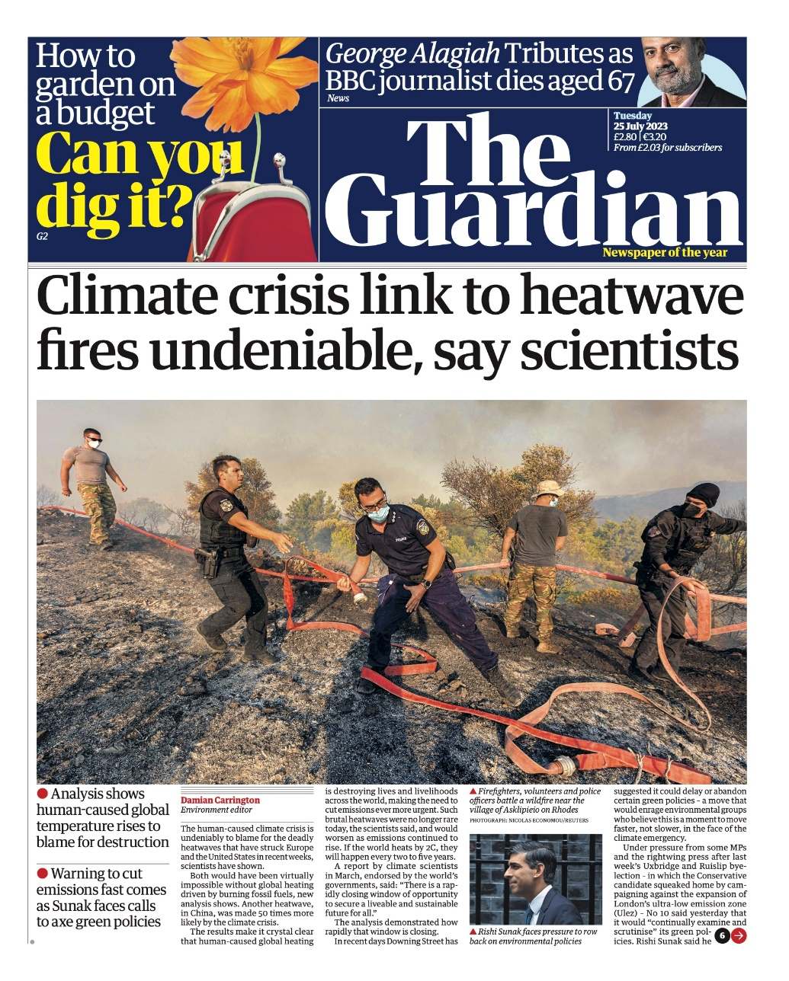
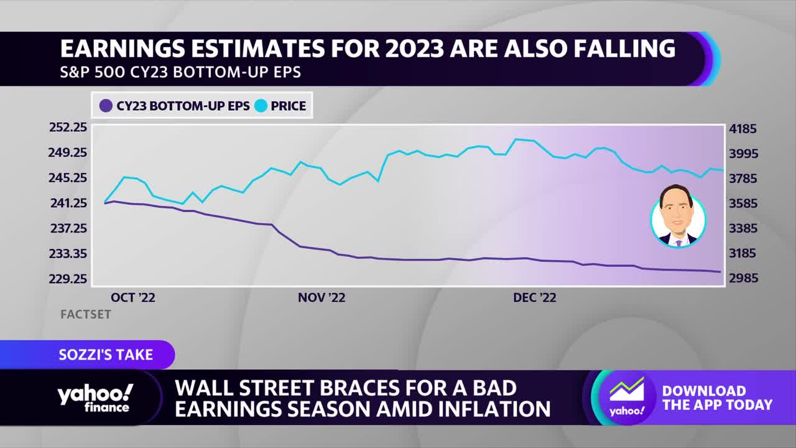
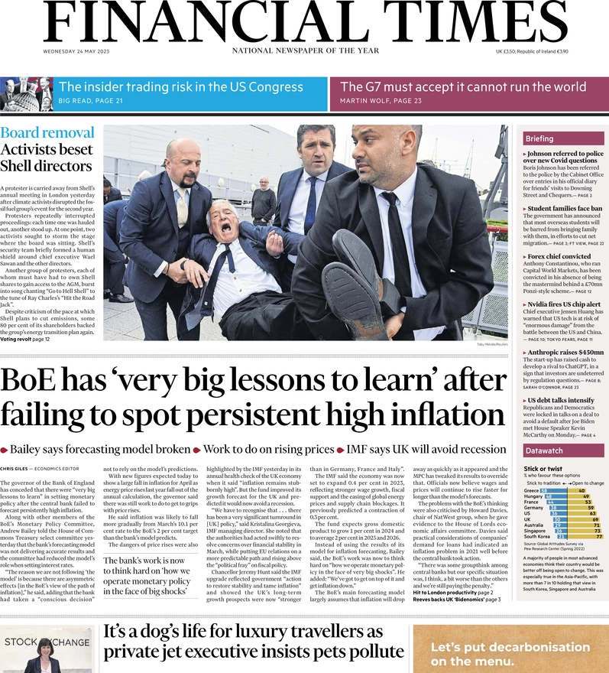
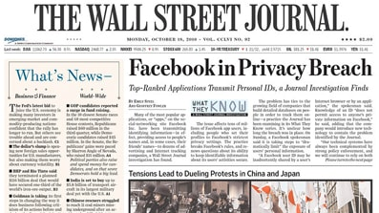
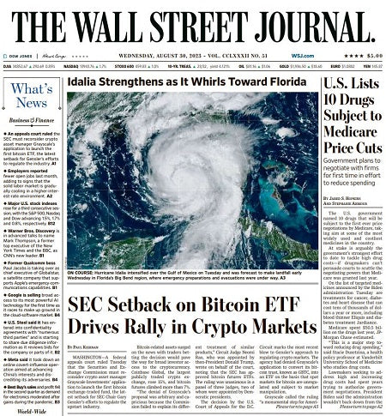
The rapidly changing world we face together…

Slide 7
We are facing a tumultuous environment and we need to align as an industry
NAIC Priorities
Rise in catastrophes
Climate Change
and Resiliency
Discriminatory Rating and use of Bots
Rise in cost of doing business
Data Security
and Privacy
Use of AI/ML across
Home and Auto
World Events
Notes:
We’re all seeing rises in CATs, the cost of doing business and feeling the uncertainty from what’s going on in the world.
We have to work together because we have common ground to share – we want to protect the customer and we want to succeed as a business.
The industry has significant concerns about the viability of insuring a wide variety of risks and they need to balance this mindset and manage to maintain a viable business model that allows them to pay claims.
Protecting customer privacy and data is paramount. The emergence of AI/ML into our collective mindset will inevitably impact our relationship with our customers, regulators and society.

Slide 8
What are we seeing across the industry?
Complaints are projected to continue to rise year over year…
…with Home and Auto being a top driver

Slide 9
What are we seeing across the industry?
Data calls are on the rise in response to CATs…
…and we are seeing a rise in the cost of exams
Notes:
Large jump in 2022 and 2023 data calls is correlated to spike in CAT reporting due to Weather/Hurricanes.
Exam volume is down across the industry *based on WK Report* - however, we are seeing penalties higher than prior years.

Slide 10
What is MCAS?
The Market Conduct Annual Statement (MCAS) is a mandatory filing that collects underwriting and claims data on a state-specific, industry-wide basis
NAIC has collected data on behalf of participating states since 2010
Comprises the following lines of business:
Life/Annuity
Property/Casualty
Long-term Care
Provides insight into the industry and may lead to regulatory investigations

Slide 11
MCAS data provides an increased ability to monitor compliance and manage regulator relationships
Current State
Ideal State
State initiates exam
Leverage data to identify issues
State delivers findings
Track trends and escalate to business
Remediate issues and pay fines
Proactively communicate with regulators where needed
Remediate issues ahead of exams
Proactive issue identification and improved communication with DOIs will lead to stronger relationships with regulators and better insight into the issues they care most about
Notes:
MCAS is a heavy lift for carriers to identify, collect, compile and produce each year – we can leverage the resources spent to take us from a current state of a passive approach with examiners to a more proactive and mindful approach.
Current state – we wait for our regulators to engage us.
Ideal state – we work collaboratively to explain our data and pursue our common interests (i.e. protecting the consumer and validating compliance).
This approach promotes a stronger relationship with regulators, consumers and ultimately benefits the industry.

Slide 12
Utilizing MCAS data to encourage a proactive compliance environment
Processes and Collaboration
Regulator Relationships
Business compliance team alignment on submission QA process
Expanded stakeholder group utilizing data
Better understanding of regulator perspective
Increased ease of access to data that informs responses to regulators
Value of Effort
Leveraging MCAS data in business decisions
Enhanced response time to regulator inquiries
Increase in regulator touchpoints to enable successful remediations
Instill trust with regulators by proactively raising concerns
Success Measures
Notes:
Self-critical analysis of our data, which we know in and out, to promote transparency and collaboration.
You can leverage the data pulled for MCAS to assist with decisions as an Organization and you can also use it to promote stronger relationships with regulators.
This is a built-in opportunity to collaborate which will encourage understanding between the Industry and Regulators as well as build trust.

Slide 13
What can we start working on?
Even the “Small Things” Matter
Systems
Expectations
More Data
We can be better too…
Rapid Response
Better Communication

Slide 14
Ideal State

