Slide 1


Activities

Slide 2
Activity:
Identify Safe Spaces for Vulnerability
List people in your life with whom you feel comfortable sharing your authentic self
Reflect on the qualities that make these relationships feel safe.
Write about one specific moment where you allowed yourself to be vulnerable with them
  How did they respond?
  How did you feel afterward
  Consider how you can cultivate more of these safe spaces in other relationships

Slide 3
Activity:
Reframing Vulnerability as Strength
Consider people you admire who show vulnerability.
Write about:
  How do they express their openness or struggle
  Now think about your own vulnerability: How could sharing more of yourself enhance your strength
  Goal: Shift your perspective from seeing vulnerability as a weakness to viewing it as an authentic expression of strength

Slide 4
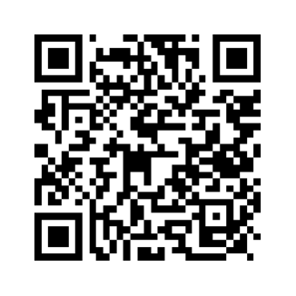
Thank you!
Bernadette Spencer
www.destinydesignedunlimited.com
www.johnmaxwellgroup.com/bernadettespencer

