Slide 1

At the Crossroads: The New Economics and Politics of the P/C Insurance Industry
Insurance Consumer Affairs Exchange
Fall 2025 ICAE Conference
Boise, ID
September 23, 2025
Robert P. Hartwig, PhD, CPCU
Clinical Associate Professor of Finance, Risk Management & Insurance
Darla Moore School of Business ♦ University of South Carolina
Robert.Hartwig@moore.sc.edu ♦ 803.777.6782

Slide 2
P/C Insurance Overview & Outlook: A World of Risks
P/C Financial Overview & Outlook in a Era of Rising Uncertainty
Premium Growth Underwriting Performance
CAT Loss Update/Reinsurance Capital and Capacity
Economic Overview & Outlook—Impacts for P/C Insurers
Growth, Employment, Investments, Inflation, and Recession
Potential impacts of changes in fiscal and monetary policy on P/C insurers
Tariff Impacts and P/C insurance
Personal and Commercial Insurance Trends
Cost drivers
Is the hard market coming to end?
Legal System Abuse
Summary and Q&A
12/01/09 - 9pm
eSlide – P6466 – The Financial Crisis and the Future of the P/C
Notes:
2

Slide 3
P/C Insurance Industry Financial Overview & Outlook:
Challenges Amid Inflation and Higher Interest Rates
The Current Economic Environment Presents Many Challenges for P/C Insurers
Industry Remains Strong
3

Slide 4
P/C Insurance Industry Combined Ratio, 2016–2026F
2024 ended up being a great year—led by improvements in Personal Lines and especially Personal Auto—despite Hurricanes Helene and Milton.
DRIVERS
Inflation moderates
Rate gains outpace claim costs
P/C insurer underwriting performance has been highly variable over the past decade, largely due to:
CATs
Inflation
Torts
Expectations for 2025-2026 are currently fairly optimistic
Sources: A.M. Best (2016-2024); S&P Global Intelligence (2024); Swiss Re (2025F-2026F as of April 2025); USC Risk and Uncertainty Management Center.

Slide 5
P/C Insurance Industry Combined Ratio, 2001–2025F*
2024 was the best underwriting performance since 2013.
2022-2023 were the industry’s worst underwriting performances since 2017
As Recently as 2001, Insurers Paid Out Nearly $1.16 for Every $1 in Earned Premiums
Relatively Low CAT Losses, Reserve Releases
Higher CAT Losses, Shrinking Reserve Releases, Toll of Soft Market
Relatively Low CAT Losses, Reserve Releases
Sharply higher CATs are driving large underwriting losses and pricing pressure
Heavy Use of Reinsurance Lowered Net Losses
COVID-19 has had no discernable net impact on the combined ratio in 2020
Avg. CAT Losses, More Reserve Releases
Lower CAT Losses
Best Combined Ratio Since 1949 (87.6)
Ian & Inflation Impacts
Sandy Impacts
2024 96.5
*Excludes Mortgage & Financial Guaranty insurers 2008–2025F.
Sources: A.M. Best, ISO (2001-2023). S&P Global Intelligence (2024).

Slide 6
Combined Ratios by Line: 2019 – 2024*
Lingering inflation will continue to pressure combined ratios in 2024
Commercial Auto, MP have struggled amid inflation, CATs
High CAT losses and inflation are pushing up combined ratios
CATS, inflation hurt personal lines in 2021-2023
Source: A.M. Best Review & Preview (2019-2023) and 2024 P/C Snapshot (as of June 26, 2025);. Univ. of South Carolina, Risk and Uncertainty Management Center.
6
Notes:
6

Slide 7
P/C Direct Premiums Written Volume and Growth, 2010–2025F
DPW growth peaked in 2023 at 10.5%, falling to 8.5% in 2024, with continued deceleration expected in 2025
US P/C insurance became a trillion-dollar industry in 2024 for the first time (based on direct premiums written)
DPW, $ Millions
Sources: A.M. Best, NAIC and S&P Global (2010-2024); Forecast figures for 2025 from Swiss Re Institute “US Property & Casualty Outlook: Dog Days are Over,” (June 2024), accessed at: https://www.swissre.com/dam/jcr:b2178beb-350f-406e-8714-63ea4b3fe2e1/swiss-re-institute-us-pc-dog-days-are-over.pdf.

Slide 8
Net Written Premium Growth (All P/C Lines): Annual Change, 1971–2024
2024: 8.5%
2023: 10.4%
2022: 8.4%
2021: 9.4%
2020: 2.4%
2019: 3.4%
2018: 10.7%
2017: 4.5%
2016: 2.7%
2015: 3.5%
1975-78
1984-87
2000-03
2020-??
(Percent)
Net Written Premiums Fell 0.7% in 2007 (First Decline Since 1943) by 2.0% in 2008, and 4.2% in 2009, the First 3-Year Decline Since 1930-33.
Sharp recovery in NWP post-COVID. Strong economic recovery and favorable rate environment both powered growth.
Shaded Areas = Hard Markets
COVID: 2.5%
NOTE: Shaded areas denote “hard market” periods.
Sources: A.M. Best (1971-2013, 2020-2024), ISO (2014-2019); Risk & Uncertainty Management Center, Univ. of South Carolina

Slide 9
P/C Industry Net Income After Taxes, 1991–2025E*
$ Millions
2012 ROAS¹ = 5.9%
2013 ROAS¹ = 10.2%
2014 ROAS¹ = 8.4%
2015 ROAS = 8.4%
2016 ROAS = 6.2%
2017 ROAS =5.0%
2018 ROAS = 8.0%
2019: ROAS = 7.7%
2020: ROAS = 6.9%
2021: ROAS = 6.4%
2022: ROAS = 5.7%
Underwriting losses increased in 2023, pushing down net income*
*2023 and 2024 figures are adjusted is adjusted to reflect $50B realized gain from a large reinsurer (National Indemnity). Including this gain, net income after tax is $86.6B in 2023 and $94.7B in 2024:H1.
Note: ROE figures are GAAP; ¹Return on avg. surplus. Excludes Mortgage & Financial Guaranty insurers for years (2009-2014).
Sources: A.M. Best, ISO, APCIA.

Slide 10
ROE: Property/Casualty Insurance by Major Event, 1987–2025F
(Percent)
P/C Profitability Is Influenced Both by Cyclicality and Volatility
Katrina, Rita, Wilma
Harvey, Irma, Maria, CA Wildfires
Low CATs
2024E* 9.4%
Ian
Sept. 11
2025F* 6.9%
Hugo
Lowest CAT Losses in 15 Years
4 Hurricanes
Sandy
Andrew, Iniki
Record Tornado Losses
2020 6.9% Covid-19
Financial Crisis* ROE fell by 8.3 pts from 12.7% to 4.4%
Northridge
*Excludes Mortgage & Financial Guarantee in 2008 – 2025F.
Sources: A.M. Best, ISO, Fortune, APCIA; USC RUM Center.

Slide 11
ROE: Property/Casualty Insurance vs. Fortune All Industry, 1987–2023*
Avg. ROE*
P/C Insurance: 7.8%
All Industry 13.8%
In the 34-year period from 1987 – 2023, profitability in the P/C Insurance industry has exceeded the All industry average only once (in 1987)
(Percent)
Hurricane Andrew
9/11 Terrorist Attack
Financial Crisis* ROE fell by 8.3 pts from 12.7% to 4.4%
Record catastrophe losses
*2023 figures are estimates.
Sources: NAIC, ISO, Fortune; USC RUM Center.

Slide 12
ROE: Property/Casualty Insurance vs. Fortune All Industry, 2014–2023*
Avg. ROE*
P/C Insurance: 6.0%
All Industry 14.9%
In the 10-year period from 2014 – 2023, profitability in the P/C Insurance industry fell well below the All Industry average every year—for an average profitability gap of 8.9 percentage points over the decade
(Percent)
All Industry profitability is near its decade high
P/C Insurer profitability rose in 2023 after trending downward from 2018 - 2022
*Latest available from NAIC Profitability by Line, by State reports available at: https://content.naic.org/sites/default/files/publication-pbl-pb-profitability-line-state.pdf.
Sources: NAIC; USC RUM Center.

Slide 13
E&S Market Trends
Can Standout Growth Be Maintained?

Slide 14
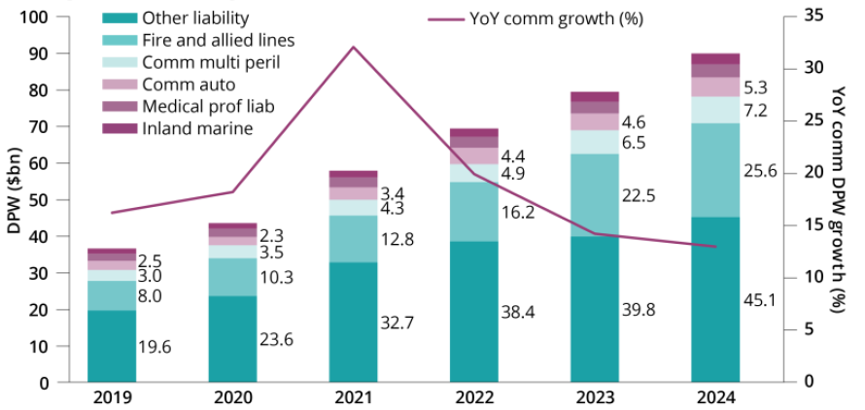
E&S Market Premiums by Key Line, 2019 – 2024*
E&S premiums hit a record $134.7B in 2024 (up ~275% since 2018).
E&S DPW grew by 14.8% in 2024, down from 21.4% growth in 2023
$134.7
$117.3
$96.6
*Includes Lloyd’s and regulated aliens. In 2024, breakdown was $97.5B US domestics and $37.2B Lloyd’s and regulated aliens.
Source: S&P Capital IQ, Insurance Insider US.

Slide 15
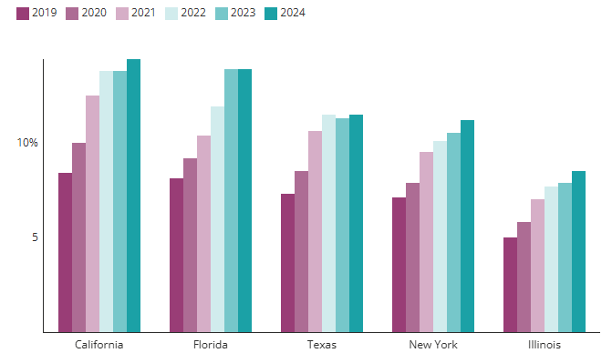
E&S Premium as a Percent of Total Premiums for Top 5 E&S States, 2019 – 2024
E&S market share has increased rapidly, with a near doubling in the Top 5 E&S states
Source: S&P Capital IQ, Insurance Insider US.

Slide 16
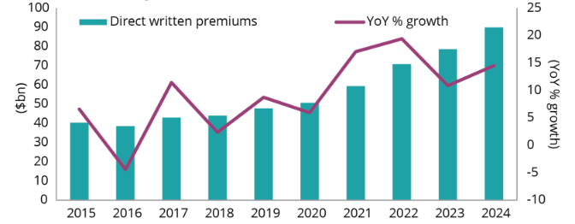
MGA DWP Volume and Growth, 2015 – 2024*
MGAs and other DUAEs generated 15% growth reaching $89.9B in DWP in 2024
2024 was the 4th consecutive year of double-digit growth
DWP premium volume is up ~110% since 2015
AMB estimates ~1,000 MGAs operated in the US in 2024 (~700 met criteria for inclusion in their report)
$89.9
“The premium momentum by MGAs writing specialty commercial lines of coverage shows no sign of slowing down despite average account pricing moderating or even declining in certain lines such as workers’ compensation, professional liability — particularly directors and officers and employment practices liability — and cyber liability,”
--AM Best (June 2025)
*Includes MGAs and other delegated underwriting authority enterprises (DUAEs), as defined by AM Best.
Source: AM Best Market Segment Report, “MGA Premiums Showed Double-Digit Growth for Fourth-Straight Year in 2024.” Available at: https://news.ambest.com/newscontent.aspx?refnum=266436&altsrc=114 and Insurance Insider US.

Slide 17
Upgrades and Downgrades
Underwriting Performance, CATs and Capital Are Impacting Insurer Ratings

Slide 18
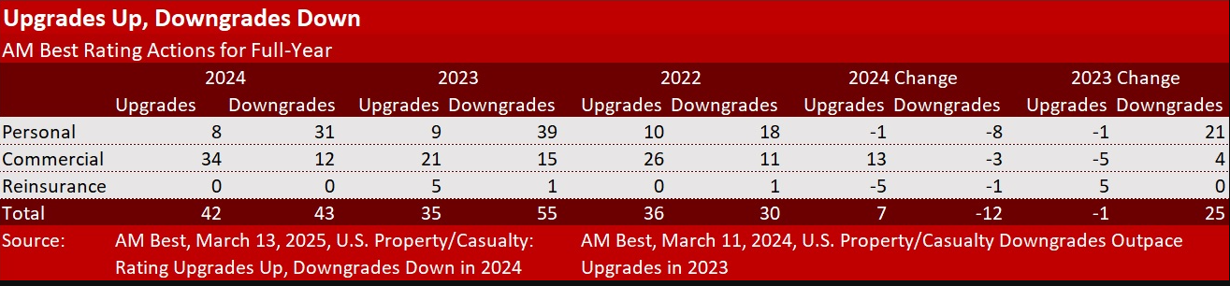
US P/C: Rating Upgrades & Downgrades, by Segment, 2024
There were 43 ratings downgrades in 2024, down from 55 in 2023. Personal lines insurers accounted for 31 (72%) of total downgrades in 2024.
Source: A.M. Best Review & Preview 2025 and 2024 from Carrier Management (March 16, 2025) at: https://www.carriermanagement.com/news/2025/03/16/273012.htm.

Slide 19
Capital and Capacity
P/C Insurance: Is the Industry’s Capital Crunch Over?
Will Industry Capacity Growth Resume?

Slide 20
Policyholder Surplus (Capacity), 2006:Q4 – 2024
The P/C insurance industry entered the COVID-19 pandemic from a position of strength and was able to withstand the 9.0% surplus decline in Q1 2020 (far less than during the Financial Crisis). 2020 ended with record surplus. 2021 set another new record, exceeding $1 trillion for the first time. Unrealized losses caused surplus to drop sharply in 2022.
2022 (-6.9%)
($ Billions)
Drop due to near-record 2011 CAT losses (-4.9%)
Surplus remains virtually the same as 2021
Financial Crisis (-16.2%)
Policyholder Surplus is the industry’s financial cushion against large insured events, periods of economic stress and financial market volatility. It is also a source of capital to underwrite new risks.
Sources: ISO, A.M. Best, NAIC. Risk and Uncertainty Management Center, University of South Carolina.
20
12/01/09 - 9pm
eSlide – P6466 – The Financial Crisis and the Future of the P/C
Notes:
20

Slide 21
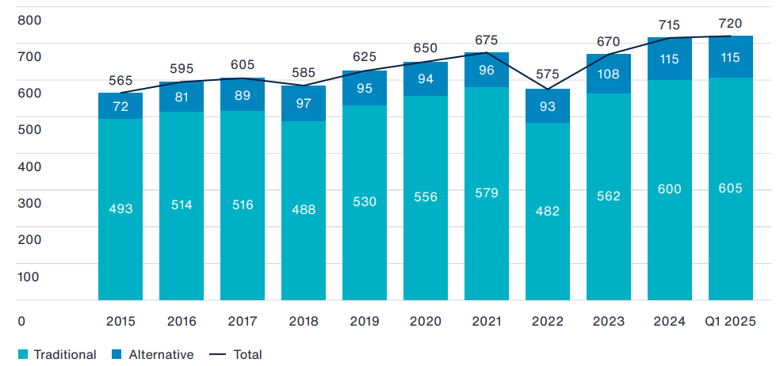
Global Reinsurance Capital, 2015 – 2025:Q1
$ Billions
Global reinsurance reached a new high in 2025:Q1, but is only 6.7% above its 2022 peak—far below the increase that would be needed to keep pace with inflation and exposure growth
Global reinsurance capital fell by $100B or 14.8% in 2022, contributing to recent property insurance challenges. Most of that capital was recovered in 2023—with ILS playing a key role
Source: Aon Reinsurance Solutions/Aon Securities accessed at: https://www.aon.com/en/insights/reports/reinsurance-market-dynamics.
12/01/09 - 9pm
eSlide – P6466 – The Financial Crisis and the Future of the P/C
Notes:
21

Slide 22
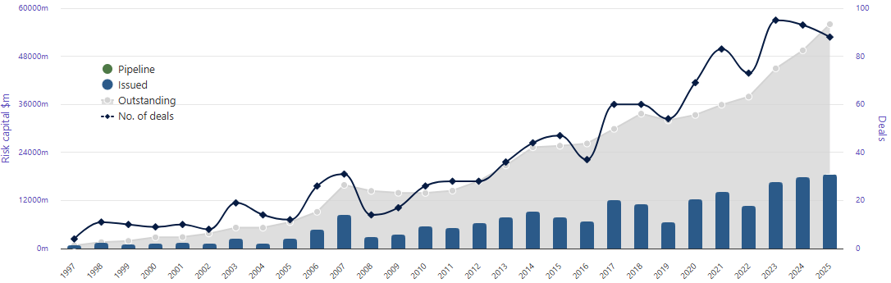
Catastrophe Bond & ILS Risk Capital Issued and Outstanding, 1997 – 2025*
The number of new CAT bond & ILS deals, risk capital issued and outstanding will all likely set new records in 2025
*As of 8/31/25.
Source: Artemis.bm Deal Directory accessed at: https://www.artemis.bm/dashboard/catastrophe-bonds-ils-issued-and-outstanding-by-year/
12/01/09 - 9pm
eSlide – P6466 – The Financial Crisis and the Future of the P/C
Notes:
22

Slide 23
US Property Catastrophe Rate-on-Line Index: 1990 – 2025*
Property CAT reinsurance pricing more than doubled (+107.1%) from 2018 – 2024. Record CAT activity and inflation were major drivers.
(Percent)
+76%
-6.2%*
+68%
*
-6.7% (as of 7/1/25)
Post Katrina, Rita, Wilma period
+35.0%
Post-Ike adjustment
2025 RoLs
US: -6.2%
Europe: -5.3%
Global: -6.6%
Post-Andrew surge
Adjustment following record tornado losses in 2011 and Sandy in 2012
Post-9/11 Adjustment
US Property-CAT Reinsurance Pricing Is Sensitive to CAT Activity and Ultimately Impacts Primary Insurance Pricing, Terms and Conditions.
*As of January 1 each year.
Source: Guy Carpenter; Artemis.bm accessed at: http://www.artemis.bm/us-property-cat-rate-on-line-index
23
Notes:
23

Slide 24
Catastrophe Loss Trends
The Rise in CAT Losses Shows No Signs of Easing
The 2020s Are Off to an Ominous Beginning
The Los Angeles Wildfires, Hurricanes Helene and Milton Are Just the Latest in a Long Series of Mega-Disasters

Slide 25
U.S. Inflation-Adjusted Insured CAT Losses: 1980 – 2024
Harvey, Irma, Maria
Ida ($36B)
TX Freeze ($15B)
113
99
Ian ($52.5B)
Ian 2022 became the 2nd costliest insured CAT loss ever
85
80
70
28
20
22
24
19
21
23
Average Insured Loss per Year*
1980-2021: $23.8 Billion
2012-2021: $44.1 Billion
The 2020s are off to an ominous start with $89.4B in average annual insured losses (2020-24)
*Stated in 2021 dollars except 2022 -2024 (in current dollars).
Sources: Property Claims Service, a Verisk Analytics business (1980-2019); 2020-22 figures from Munich Re; 2023 and 2024 figures from Aon. Insurance Information Institute; University of South Carolina, Risk & Uncertainty Management Center.

Slide 26
Top 26 Most Costly Disasters in U.S. History
(Insured Losses, 2024 Dollars, $ Billions)
Los Angeles wilfires in Jan. 2025 Ian in 2022 became the 4th costliest insured CAT loss ever
Over the past 5 months (Sept. 2024 – Jan. 2025), the US has experienced 3 of the costliest disasters in US history, with total losses likely exceed $60B
23 of the 26 Most Expensive Insurance Events in US History Have Occurred Since 2004.
*2025 dollars; Munich Re estimates as of Jan. 2025 for Hurricanes Helene and Milton; Aon estimate as of Apr. 2025 for LA wildfires.
Sources: PCS, RMS, Aon, Karen Clark & Co; USC Center for Risk and Uncertainty Management adjustments to 2024 dollars using the CPI.

Slide 27
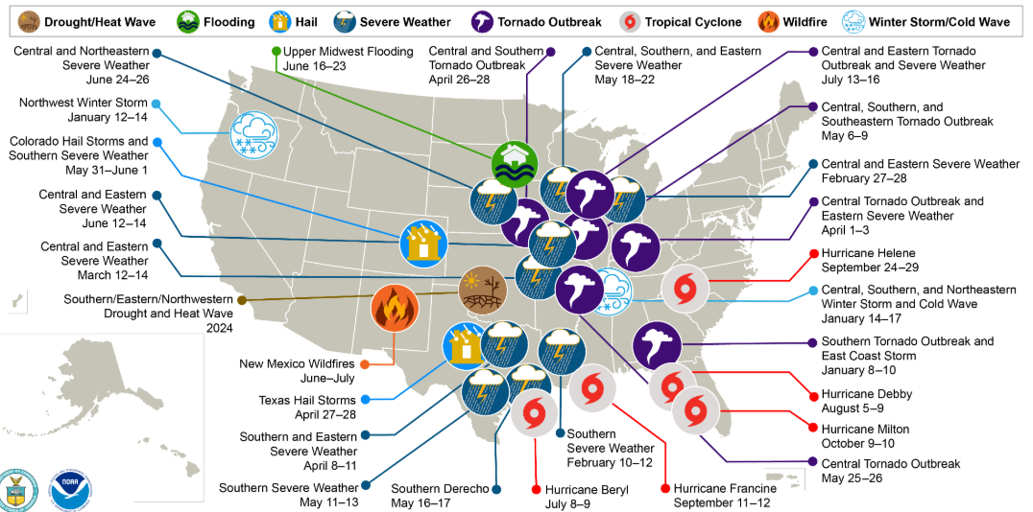
US Billion-Dollar Weather and Climate Disaster Events, Economic Costs, 2024*
There were 27 events in the US in 2024 that caused at least $1B in economic damage, down from a record 28 in 2023
*As of Feb. 1, 2025.
Source: NOAA, accessed at: https://www.ncei.noaa.gov/access/billions/.
12/01/09 - 9pm
eSlide – P6466 – The Financial Crisis and the Future of the P/C
Notes:
27

Slide 28
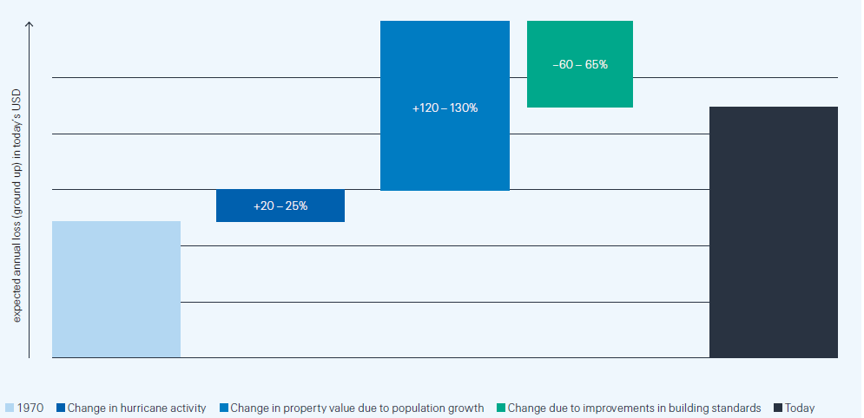
Factors Influencing Change in Residential Property Insured Hurricane Losses Since the 1970s (in current dollars)
Since 1970, hurricane-related losses are up 80% - 90% on inflation adjusted bases, primarily because of population growth in vulnerable areas and secondarily due to changes in hurricane activity
Improvements in building codes since 1970 have kept losses 60 – 65% lower than they otherwise would have been
Increase in aggregate property values due to population growth are responsible for a 120 – 130% increase in losses
Increase in hurricane activity has pushed losses up 20 – 25%
Sources: Swiss Re, Ian Revisited: Disentangling the Drivers of US Hurricane Losses, (Nov. 2023). Accessed at: https://www.swissre.com/risk-knowledge/mitigating-climate-risk/hurricane-ian-revisited.html.

Slide 29
State of the Homeowners Insurance Market
Inflation, High Catastrophe Losses Are Challenges for Insurers and Policyholders Across the Country

Slide 30
Homeowners Insurance Combined Ratios: US, 2010 – 2025F
Average:
99.0% (2010-2023)
93.1 (2010-2016)
106.1% (2017-2023)
The Homeowners combined ratio from 2017-2023 (106.1) was 13 points higher from than from 2010-2016 (93.1)
Combined Ratio
Sources: APCIA estimates using S&P Global Market Intelligence data; A.M. Best Review & Preview (Feb. 20, 2025) for 2024E – 2025F); University of South Carolina, Risk & Uncertainty Management Center.

Slide 31
Homeowners Insurance Combined Ratio by State in 2024
Nebraska, New Mexico and Georgia all had HO combined ratios exceeding 140 in 2024
HO combined ratios are highly volatile—with a 100.9 point spread across the 50 states from highest to lowest in 2024
The US HO combined ratio fell to 94.0 in 2024, from 103.6 in 2023 and 105.9 in 2022
Sources: American Property Casualty Insurance Association, based on NAIC Annual Statement database via S&P Global Market Intelligence; University of South Carolina Risk & Uncertainty Management Center.

Slide 32
Average Cost of Homeowners Insurance by State in 2025 for $300,000 in Dwelling Coverage*
Nebraska and Louisiana have the most expensive home insurance in 2025.
The average HO premium in the US varies tremendously by state—from $816 in VT to $6,366 in NE—a 7.8x differential
The average cost for $300K in home insurance in the US in 2025 is $2,408, up 4.5% from 2024
*As of September 1, 2025.
Sources: Bankrate.com. Accessed at: https://www.bankrate.com/insurance/homeowners-insurance/states/; University of South Carolina Risk & Uncertainty Management Center.

Slide 33
Homeowners Insurance Cost as a Share of State Median Income, 2025*
The average HO premium as a share of income varies tremendously by state—from 1.03% in VT to 10.78% in LA—a 10.5x differential.
LA is heavily CAT exposed and relatively low-income state, while VT has little major CAT exposure and is relatively high income.
As a share of income, home insurance is most expensive in Louisiana and Nebraska
Home insurance accounted for 3.18% of income in 2025 for $300K in coverage
*As of September 1, 2025. Figure is for $300,000 in coverage.
Source: Bankrate.com. Accessed at: https://www.bankrate.com/insurance/homeowners-insurance/states/; University of South Carolina Risk & Uncertainty Management Center.

Slide 34
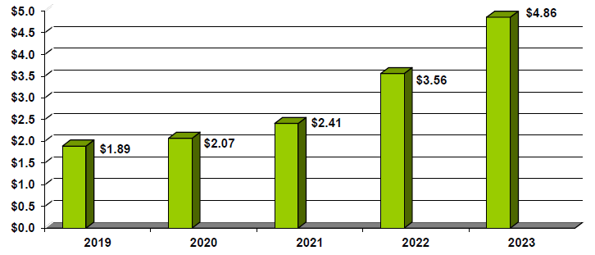
Residual Market (All Plans) Earned Premium: HO, CMP, Fire and Allied Lines, 2019 - 2023
$ Billions
Property residual market earned premiums soared 157.1% (2.97B) from 2019 through 2023
(More than triple the 48.2% Voluntary market growth across the same lines)
+157.1%
Source: Property Insurance Plans Service Office (PIPSO), 2024 FAIR and Beach Plan Underwriting Results and Market Penetration Report, (Fig. 2, p. V).
12/01/09 - 9pm
eSlide – P6466 – The Financial Crisis and the Future of the P/C
Notes:
34

Slide 35
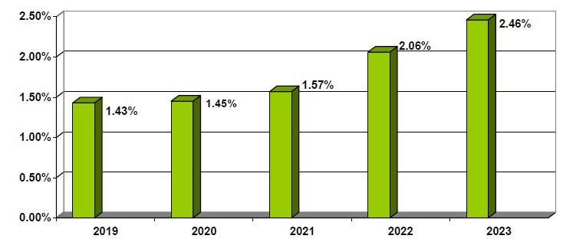
Residual Market (All Plans) Earned Premium as a Percent of Total Market: HO, CMP, Fire and Allied Lines, 2019 - 2023
$ Billions
Property residual markets as a percent of total markets rose from 1.43% in 2019 to 2.46% in 2023—an increase of 72%
+72.0%
Source: Property Insurance Plans Service Office (PIPSO), 2024 FAIR and Beach Plan Underwriting Results and Market Penetration Report, (Fig. 3, p. V).
12/01/09 - 9pm
eSlide – P6466 – The Financial Crisis and the Future of the P/C
Notes:
35

Slide 36
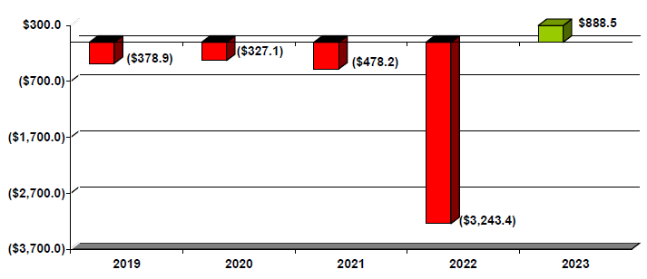
Residual Market (All Plans) Underwriting Results: HO, CMP, Fire and Allied Lines, 2019 - 2023
$ Billions
Property residual markets sustained a net loss of $3.539B from 2019 - 2023
Source: Property Insurance Plans Service Office (PIPSO), 2024 FAIR and Beach Plan Underwriting Results and Market Penetration Report, (Fig. 4, p. VI).
12/01/09 - 9pm
eSlide – P6466 – The Financial Crisis and the Future of the P/C
Notes:
36

Slide 37
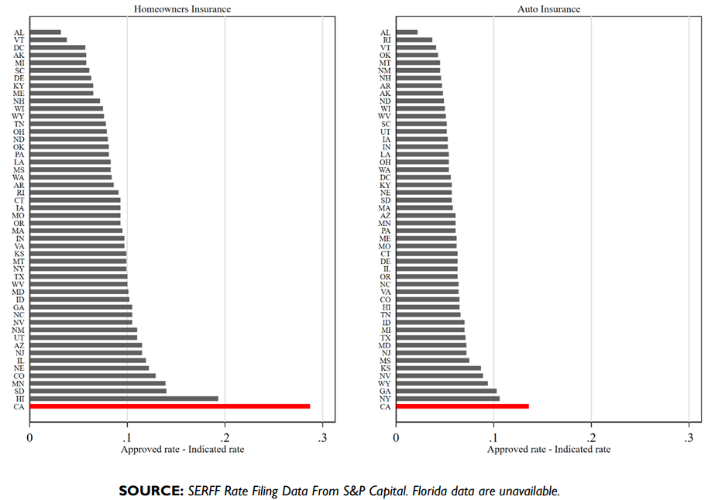
Regulatory Rate Suppression by State, 2018 - 2022
Rate suppression is defined as the difference between the actuarially indicated rate and the rate approved by regulators.
Example: If an insurer’s rate analysis indicates that a 40% increase is required for rates to be adequate, and the regulator instead approves only a 15% increase, the effect of rate suppression is (40%–15%=) 25%
TX: ~10%
TX: ~7%
CA: 29%
CA: 14%
CA and NY lead the way in rate suppression in auto insurance
Source: International Center for Law & Economics, ICLE White Paper 2023-11-06, “Rethinking Prop 103’s Approach to Insurance Regulation.” Accessed at: https://laweconcenter.org/wp-content/uploads/2023/11/Rethinking-Prop-103s-Approach-to-Insurance-Regulation-2.pdf
12/01/09 - 9pm
eSlide – P6466 – The Financial Crisis and the Future of the P/C
Notes:
37

Slide 38
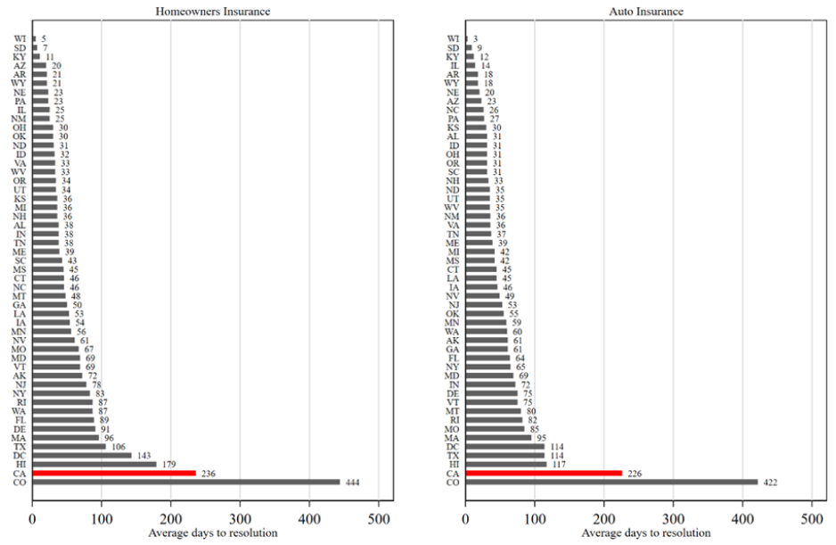
Average Days to Resolution of Rate Filings by State, 2018 - 2022
HO rate filing resolutions take about 2.5 months in NY, on average vs. 7-8 months in CA and 14-15 months in CO
TX: 106 Days
TX: 114 Days
Source: International Center for Law & Economics, ICLE White Paper 2023-11-06, “Rethinking Prop 103’s Approach to Insurance Regulation.” Accessed at: https://laweconcenter.org/wp-content/uploads/2023/11/Rethinking-Prop-103s-Approach-to-Insurance-Regulation-2.pdf
12/01/09 - 9pm
eSlide – P6466 – The Financial Crisis and the Future of the P/C
Notes:
38

Slide 39
Economic Overview The U.S. Economy Remains Resilient but Consumer Gloom is Returning
Inflation, Geopolitical Conflicts, High Interest Rates and Now Tariffs Have Weighed Heavily on Business and Consumer Sentiment
Tariffs Will Increase Auto and
Property Claim Severities
39

Slide 40
US Real GDP Growth, 2000 – 2026F*
“Soft landing” was achieved in 2024 and a recession averted, with annual real GDP growth at 2.8%. Growth is expected to slow in 2025 (to 1.8%) under the weight of tariffs and associated higher inflation. Additional tax cuts (beyond TCJA extension) and Fed rate cuts should stabilize growth in 2026 (2.0% est.).
Real GDP Growth (%)
Financial Crisis
COVID CRASH
Q2 2020 plunged by 31.2%
“Great Recession” began in Dec. 2007
Demand for Insurance Increased Materially in 2021/22 During Recovery from the Pandemic—Particularly in Economically Sensitive Commercial Lines Such as WC. Premium growth will likely slow as Economy Slows in 2025-26.
* Estimates/Forecasts from Wells Fargo Securities.
Source: US Department of Commerce, Wells Fargo Securities (9/25); Center for Risk and Uncertainty Management, University of South Carolina.

Slide 41
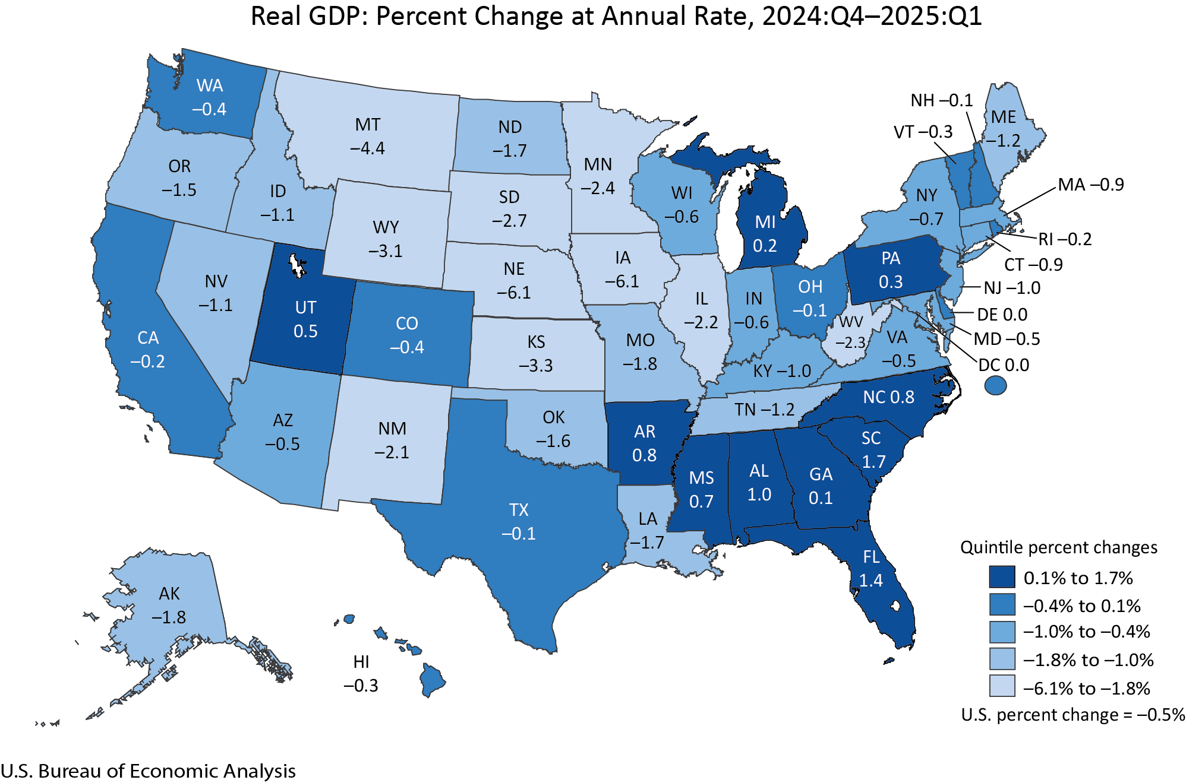
Real GDP by State, 2024:Q4 – 2025:Q1
Economic performance in Q1 was distorted by a huge surge in imports as businesses and consumers sought to stock up to avoid tariff increases
Texas Q1 Real GDP Growth = -0.1%
(13th fastest in the US)
Sources: US Bureau of Economic Analysis at https://www.bea.gov/data/gdp/gdp-state; Risk and Uncertainty Management Center, University of South Carolina.

Slide 42
US Unemployment Rate Forecast: 2007:Q1–2026:Q4
Great Recession
Rising unemployment eroded payrolls and WC’s exposure base.
Unemployment peaked at 10% in late 2009.
2.6M jobs added in 2023 and 2.0M in 2024. Through Aug. 2025, 598K jobs added. (Data include all major revisions)
US unemployment rate peaked at 14.7% in April 2020 (13.1% Q2 avg.)
At 4.3% in Aug. 2025, the unemployment rate remains low, but tariff impacts are expected to push unemployment higher
Unemployment rate is expected to rise due to a tariff-induced economic slowdown though increase will be tempered by slower labor market growth due in large part to restrictive immigration policies
= forecasts ; = actuals
Sources: US Bureau of Labor Statistics; Wells Fargo Securities (9/25 edition); Risk and Uncertainty Management Center, University of South Carolina.

Slide 43
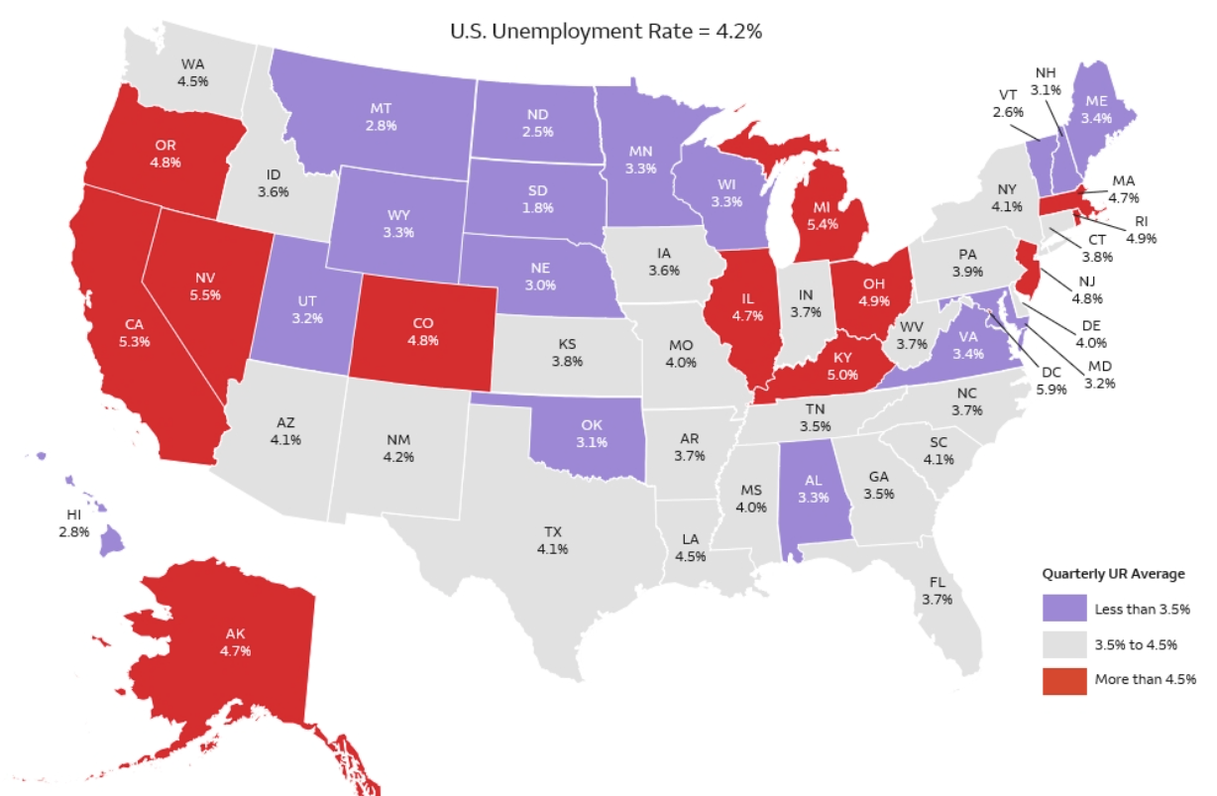
Unemployment Rate by State, Q2 2025
Unemployment has remained relatively low in 2025 despite slower job growth and significat economy uncertainty
The “No Hire, No Fire” economy
TX unemployment rate of 4.1% was just below that of the US overall in Q2
Sources: US Dept. of Labor and Wells Fargo Economics; Risk and Uncertainty Management Center, University of South Carolina.

Slide 44
Probability the U.S. Is in a Recession Within Next 12 Months: Jan. 2017 – July 2025*
Recession odds decreased substantially since 2022…but tariff concerns are pushing the odds back up
COVID: 96% chance of recession
Oct. 2022
Probability of recession peaked at 64%
Apr. 2025
Probability of recession soared to 45% as tariff threats roil markets, stoke inflation and slowdown fears
Before COVID, economists typically assessed the risk of recession within the next 12 months at 15% -18%
July 2025
Probability of recession falls to 33% as tariff fears ease somewhat
July 2021
Probability of recession falls to just 12%
Jan. 2025
Probability of recession falls to 22% in January, just before Trump inauguration
Recession?
The economy achieved a “soft landing” in 2024, averting a recession most thought would result from higher interest rates—but tariffs are raising recession worries
*July 2025 survey included the responses of 69 economists.
Source: Wall Street Journal surveys of economists: https://www.wsj.com/economy/central-banking/where-do-economists-think-were-headed-these-are-their-predictions-b3db91ea?mod=hp_listb_pos1; Risk and Uncertainty Management Center, University of South Carolina.

Slide 45
Auto/Light Truck Sales, 1999-2027F
Job growth and improved credit market conditions boosted auto sales to near record levels by 2015/16
(Millions of Units)
New vehicle sales are expected to fall into 2026 as financing costs edge down but as tariffs increase the price of new vehicles. Sales should recover in 2027.
New auto/light truck sales fell to the lowest level since the late 1960s.
New vehicle purchases were constrained by supply chain problems, higher interest rates
Yearly car/light truck sales remain below pre-COVID levels. Auto manufacturer supply chain issues are largely resolved but vehicle financing costs remain stubbornly elevated and tariffs will push up new car prices, resulting in downward sales pressure in 2025-26
Source: U.S. Department of Commerce; Wells Fargo Securities (9/25); Univ. of South Carolina, Center for Risk and Uncertainty Management..

Slide 46
New Private Housing Starts, 1990-2027F
Job growth, low inventories of existing homes, low mortgage interest rates and demographics propelled new home construction into 2022, though materials prices, supply chain problems, lack of labor were headwinds
(Millions of Units)
High prices, rising mortgage rates, tempered new home construction activity through 2025. Falling mortgage rates should help in 2026-27. Tariffs will add pressure to building costs
No Repeat of the Housing Collapse that Began in 2007
New home starts plunged 72% from 2005-2009; A net annual decline of 1.49 million units, lowest since records began in 1959
Insurers Are Continue to See Meaningful Exposure Growth in the Homeowners Line as well as Lines Associated with Home Construction: Construction Risk Exposure, Surety, Commercial Auto; Potent Driver of Workers Comp Exposure
Source: U.S. Department of Commerce; Wells Fargo Securities (9/25); Univ. of South Carolina, Center for Risk and Uncertainty Management..

Slide 47
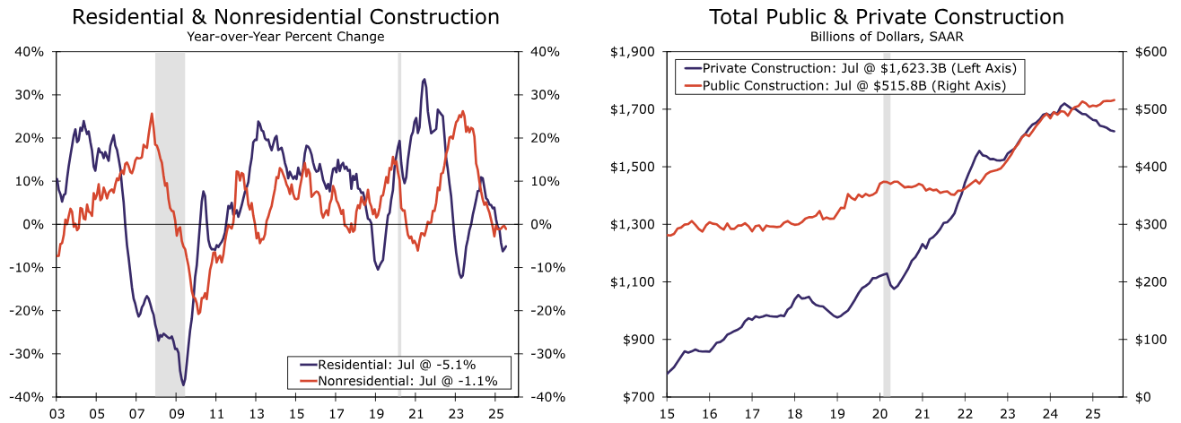
Construction Spending: Widespread Weakness Will Temper Top Line Growth for Many Insurers and Brokers
2055F
156%
Residential and nonresidential construction remain weak
Source: Wells Fargo Economic Research from US Dept. of Commerce
12/01/09 - 9pm
eSlide – P6466 – The Financial Crisis and the Future of the P/C
Notes:
47

Slide 48
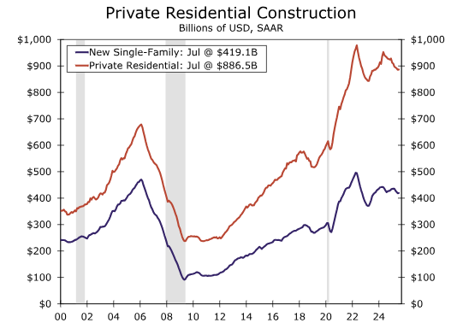
Construction Spending: Under Pressure
Residential Construction Remains Under Pressure
Private single-family outlays inched up 0.1% in July, the first increase in five months. Nevertheless, single-family construction remains under pressure by high mortgage rates and stalling new home demand.
Multifamily construction also turned lower in July, slipping by 0.4%. Although multifamily construction is no longer descending as rapidly as it once was, multifamily developers similarly face challenges in the form of high interest rates and reduced credit access.
By keeping owners in their homes for longer, high mortgage rates are encouraging a rise in home improvement spending. Residential improvement outlays inched 0.1% higher in July, the third uptick in the past four months.
Less organic growth for insurers, mortgage lenders
Residential construction remains under pressure
Source: Wells Fargo Economic Research (9/2/25) from US Dept. of Commerce.
12/01/09 - 9pm
eSlide – P6466 – The Financial Crisis and the Future of the P/C
Notes:
48

Slide 49
The Economy Drives P/C Insurance Industry Premiums: 2006:Q1–2025F* Direct Premium Growth (All P/C Lines) vs. Nominal GDP: Quarterly Y-o-Y Pct. Change
2025E
+5.0%*
+4.3%
Direct written premiums track nominal GDP fairly tightly over time, suggesting the P/C insurance industry’s growth prospects inextricably linked to economic performance.
*2020-25F figures are annual.
Sources: SNL Financial; U.S. Commerce Dept., Bureau of Economic Analysis; ISO;, Swiss Re (2025E) I.I.I.; Risk and Uncertainty Management Center, University of South Carolina.

Slide 50
U.S. National Debt, 1966 – 2025:Q1
($ Trillions)
The national debt held steady at $36.2 Trillion in Q1 2025 but will likely continue to grow for the foreseeable future.
Debt/GDP Ratio = ~120% (Nearly the Highest Since WW II)
$36.2 Trillion
Large deficits that increase as a share of GDP are, at some point, unsustainable and inflationary
Source: Congressional Budget Office; Federal Reserve Bank of St. Louis: https://fred.stlouisfed.org/series/GFDEBTN.
18

Slide 51
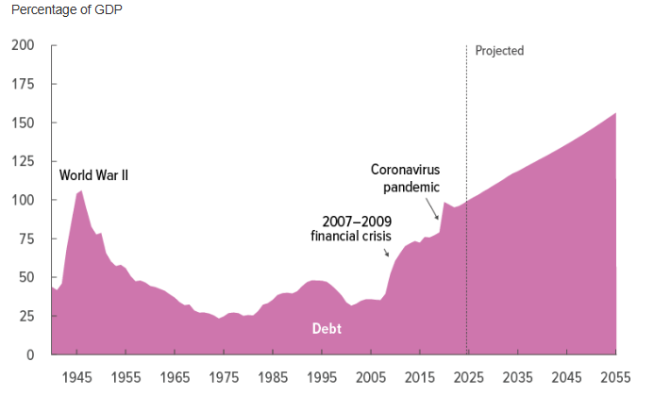
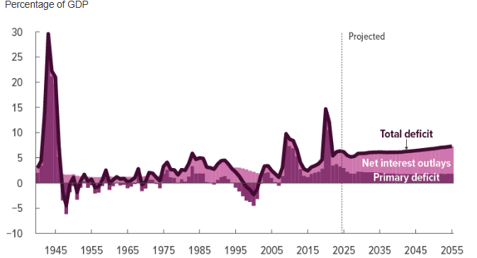
Federal Debt Held by the Public and Composition of Annual Deficits as a Percent of GDP, 1940 – 2055F*
Net interest outlays account for the majority of deficit increase
2055F
156%
CBO: “Debt held by the public, boosted by large deficits, reaches its highest level ever in 2029 (measured as a percentage of gross domestic product, or GDP) and then continues to grow, reaching 156 percent of GDP in 2055. It remains on track to increase thereafter. Mounting debt would slow economic growth, push up interest payments to foreign holders of U.S. debt, and pose significant risks to the fiscal and economic outlook; it could also cause lawmakers to feel constrained in their policy choices.”
*Estimates assumes current laws remain generally unchanged.
Source: CBO Long-Term Budget Outlook: 2025-2055 (March 2025). Accessed at: https://www.cbo.gov/publication/61270.
12/01/09 - 9pm
eSlide – P6466 – The Financial Crisis and the Future of the P/C
Notes:
51

Slide 52
How Will US Policy Shifts Impact the P/C Insurance Industry?
Inflation, Fiscal Policy, Trade Policy, Geopolitical Conflicts and High Interest Rates Have Weighed Heavily on Business and Consumer Sentiment
Tariffs Will Increase Auto and
Property Claim Severities
52

Slide 53
Insurance Lines/Segments Impacted by Tariffs
Line/Segment | Risk | Consequences
Personal Auto | Tariffs imposed on most vehicles and parts | Rising physical damage severities→ Rate increases
Commercial Auto | Tariffs imposed on most vehicles and parts | Rising physical damage severities→ Rate increases
Ocean Marine | Decreased transoceanic shipping | Hull and cargo exposures shrink→ Premium volume falls
Residential & Commercial Property | Tariffs imposed on many important construction goods, electronics, appliances, etc. | Rising property claim severities→ Rate increases, Limits become inadequate (ITV)
Inland Marine | Tariffs reduce cargo transport volumes | Exposures shrink→ Premium volume falls
Aviation | Tariffs reduce air cargo volumes; Economic uncertainty and hostility toward US allies is reducing travel demand. | Exposures shrink→ Premium volume falls
Source: University of South Carolina, Risk & Uncertainty Management Center.
12/01/09 - 9pm
eSlide – P6466 – The Financial Crisis and the Future of the P/C
Notes:
53

Slide 54
Insurance Lines/Segments Impacted by Tariffs (cont’d)
Line/Segment | Risk | Consequence
Trade Credit | Decreased international trade | Exposures shrink→ Premium volume falls
Farm/Ag | Retaliatory tariffs against US ag exports | Lower farm production/income→ Premium volumes falls
USL&H | Decreased import and export activity at US ports reduces port employment | Exposures fall→ Premium volume slows or shrinks
Workers Comp. | Economic slowdown results in higher unemployment rate | Reduced payroll exposure→ Premium volumes slows or shrinks
D&O | Earnings uncertainty; Share price plunges; Supply chain disruptions | Increased shareholder litigation
Source: University of South Carolina, Risk & Uncertainty Management Center.
12/01/09 - 9pm
eSlide – P6466 – The Financial Crisis and the Future of the P/C
Notes:
54

Slide 55
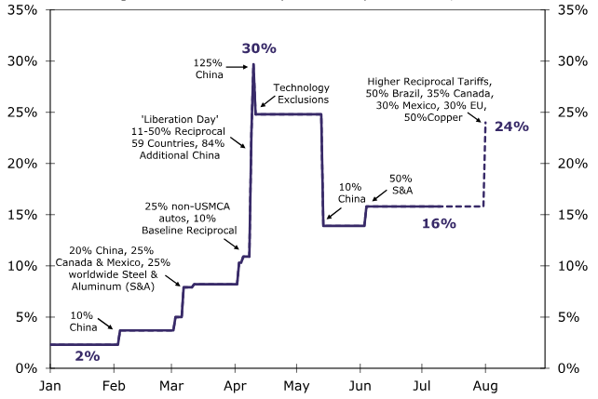
Est. US Average Effective Tariff Rate, Jan. – Aug. 2025*
Effective tariff rates have fluctuated wildly in 2025, starting the year ~2%, peaking at 30% and currently standing at 14%
Renewed tariff threat could push effective rate far higher as of Aug. 1. (e.g., EU, Mexico, Brazil)
Peak Apr. 2025
30%
Aug. 2025* ~24%
July 2025 16%
Estimated Impact of Tariffs
New Home Price: $9,200 (NAHB)
New Car Prices: $2,000 - $15,000 (Anderson Economics Group)
*August 2025 figures are estimates based on information available as of 7/23/25.
Source: US Dept. of Commerce and Wells Fargo Economics.
12/01/09 - 9pm
eSlide – P6466 – The Financial Crisis and the Future of the P/C
Notes:
55

Slide 56
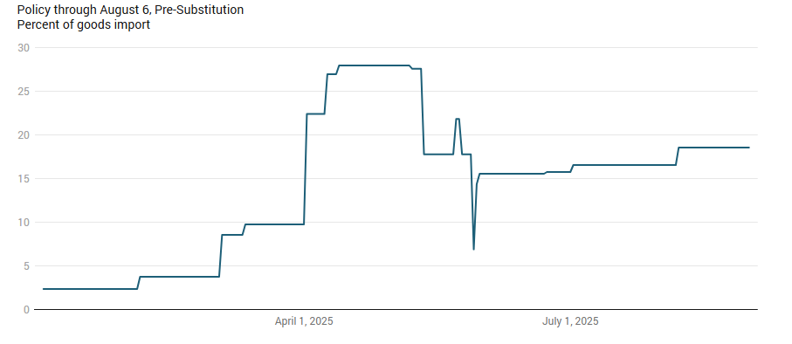
US Average Effective Tariff Rate, Jan. – Aug. 2025*
Effective tariff rates have fluctuated wildly in 2025, starting the year ~2%, peaking at ~30% and currently standing at 18.6%, according to the YBL.
NOTE: On Aug. 29, the US Court of Appeals ruled that most tariffs imposed by President Trump are illegal. Tariffs remain in place while the case is appealed, likely all the way to the Supreme Court.
Peak Apr. 2025
27.99%
Aug. 2025*
18.61%
Jan. 2025 2.4%
*Reflects US policy through August 6, 2025.
Source: Yale Budget Lab accessed as of 9/1/25: https://budgetlab.yale.edu/research/state-us-tariffs-august-7-2025.
Notes:
56

Slide 57
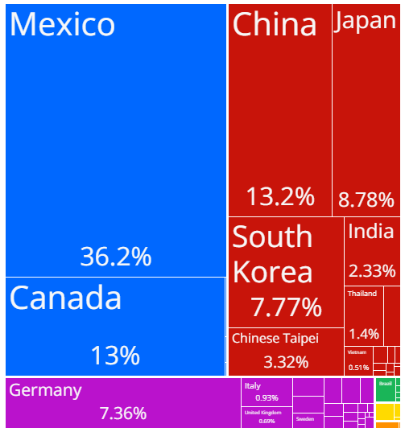
US Imports of Auto Parts, by Source Country, 2022
Total = $88 Billion
36.2% of auto part imports into the US in 2022 were from Mexico. China and Canada are a distant second and third. All are vulnerable to potential sharp price increases due to threatened tariffs ranging from 20% to 60%.
Imported auto parts account for a large share of those used in repairs paid for by insurers (esp. aftermarket parts). Tariffs will likely drive up personal and commercial auto claim severities.
Source: Observatory of Economic Complexity (OEC) available at: https://oec.world/en/profile/bilateral-product/motor-vehicles-parts-and-accessories-8701-to-8705/reporter/usa.
12/01/09 - 9pm
eSlide – P6466 – The Financial Crisis and the Future of the P/C
Notes:
57

Slide 58
The Inflation Threat
Inflation Has Been a Major Driver of Auto and Property Claims Severities
Will Tariffs Reignite Inflation?

Slide 59
U.S. Inflation Rate: 2009-2027F*
Inflation accelerated sharply in 2021 before peaking at 9.1% in June 2022. Inflation was nearly halved in 2023 and fell further in 2024, but will remain above the Fed’s 2% target in 2025-27
40-Year High
Highest inflation rate since 1982
Percentage Change (%)
There’s concern that the Fed may need to keep rates higher for longer to achieve its 2% inflation target
Inflation projections for 2025-26 remain stubbornly high, due largely to anticipated tariff impacts
Insurer Concerns About Inflation
Rate Inadequacy
Reserve Inadequacy
Insurance-to-Value
*Annual change in Consumer Price Index for All Urban Consumers (CPI-U).
Source: U.S. Bureau of Labor Statistics; Wells Fargo Securities (9/25); USC Center for Risk and Uncertainty Management.

Slide 60
Cost Indicators for Residential Const., Price Index Changes, Jan. 2020 – June 2025
The cost of construction materials and labor has increased at a pace far above that of the overall CPI
Source: U.S. Bureau of Labor Statistics from Federal Reserve Bank of St. Louis: https://fred.stlouisfed.org/series/WPUIP23111021 (Trade Services) and https://fred.stlouisfed.org/series/WPUSI012011 (Construction Materials).
Notes:
Fig 2-P

Slide 61
Change in Cost Indicators for Selected Construction Inputs, Jan. 2020 – June 2025
The rapid increase in and still-elevated cost of building materials has immediate and longer-term implications for property insurers and reinsurers
Source: U.S. Bureau of Labor Statistics.
Notes:
Fig 2-P

Slide 62
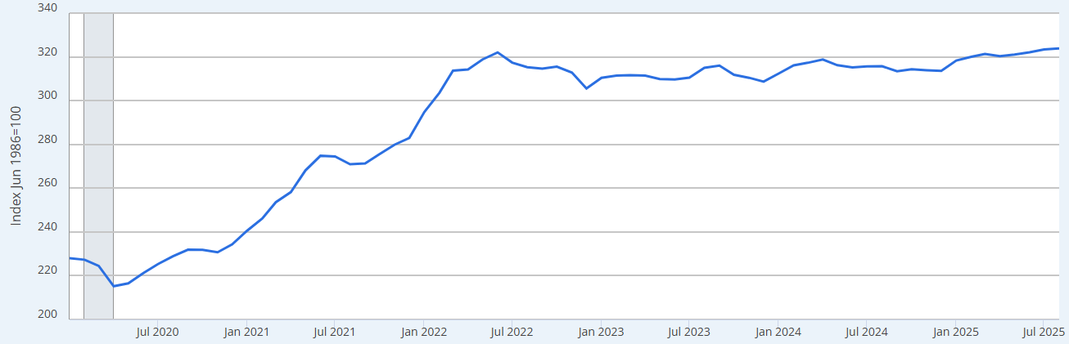
PPI: Net Inputs to Residential Construction, Goods, Jan. 2019 – Aug. 2025
The cost of Residential Construction materials surged during and after the pandemic, +41.2% from Jan. 2020 before peaking in June 2022, putting significant pressure on home insurers
Aug. 2025
+42.0%
The cost of Residential Construction materials peaked in 2022, moderated a bit in 2023-24, but has begun to climb again in 2025, with tariffs a likely important driver
Sources: Federal Reserve Bank of St. Louis from US Bureau of Labor Statistics: https://fred.stlouisfed.org/series/WPUIP2311001; Risk and Uncertainty Management Center, University of South Carolina.

Slide 63
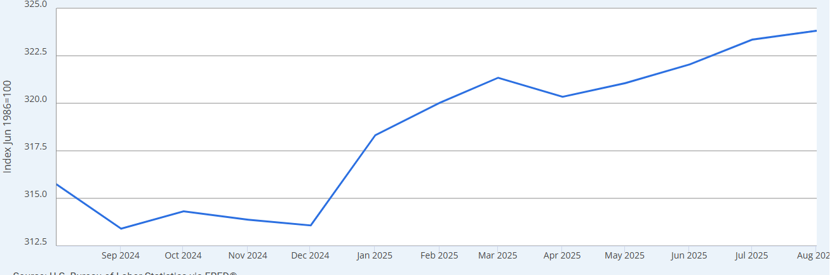
PPI: Net Inputs to Residential Construction, Goods, Jan. 2019 – Aug. 2025
Dec. 2024 - Aug. 2025
+3.3%
The cost of Residential Construction has accelerated markedly in 2025, with tariffs a likely important driver
+3.3%
Sources: Federal Reserve Bank of St. Louis from US Bureau of Labor Statistics: https://fred.stlouisfed.org/series/WPUIP2311001; Risk and Uncertainty Management Center, University of South Carolina.

Slide 64
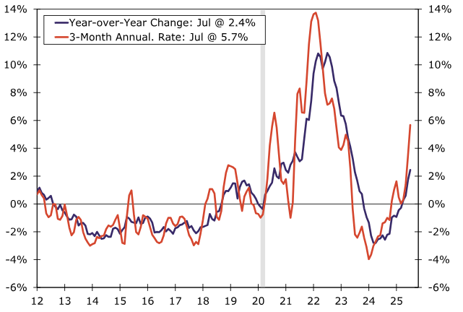
Household Furnishings Inflation, Jan. 2012 – July 2025 (Year-over-Year vs. 3-Month Moving Avg.)
Sharp accelration in inflation for household furnishings in recent months—a high proportion of which are imported.
Source: US Department of Commerce, Wells Fargo Securities (8/25); Center for Risk and Uncertainty Management, University of South Carolina.

Slide 65
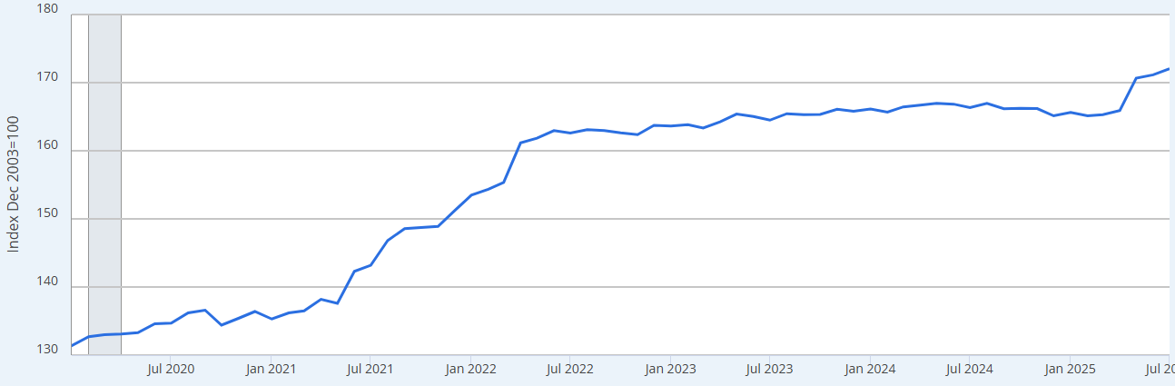
PPI: Price Index Changes for Major Household Appliance Manufacturing, Jan. 2020 – July 2025
Major household appliance prices received by manufacturers surged 24.0% during the pandemic, from Jan. 2020 to June 2022
Major Household Appliance prices in recent months have spiked, increasing by 3.7% from April to July, mostly due to tariffs
Sources: US Bureau of Labor Statistics: https://fred.stlouisfed.org/series/PCU3352233522; Risk and Uncertainty Management Center, University of South Carolina.

Slide 66
CPI for Motor Vehicle Insurance, 12-Month Change: Jan. 2020 – Aug. 2025
Peak
Apr. 2024: 22.6%
(%)
The auto insurance component of the Consumer Price Index in August was up 4.7%
Smallest increase since May 2022
Tariff Trouble in 2025-2026?
Threatened tariffs of 20% - 60% would result in a material increase in the price of imported motor vehicle parts and accessories ($88 billion in auto parts were imported into the US in 2022--with Mexico, Canada and China the biggest suppliers). Higher tariffs would therefore lead directly to higher claim severities in both personal and commercial auto.
Auto insurance accounts for 2.796% of the overall CPI* and 18.5%* of the Private Transportation CPI component
Refunds/Rebates made by auto insurers
*Weighting as of Dec. 2024: https://www.bls.gov/cpi/factsheets/motor-vehicle-insurance.htm
Sources: US Bureau of Labor Statistics, accessed at: https://data.bls.gov/timeseries/CUUR0000SETE. Risk and Uncertainty Management Center, University of South Carolina.

Slide 67
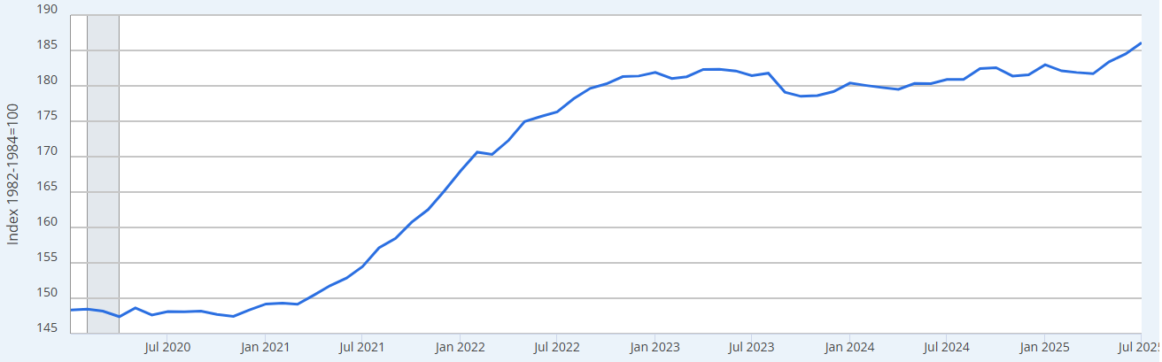
Price Index Changes for Motor Vehicle Parts & Equipment, Jan. 2020 – July 2025
Motor Vehicle Parts & Equipment prices surged during the pandemic, +22.9% from Jan. 2020 before peaking in May 2023—putting significant pressure on the overall CPI (auto insurance accounts for 2.8% of the CPI)
Motor Vehicle & Equipment prices in recent months have increased sharply, increasing by 2.4% from April to July (a 9.6% annualized rate), mostly due to tariffs
Sources: US Bureau of Labor Statistics: https://fred.stlouisfed.org/series/CUUR0000SETC; Risk and Uncertainty Management Center, University of South Carolina.

Slide 68
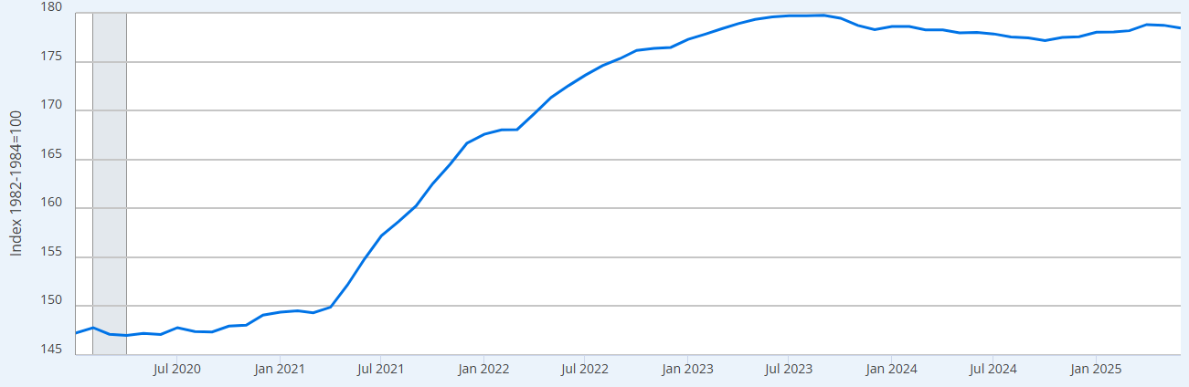
Price Index for New Vehicles, Jan. 2020 – June 2025
New car prices are relatively flat but still remain well above pre-Covid levels, +21.2% as of June 2025
New vehicle prices surged during and after the pandemic, +22.1% from Jan. 2020 to Sept. 2023 (peak), putting significant pressure on the overall CPI and auto insurance rates (new and used vehicles account for 7.4% of the index and gasoline 3.0% — auto insurance is 2.8%)
Realistically, new vehicle prices will likely never return to pre-pandemic levels—supply/demand imbalances, technology, tariffs, EV transition will support an upward trend
Sources: US Bureau of Labor Statistics; Risk and Uncertainty Management Center: https://fred.stlouisfed.org/series/CUUR0000SETA01; University of South Carolina.

Slide 69
Medical Cost Inflation vs. Overall CPI Since COVID, Jan. 2020 – Aug. 2025 (Percent Change from Year Ago)
Jan 2020 – Dec 2022
Healthcare: 3.1
Overall: 4.6%
Medical inflation began to spike in mid-2025 after a year of tracking the overall CPI fairly closely
Medical Inflation
Aug. 2025: 3.4%
All Items CPI
Aug. 2025: 2.9%
Jan 2020 – Feb 2021
Healthcare: 3.8% Overall: 1.3%
Mar 2021 – Nov 2022
Healthcare: 2.6%
Overall: 6.8%
Sources: US Bureau of Labor Statistics via Federal Reserve Bank of St. Louis: https://fred.stlouisfed.org/series/CPIMEDSL; Risk and Uncertainty Management Center, University of South Carolina.

Slide 70
Overview of Recent Private Passenger Auto Frequency & Severity Trends
Severity and Loss Ratio Trends Have Generally Been Adverse
Inflation is a Major Driver
70

Slide 71
Personal Auto Claim Severities Continue to Trend Generally Upward; Frequency Is Generally Falling (Excl. BI): 4 Qtrs. Ending Q1 2025
Year-over-Year Change
Auto Claim Frequencies Fell Sharply During the Pandemic, though Claim Severities Rose Materially. Severities Increases Moderated, though Tariffs Could Push Severities Upward in 2026
Recall: PD Liability claims were down 32.2% for the 4 qtrs. ending Q1 2021
Source: ISO/PCI Fast Track data for Q1 2025; Risk and Uncertainty Management Center, Univ. of South Carolina.

Slide 72
Collision Claim Severity: Still Near Record Highs
Collision claim severity reached a record high in 2023:Q1, up 42.4% from 2020:Q1
Average Loss, 2018:Q1 through 2025:Q1
Q1:2025 Collision claim severity is still up 41.3% since Q1:2020
Severities Are Up Sharply—Inflation Is a Major Factor. Tariffs Could Pressure Severities Upward.
Source: ISO/PCI Fast Track data; Center for Risk and Uncertainty Management, Univ. of South Carolina.

Slide 73
US: Collision Loss Ratios, Personal Auto, 2019:Q1 – 2025:Q1
The Personal Auto collision loss ratio as of 2025:Q1 is now below pre-pandemic levels. Rate pressure from post-pandemic inflation is dissipating, but tariffs could reignite pressure by late 2025-26.
The Personal Auto collision loss ratio at YE 2022 was up approximately 20 pts. compared to pre-pandemic levels. The upward trend put significant pressure on rates.
Loss Ratio
Collision Loss Ratios Rose Rapidly After COVID, Peaking in Late 2022 and Until Recently Remained Above Pre-Covid Levels. Tariffs Could Pressure Loss Ratios by late 2025 and into 2026.
Source: ISO Fast Track data; University of South Carolina, Risk & Uncertainty Management Center.

Slide 74
US Collision Claim Frequency Trend: Returning to Pre-Pandemic Levels?
Paid Claim Frequency, 2019:Q1 through 2025:Q1*
Collision claim frequency remains somewhat below pre-pandemic levels
Pandemic-Induced Frequency Decline Was Short-Lived and Has Now Normalized
*Number of claims per 100 earned car years.
Source: ISO/PCI Fast Track data; Center for Risk and Uncertainty Management, Univ. of South Carolina.

Slide 75
America’s Deadly Highways
Motor Vehicle Fatalities Have Skyrocketed
Driver Behaviors Have Changed for the Worse, Pushing Up Fatality Rates and Claim Costs

Slide 76
Traffic Fatalities in the U.S., 2000-2024
During COVID, fatalities surged by 7.3% in 2020 and 10.1% in 2021 (up 18.1% since 2019)
Fatalities remained elevated in 2022 but fell slightly, by 1.0%
Financial Crisis/ ”Great Recession” –fatalities fell 25.4%
Fatalities in 2023 were down 3.8%, but were still 12.5% above pre-COVID (2019) levels
Fatalities in 2024 were down 3.8% from 2023
Extraordinary Increase in Poor Driving Behaviors in 2020 -2023 Contributed to Sharply Higher Auto Fatalities
Source: Insurance Institute for Highway Safety and Highway Loss Data Institute: https://www.iihs.org/iihs/topics/t/general-statistics/fatalityfacts/overview-of-fatality-facts and NHTSA: https://crashstats.nhtsa.dot.gov/Api/Public/ViewPublication/813670#; Risk and Uncertainty Management Center, University of South Carolina.

Slide 77
Motor Vehicle Crash Deaths per 100 Million Vehicle Miles Traveled, 2024
South Carolina has the second highest motor vehicle fatality rate in the US (up from 3rd in 2023). Fatality rates are 42.5% higher than the US average of 1.20 and more than twice that of the best states. SC’s fatality is also higher than nearby states.
SC’s fatality rate is more than double that of the 5 best states
Deaths per 100M VMT
Top 10 Highest
Nearby States
5 Lowest States
Sources: DOT Federal Highway Administration, NHTSA Fatality Analysis Reporting System, Early Estimate of Motor Vehicle Traffic Fatalities in 2024. Accessed at: https://crashstats.nhtsa.dot.gov/Api/Public/ViewPublication/813710.

Slide 78
Commercial Lines Growth
& Pricing Cyclicality
Economic and Tort Environment Create Pricing Pressure
78

Slide 79
CIAB: Average Commercial Rate Change, All Lines, 2011:Q1–2025:Q2
Rate increases peaked in 2020 but continued throughout 2021-2024
(Percent)
Smallest increase since 2018
Renewals turned positive in late 2011 in the wake of record tornado losses and Superstorm Sandy
High CAT losses and poor underwriting results in recent years combined with inflation, litigation, reduced capacity, higher reinsurance costs, lower interest rates (until 2022) and increased uncertainty exerted significant pressure on markets with overall rates up materially from 2018-2024.
Note: CIAB data cited here are based on a survey. Rate changes earned by individual insurers can and do vary, potentially substantially.
Source: Council of Insurance Agents & Brokers; Center for Risk and Uncertainty Management, Univ. of South Carolina.

Slide 80
Change in Commercial Rate Renewals, by Line: 2025:Q2
Commercial Umbrella, Auto and GL are adversely impacted by legal system abuse/social inflation. Commercial Property increases have eased substantially after years of sharp increases due to high CAT losses, inflation and expensive reinsurance.
(Percent Change)
WC rates have been basically flat or slightly down for several years, due to strong underwriting results
An increasing number of lines are flat or declining
Note: CIAB data cited here are based on a survey. Rate changes earned by individual insurers can and do vary, potentially substantially.
Source: Council of Insurance Agents and Brokers; USC Center for Risk and Uncertainty Management.

Slide 81
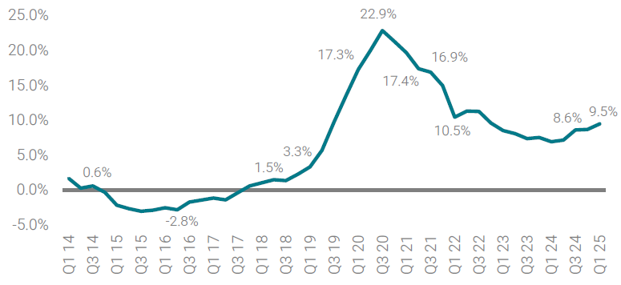
Premium Change for Commercial Auto, 2014:Q1 – 2025:Q1
Commercial Auto premiums have been on the rise for nearly a decade
Source: Council of Insurance Agents Commercial P/C Market Index, 2025:Q1.

Slide 82
Investments: Wall Street’s Wild Ride Continues
Investment Performance Is a Key Driver of Insurer Profitability
How Has the Hawkish Fed Impacted Insurer Portfolios?

Slide 83
Property/Casualty Insurance Industry Investment Income: 2000–2024F*
Higher interest rates are pushing investment income sharply upward
($ Billions)
Aggressive Fed actions in response to COVID and recession pushed interest rates lower in 2020, adversely impacting investment income
Due to persistently low interest rates, investment income remained below pre-crisis levels for a decade. Lower interest rates during COVID drove investment income down once again. Fed rate hikes in 2022-23 are reversing this trend.
* 2018-19 figures are distorted by provisions of the TCJA of 2017. Increase reflects such items as dividends from foreign subsidiaries.
**2022 figure includes a $10.8B intercompany distribution by a large reinsurer that flowed through NII.
¹ Investment gains consist primarily of interest and stock dividends. Sources: A.M. Best Review & Preview (March 2024); ISO; University of South Carolina, Center for Risk and Uncertainty Management.

Slide 84
Net Investment Yield on Property/Casualty Insurance Invested Assets, 2007–2026F
In 2025, investment yields could be the highest since the Financial Crisis
Investment yields in 2021 were depressed--down about 200 BP from pre-crisis (and 50-80BP from pre-COVID) but are now rising. Yields in 2021 were the lowest since at least 1960.
(Percent)
The yield on invested assets remains depressed relative to pre-financial crisis and pre-COVID yields. Fed rate hikes in 2022-23 are lifting yields and investment income.
Average: 1960-2019 = 4.9%
Low: 2.8% (1961)
High: 8.2% (1984/85)
Sources: NAIC data, sourced from S&P Global Market Intelligence; 2017-19 figures are from ISO. 2020-22 data from APCIA. 2024-26F from Swiss Re (Apr. 2025). Risk and Uncertainty Management Center, Univ. of South Carolina.

Slide 85
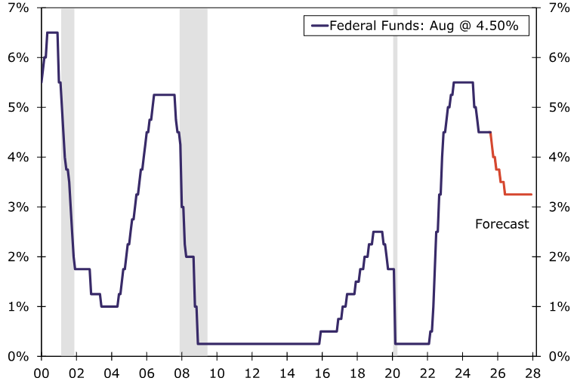
Federal Funds Target Rate: Easing in Store
Labor market concerns are leading the Fed to ease despite ongoing inflation concerns.
Cuts of 25BP are expected at each Fed meeting into June 2026.
Source: Federal Reserve Board and Wells Fargo Economics.

Slide 86
Interest Rate Forecasts: 2019 – 2027F: Higher for Longer
Yield (%)
The prospect of tariff-driven inflation and greater deficit spending have kept the expected yield on 10-year Treasurys elevated
3-Month Treasury
10-Year Treasury
Persistently low yields had been a challenge for insurers for many years. Fed rate hikes in 2022/23 boosted yields on invested assets
Fed rate cuts will begin in Sept. 2025 and likely continue through mid-2026
Higher interest rates provided a modest tailwind for insurers. Enormous uncertainty regarding future Fed actions and questions about the degree of Fed independence mount.
Sources: Wells Fargo Securities (9/25); Risk and Uncertainty Management Center, University of South Carolina.

Slide 87
Legal System Abuse (Social Inflation) &
Litigation Trends
Rising Litigation Costs Are a Concern for Businesses Large and Small—and Their Insurers
Major Driver of Rate Across Multiple Lines
87

Slide 88
Social Inflation: Many Interrelated Causes, Difficult to Manage
INSURANCE CLAIM COSTS
Increasing Propensity to Sue
Size of Jury Awards
Courts/ Juries Favoring Plaintiffs
Growing Distrust of Large Corps.
Litigation Financing
Aggressive Plaintiff Bar Ads
Changes in Regulatory and Legal Environment Bar Ads
Applied to a seemingly limitless number of issues, these drivers are pushing tort costs (and therefore claim costs upward)
Source:Risk and Uncertainty Management Center, Univ. of South Carolina, adapted from Verisk “Social Inflation” presentation (2020).

Slide 89
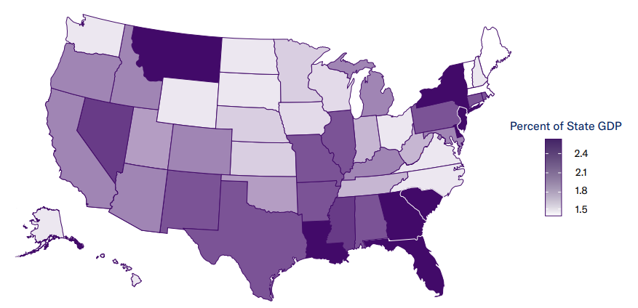
Tort Costs as Percent of State GDP, by State (2022)
On a Per Household basis, the US “tort tax” equated to $4,207 in 2022
Auto Accident
Medical Liability
Premises Liability
Products Liability
Tort costs as a share of GDP stood at 2.07% for the US overall in 2022 but are materially higher in the Southeast
Source: US Chamber of Commerce Institute for Legal Reform (Nov. 2024), “Tort Costs in America: An Empirical Analysis of Costs and Compensation of the U.S. Tort System” (3rd Edition) accessed at: https://instituteforlegalreform.com/research/tort-costs-in-america-an-empirical-analysis-of-costs-and-compensation-in-the-u-s-tort-system-third-edition/. Risk and Uncertainty Management Center, Univ. of South Carolina.
12/01/09 - 9pm
eSlide – P6466 – The Financial Crisis and the Future of the P/C
Notes:
89

Slide 90
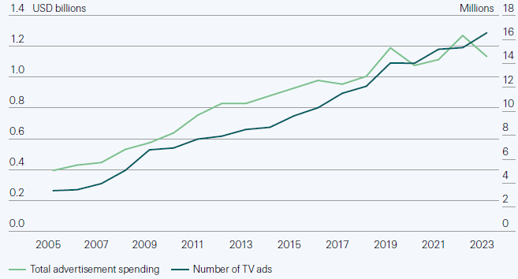
Attorney Advertising Remains Very Aggressive
Auto Accident
Medical Liability
The average American has attitudes that are conducive to continued social inflation.
Premises Liability
Products Liability
Over the past decade, legal services ad spending is up 34% to nearly $1.2B while the the number of ads has nearly doubled to more than 16 million
Source: Swiss Re Institute (sigma No. 4/2024), “Quantifying Social Inflation in the US,” from X-Ante Legal Services Ad Trends, accessed at: https://www.swissre.com/institute/research/sigma-research/sigma-2024-04-social-inflation.html.
12/01/09 - 9pm
eSlide – P6466 – The Financial Crisis and the Future of the P/C
Notes:
90

Slide 91
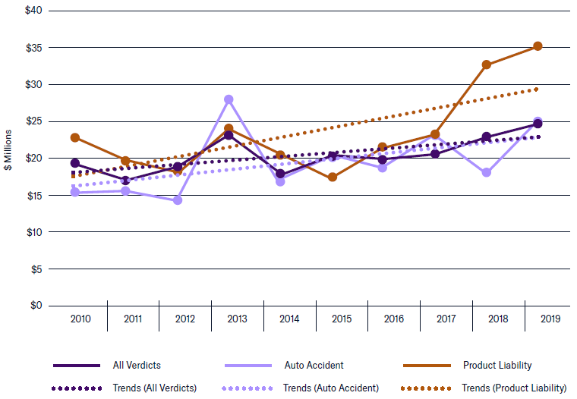
Median Nuclear Verdict and Trend Line: 2010 – 2019*
Products Liability
+53.2% from $23.0M in 2010 to $35.1M in 2019
Auto Accident
Medical Liability
All Nuclear Verdicts
+27.5% from $19.3M in 2010 to $24.6M in 2019
Premises Liability
Auto Accident
+63.2% from $15.2M in 2010 to $24.8M in 2019
Products Liability
*The ILR defines a nuclear verdict as a jury verdict of $10M or more.
Source: US Chamber of Commerce Institute for Legal Reform (Sept. 2022), “Nuclear Verdicts: Trends, Causes and Solutions,” accessed at: https://instituteforlegalreform.com/research/nuclear-verdicts-trends-causes-and-solutions/. Risk and Uncertainty Management Center, Univ. of SC.
12/01/09 - 9pm
eSlide – P6466 – The Financial Crisis and the Future of the P/C
Notes:
91

Slide 92
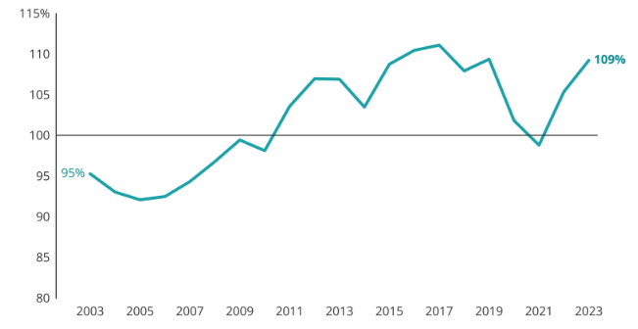
Commercial Auto Combined Ratio, 2003 - 2024
Commercial Auto has been generally unprofitable since 2011, including in 2023 and 2024
107%
2024
Source: S&P Capital IQ, Insurance Insider US.

Slide 93
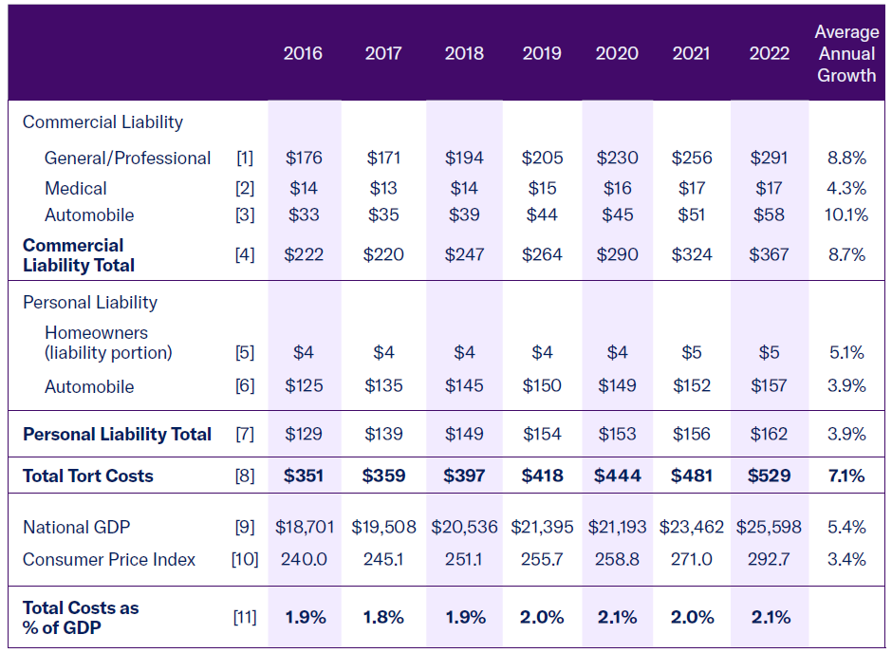
Tort Costs Over Time by Category, 2016 - 2022 ($Bill) (2022)
Increases in tort liability costs are driven primarily by Commercial lines, which are grew at and average annual rate 8.7% from 2016 – 2022, compared to 3.9% for Personal lines
Auto Accident
Medical Liability
Premises Liability
Products Liability
The US “tort tax” equated to $4,207 per household in 2022
Source: US Chamber of Commerce Institute for Legal Reform (Nov. 2024), “Tort Costs in America: An Empirical Analysis of Costs and Compensation of the U.S. Tort System” (3rd Edition) accessed at: https://instituteforlegalreform.com/research/tort-costs-in-america-an-empirical-analysis-of-costs-and-compensation-in-the-u-s-tort-system-third-edition/; Risk and Uncertainty Management Center, Univ. of South Carolina.
12/01/09 - 9pm
eSlide – P6466 – The Financial Crisis and the Future of the P/C
Notes:
93

Slide 94
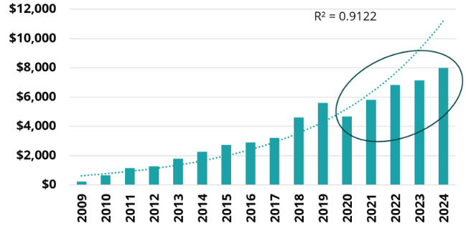
Estimated Impact of Social Inflation on Commercial Auto, 2009 – 2024 ($ millions)
Comparing current loss development patterns to those from past suggests that social inflation is pushing up Commercial Auto costs by about $8B per year as of 2024.
Source: S&P Capital IQ, Insurance Insider US.

Slide 95
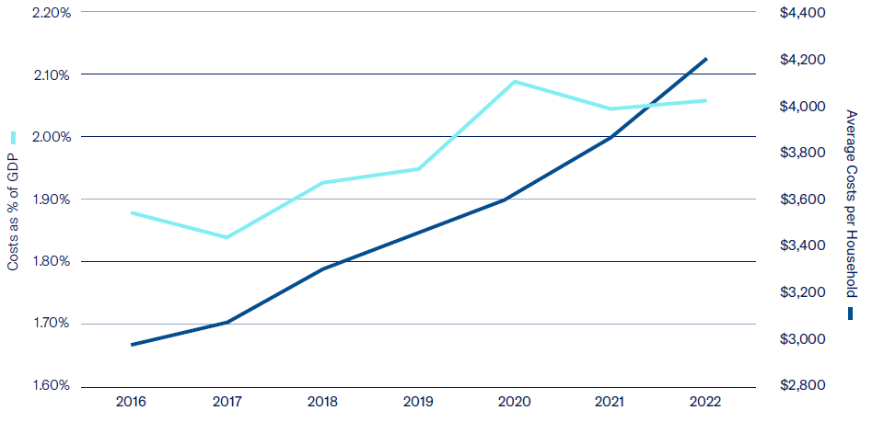
Change in Tort Costs Over Time: 2016 – 2022
The Household “Tort Tax” hit $4,207 in 2022, up about 50% since 2016
2022 $4,207
Auto Accident
Medical Liability
2016 1.88%
2020 2.07%
Premises Liability
Products Liability
2016 ~$2,800
Source: US Chamber of Commerce Institute for Legal Reform (Nov. 2022), “Tort Costs in America: An Empirical Analysis of Costs and Compensation of the U.S. Tort System” accessed at: https://instituteforlegalreform.com/research/tort-costs-in-america-an-empirical-analysis-of-costs-and-compensation-of-the-u-s-tort-system/. Risk and Uncertainty Management Center, Univ. of South Carolina.
12/01/09 - 9pm
eSlide – P6466 – The Financial Crisis and the Future of the P/C
Notes:
95

Slide 96
SUMMARY
The P/C Insurance Industry Remains Strong, Stable, Sound and Secure
Auto lines, property and reinsurance segments were stressed but are improving
E&S markets have experienced outsized growth
Loss Cost Challenges Have Been Easing, but Changes in Fiscal, Trade and Labor Policies in 2025/26 Could Exert Inflationary Pressures
Tariffs would adversely impact auto and property claim severities
Recession Risk Has Receded Materially
Asset Price Volatility Will Persist with Monetary Policy, Fiscal, Geopolitical Uncertainty
Higher Interest Rates Are Providing a Modest Tailwind for Investment Income
Inflationary Pressures Moderated in 2024, though Persisting into 2025
Legal System Abuse Issues Remain a Long-Term Challenge and Major Cost Driver
96
12/01/09 - 9pm
eSlide – P6466 – The Financial Crisis and the Future of the P/C
Notes:
96

Slide 97

Thank you for your time and your attention!
For a copy of this presentation, email me at robert.hartwig@moore.sc.edu or
Download at www.uscriskcenter.com

