Slide 1

AI Governance
for Insurers

Slide 2

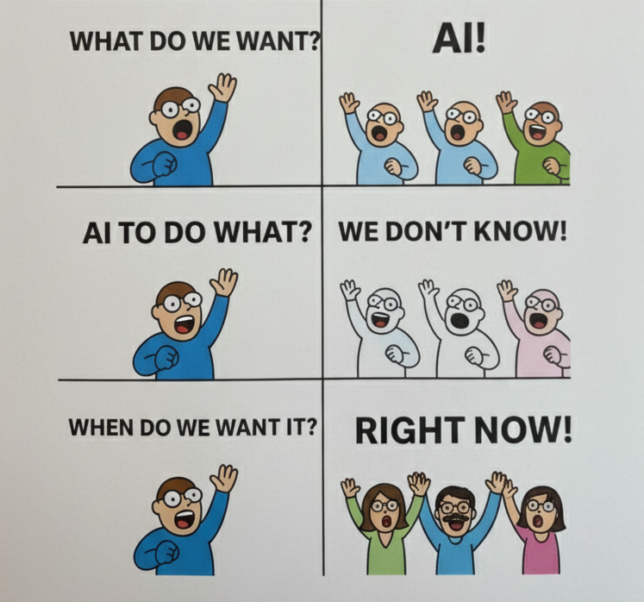

Slide 3
Rules.
Compliance.

Slide 4

Rules.
Make sure AI follows the rules already in place.

Slide 5
Rules.
Make sure AI follows the rules already in place.
Fairness – unfair trade, claims, and pricing practices.
Oversight – rate and model filing, subject to exams.
Transparency – privacy and consumer notice obligations.
Security – data protection and governance requirements.

Slide 6
Rules.
NAIC Model Bulletin.
NIST AI RMF.
State Laws.
Draft Regulator Evaluation Tool.

Slide 7
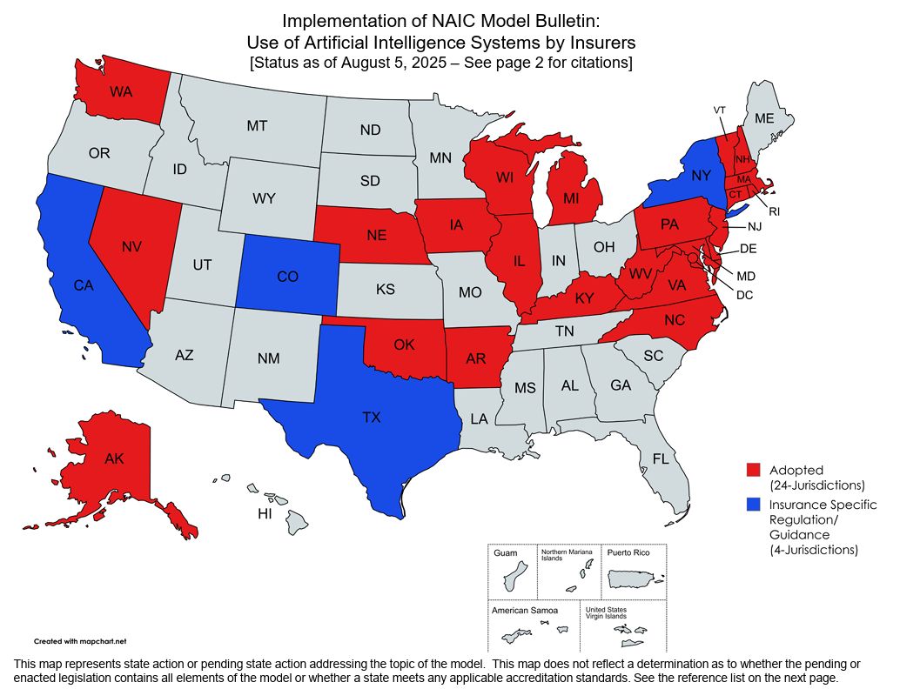
Rules.

Slide 8

Compliance.

Slide 9
Compliance.
Make sure AI is vetted, tested, and documented.

Slide 10
Compliance.
Make sure AI is vetted, tested, and documented.
Governance – executive oversight, written program.
Controls – assess risk, validate models.
Vendors – diligence, ongoing audit.
Transparency – notify, explain decisions.
Reporting – document compliance.

Slide 11
Compliance.
Governance.
AI Program = the system.
AI Policy = the rules.

Slide 12
Compliance.
Governance.
AI Program = the system.
Policies, standards, and procedures;
adopted by senior leadership, and
reported to a Board‑designated committee.
AI Policy = the rules.

Slide 13
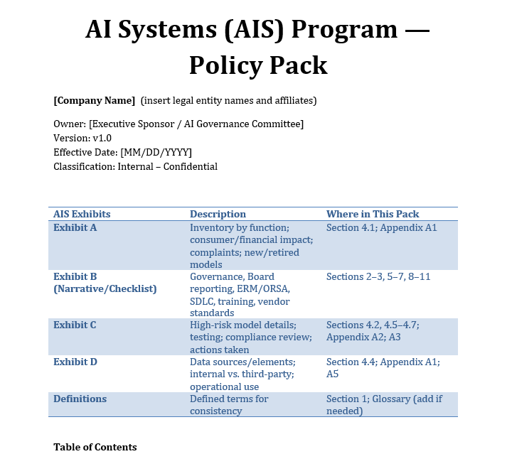
Compliance.
Governance.
AI Program = the system.

Slide 14
Compliance.
Governance.
AI Program = the system.
AI Policy = the rules.

Slide 15
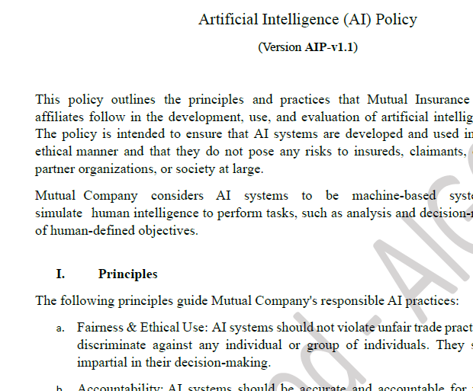
Compliance.
Governance.
AI Program = the system.
AI Policy = the rules.

Slide 16
Compliance.
Controls.

Slide 17
Compliance.
Controls.
Assess Risk.
Data Management.
Model Validation.

Slide 18
Compliance.
Controls.
Assess Risk.
Define purpose & context.
Assign risk tier.
Data Management.
Model Validation.

Slide 19
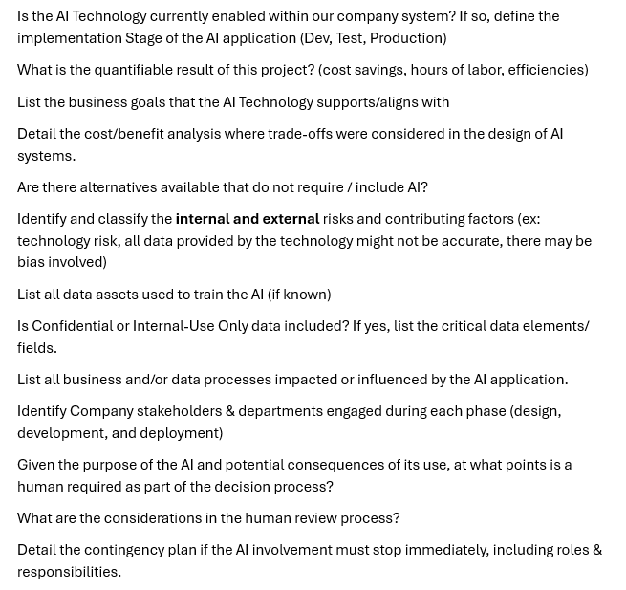
Compliance.
Controls.
Assess Risk.
Define purpose & context.
Assign risk tier.
Data Management.
Model Validation.

Slide 20
AI Risk Assessment Tests
NIST RMF Alignment: Follows the NIST RMF steps: Categorize, Select & Implement, Assess, Authorize, Monitor.
EU AI Act Posture: Assesses risk management, data governance, documentation, transparency, human oversight, and robustness per EU AI Act requirements.
Probability × Severity (3×3 Matrix) : Uses a 3×3 scale for Probability (P) and Severity (S), calculates Overall Risk as P×S (range 1–9). Example: P=2, S=3 ⇒ Overall Risk = 6/9 (~66.7%).
Seven Risk Categories (Categorical View): Each category is scored for Probability and Severity, then multiplied for a risk score.
Composite Overall Risk Score: Averages normalized results from the above methods to produce a single overall risk score.

Slide 21
Compliance.
Controls.
Assess Risk.
Define purpose & context.
Assign risk tier.
Data Management.
Model Validation.
Risk Factors
Nature of decisions
Potential harm
Human involvement
Transparency
Third-Party reliance

Slide 22

A “human in the loop” is considered a risk control only if the human has authority, knowledge, and independence to override the AI.

Slide 23
Compliance.
Controls.
Assess Risk.
Define purpose & context.
Assign risk tier.
Data Management.
Model Validation.
Risk Factors
Nature of decisions
Potential harm
Human involvement
Transparency
Third-Party reliance

Slide 24
Compliance.
Controls.
Assess Risk.
Data Management.
Sources - internal, third-party, synthetic.
Quality - accuracy, completeness, consistency.
Bias testing - metrics, sampling, remediation.
Security - access, integrity, retention.
Documentation - data dictionaries, lineage, metadata.
Model Validation.

Slide 25
Compliance.
Controls.
Assess Risk.
Data Management.
Model Validation.
Performance – accuracy, reliability, error rates.
Fairness – disparate impact testing, protected classes.
Drift – monitor, re-test, recalibrate.
Remediation – document corrective actions.

Slide 26

Compliance.
Vendors.

Slide 27
Compliance.
Vendors.
Due Diligence.
Contract Obligations.
Monitoring.

Slide 28
Compliance.
Vendors.
Due Diligence.
Contract Obligations.
Audit rights.
Data access.
Compliance with legal standards.
Cooperation with regulatory exams.
Monitoring.

Slide 29

Compliance.
Transparency.

Slide 30
Compliance.
Transparency.
Notice.
Explanation.

Slide 31
Compliance.
Transparency.
Notice.
Processes and procedures providing notice to impacted consumers that AI systems are in use and access to information based on materiality of the impact.
NAIC Model Bulletin: Use of Artificial Intelligence Systems by Insurers
Explanation.

Slide 32
Compliance.
Transparency.
Notice.
Explanation.
Understand what happened and why.

Slide 33

Compliance.
Reporting.

Slide 34
Compliance.
Reporting.
Documentation.
Attestation.
Exams.

Slide 35
Compliance.
Reporting.
Documentation.
Attestation.
Exams.
NAIC Draft AI Systems Evaluation Tool.

Slide 36
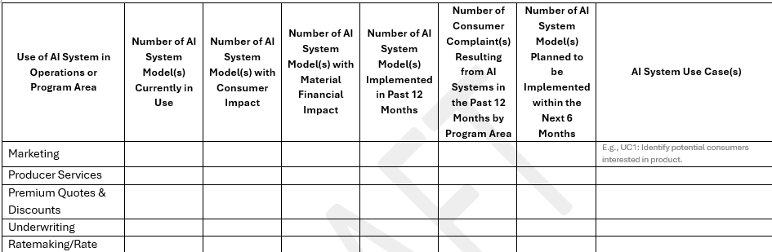
NAIC Draft AI Systems Evaluation Tool
Exhibit A — count and location of AI models across operations and any related complaints.

Slide 37
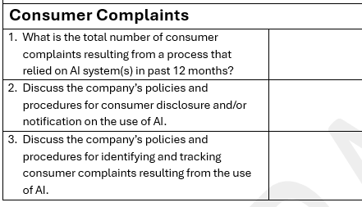
NAIC Draft AI Systems Evaluation Tool
Exhibit A — count and location of AI models across operations and any related complaints.

Slide 38
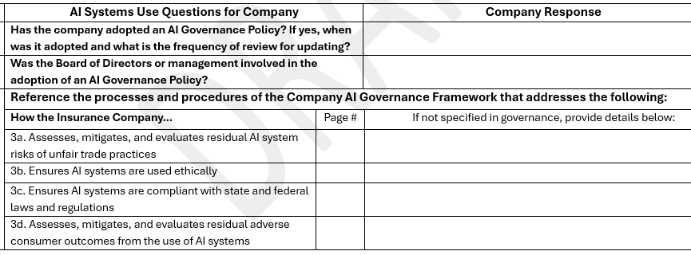
NAIC Draft AI Systems Evaluation Tool
Exhibit B — AI governance checklist: policy ownership, Board reporting, testing/monitoring, human‑in‑the‑loop, vendor/open‑source oversight, ERM/ORSA, and financial reporting.

Slide 39
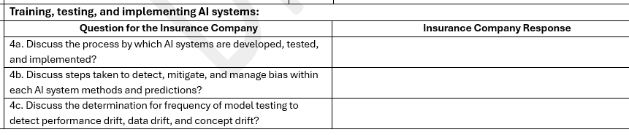
NAIC Draft AI Systems Evaluation Tool
Exhibit B — AI governance checklist: policy ownership, Board reporting, testing/monitoring, human‑in‑the‑loop, vendor/open‑source oversight, ERM/ORSA, and financial reporting.

Slide 40
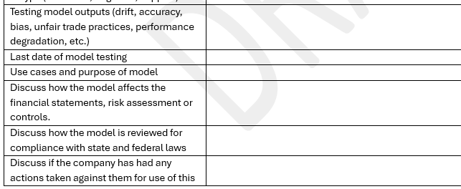
NAIC Draft AI Systems Evaluation Tool
Exhibit C — high‑risk model details: model purpose, risk classification, testing cadence/results, compliance reviews, and any regulatory actions.
Notes:
1. Documentation – keep records across the lifecycle
What it means: Every AI system should have a file that shows its purpose, data sources, testing results, monitoring logs, and governance approvals.
NAIC AI Model Bulletin: Regulators may request documentation including model inventories, data lineage, validation reports, bias testing, and monitoring records.
NIST AI RMF (Manage): Calls for continuous tracking of risks, controls, and outcomes, with documentation that enables accountability.
AISET: Section I requires insurers to show what documentation is maintained for each AI system, including testing and compliance evidence.
State examples: Colorado requires insurers to maintain documentation and make it available to the Division of Insurance on request.
2. Compliance Reporting – formal attestations
What it means: Some states now require annual reports and officer attestations showing compliance with AI and unfair discrimination requirements.
NAIC AI Model Bulletin: Expects companies to be able to demonstrate compliance to regulators on demand, including through examinations.
NIST AI RMF (Govern & Manage): Encourages organizations to maintain audit-ready records and be able to report risk posture to internal and external stakeholders.
AISET: Asks about reporting cadence — e.g., whether compliance summaries are produced annually or more often.
State example: Colorado Reg. 10-1-1 requires insurers to file an initial narrative compliance report and annual updates with officer attestation; corrective action plans must be submitted if gaps are found.
3. Exam Support – regulator access to reports
What it means: Insurers must anticipate that regulators will review AI systems as part of market conduct exams or special investigations. Reports need to be in a format examiners can use.
NAIC AI Model Bulletin: Lists the types of documents regulators may request in exams (AIS Program, inventories, vendor contracts, test results, audit logs).
NIST AI RMF (Transparency/Accountability): Requires organizations to maintain traceable documentation that external reviewers can evaluate.
AISET: Prompts insurers to describe how reporting is made available to regulators if requested.
State example: NYDFS Circular Letter No. 7 allows DFS to audit and examine records related to AI/ECDIS use in underwriting.

Slide 41
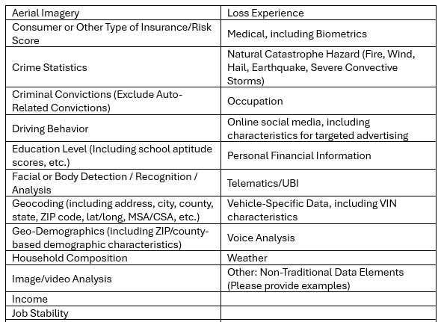
NAIC Draft AI Systems Evaluation Tool
Exhibit D — data transparency: which data elements are used, how they’re used, and source.
Notes:
1. Documentation – keep records across the lifecycle
What it means: Every AI system should have a file that shows its purpose, data sources, testing results, monitoring logs, and governance approvals.
NAIC AI Model Bulletin: Regulators may request documentation including model inventories, data lineage, validation reports, bias testing, and monitoring records.
NIST AI RMF (Manage): Calls for continuous tracking of risks, controls, and outcomes, with documentation that enables accountability.
AISET: Section I requires insurers to show what documentation is maintained for each AI system, including testing and compliance evidence.
State examples: Colorado requires insurers to maintain documentation and make it available to the Division of Insurance on request.
2. Compliance Reporting – formal attestations
What it means: Some states now require annual reports and officer attestations showing compliance with AI and unfair discrimination requirements.
NAIC AI Model Bulletin: Expects companies to be able to demonstrate compliance to regulators on demand, including through examinations.
NIST AI RMF (Govern & Manage): Encourages organizations to maintain audit-ready records and be able to report risk posture to internal and external stakeholders.
AISET: Asks about reporting cadence — e.g., whether compliance summaries are produced annually or more often.
State example: Colorado Reg. 10-1-1 requires insurers to file an initial narrative compliance report and annual updates with officer attestation; corrective action plans must be submitted if gaps are found.
3. Exam Support – regulator access to reports
What it means: Insurers must anticipate that regulators will review AI systems as part of market conduct exams or special investigations. Reports need to be in a format examiners can use.
NAIC AI Model Bulletin: Lists the types of documents regulators may request in exams (AIS Program, inventories, vendor contracts, test results, audit logs).
NIST AI RMF (Transparency/Accountability): Requires organizations to maintain traceable documentation that external reviewers can evaluate.
AISET: Prompts insurers to describe how reporting is made available to regulators if requested.
State example: NYDFS Circular Letter No. 7 allows DFS to audit and examine records related to AI/ECDIS use in underwriting.

Slide 42





Recap.
Governance – executive oversight, written program.
Controls – assess risk, validate models.
Vendors – diligence, ongoing audit.
Transparency – notify, explain decisions.
Reporting – document compliance.

Slide 43
Let’s Do it!

Slide 44


ClaimPilot AI empowers insurers to respond faster, smarter, and with greater empathy, no matter the scale of the disaster.
ClaimPilot AI uses advanced Large Language Models as real-time copilots, guiding staff step-by-step on what to ask and how to log information. Even non-experts can help customers effectively, ensuring claims are handled smoothly and accurately.
ClaimPilot AI: Smoother claims. Faster recovery. Happier customers.

Slide 45
Executive AI Governance Committee
AIS Program
AIS Policy
AIS Application
Vendor Risk Assessment
Transparency
Reporting

Slide 46
AIGC Approval Application
Submitted by: Claims Department
AI Vendor Name / Technology Name: ClaimPilot AI / ClaimPilot Technologies, Inc.
Is the AI Technology currently enabled within our company system? If so, define the implementation Stage of the AI application (Dev, Test, Production): Currently in Test environment; not yet deployed to Production.
What is the quantifiable result of this project? (cost savings, hours of labor, efficiencies):

Slide 47
AIGC Approval Application
Submitted by: Claims Department
AI Vendor Name / Technology Name: ClaimPilot AI / ClaimPilot Technologies, Inc.
Is the AI Technology currently enabled within our company system? If so, define the implementation Stage of the AI application (Dev, Test, Production): Currently in Test environment; not yet deployed to Production.
What is the quantifiable result of this project? (cost savings, hours of labor, efficiencies):
Estimated 40% reduction in average claim handling time during catastrophes
25% fewer escalations to Tier 2 adjusters
Improved customer satisfaction (NPS +15 points in pilot)

Slide 48
List the business goals that the AI Technology supports/aligns with:
Rapid, empathetic response to catastrophe claims
Business continuity during surge events
Regulatory compliance and auditability
Improved customer experience
Detail the cost/benefit analysis where trade-offs were considered in the design of AI systems:
Chose ClaimPilot AI for its proven disaster response workflows, scalability, and compliance features, accepting higher licensing costs for long-term labor and efficiency gains
Considered in-house development and other vendors, but ClaimPilot AI offered the best integration with our existing claims platform and regulatory requirements
Manual-only approach rejected due to slow response and high error rates during past disasters
Are there alternatives available that do not require / include AI?
Yes: Traditional call center staffing and manual claim intake.

Slide 49
Identify and classify the internal and external risks and contributing factors (ex: technology risk, all data provided by the technology might not be accurate, there may be bias involved):
List all data assets used to train the AI (if known):
Is Confidential or Internal-Use Only data included? If yes, list the critical data elements/fields:

Slide 50
Identify and classify the internal and external risks and contributing factors (ex: technology risk, all data provided by the technology might not be accurate, there may be bias involved):
Technology risk: Vendor system downtime, integration failures
Data risk: Inaccurate or incomplete customer input
Bias risk: Potential for model bias in triage recommendations
Regulatory risk: Compliance with state/federal insurance regulations
Vendor risk: Dependency on ClaimPilot Technologies, Inc. for support and updates
List all data assets used to train the AI (if known):
Vendor-provided: Industry-standard, de-identified claims datasets, public disaster response data
Internal: Historical, de-identified claims data, claims manuals, internal call scripts
Is Confidential or Internal-Use Only data included? If yes, list the critical data elements/fields:
Yes: Policy numbers, claim details, customer contact information, loss descriptions

Slide 51
List all business and/or data processes impacted or influenced by the AI application:
Catastrophe claim intake and triage
Call center staffing and workflow
Claims audit and compliance reporting
Identify Company stakeholders & departments engaged during each phase (design, development, and deployment):
Design: Claims, IT, Legal, Compliance
Development: Claims, IT, Data
Deployment: Claims Operations, Customer Service
Given the purpose of the AI and potential consequences of its use, at what points is a human required as part of the decision process?
What are the considerations in the human review process?

Slide 52
Given the purpose of the AI and potential consequences of its use, at what points is a human required as part of the decision process?
A trained employee is using the script and entering the information.
All claim decisions are reviewed by a licensed adjuster before settlement.
What are the considerations in the human review process?
Ensure AI recommendations are aligned with Company policies, and legal and regulatory requirements.
Override or escalate if AI output is unclear or incomplete.
Document any manual intervention.

Slide 53
Given the purpose of the AI and potential consequences of its use, at what points is a human required as part of the decision process?
A trained employee is using the script and entering the information.
All claim decisions are reviewed by a licensed adjuster before settlement.
What are the considerations in the human review process?
Ensure AI recommendations are aligned with Company policies, and legal and regulatory requirements.
Override or escalate if AI output is unclear or incomplete.
Document any manual intervention.
What validation activities have been performed on the AI model?
Describe the tests, audits, or evaluations conducted to ensure the model’s accuracy, reliability, and fairness.
What documentation or evidence (e.g., validation reports, test results, third-party assessments) has been provided to support these validation activities?

Slide 54
What validation activities have been performed on the AI model?
Describe the tests, audits, or evaluations conducted to ensure the model’s accuracy, reliability, and fairness.
What documentation or evidence (e.g., validation reports, test results, third-party assessments) has been provided to support these validation activities?
Vendor-Provided Information:
Basic functional test summary, confirming that ClaimPilot AI meets performance benchmarks for claim triage in their standard test environment.
Documentation included a description of the model architecture, data sets trained on, and a statement of compliance with general industry standards.
Internal Validation:
The Claims Department conducted hands-on testing in a controlled pilot to evaluate accuracy, reliability, and consistency.
Internal validation reports were generated, summarizing accuracy rates, intervention frequency, and pilot outcomes.
Audit trails were maintained to document the sequence of AI recommendations and human decisions throughout the pilot.

Slide 55
Risk Assessment
Probability × Severity (3×3 Matrix) : Uses a 3×3 scale for Probability (P) and Severity (S), calculates Overall Risk as P×S (range 1–9). Example: P=2, S=3 ⇒ Overall Risk = 6/9 (~66.7%).
Probability: The likelihood that a risk event will occur.
1: Low probability (rare or unlikely)
2: Moderate probability (possible, but not frequent)
3: High probability (likely or expected to occur)
Severity: The potential impact or consequences if the risk event occurs.
1: Low severity (minimal impact, easily managed)
2: Moderate severity (noticeable impact, may require intervention)
3: High severity (major impact, significant harm or regulatory exposure)

Slide 56
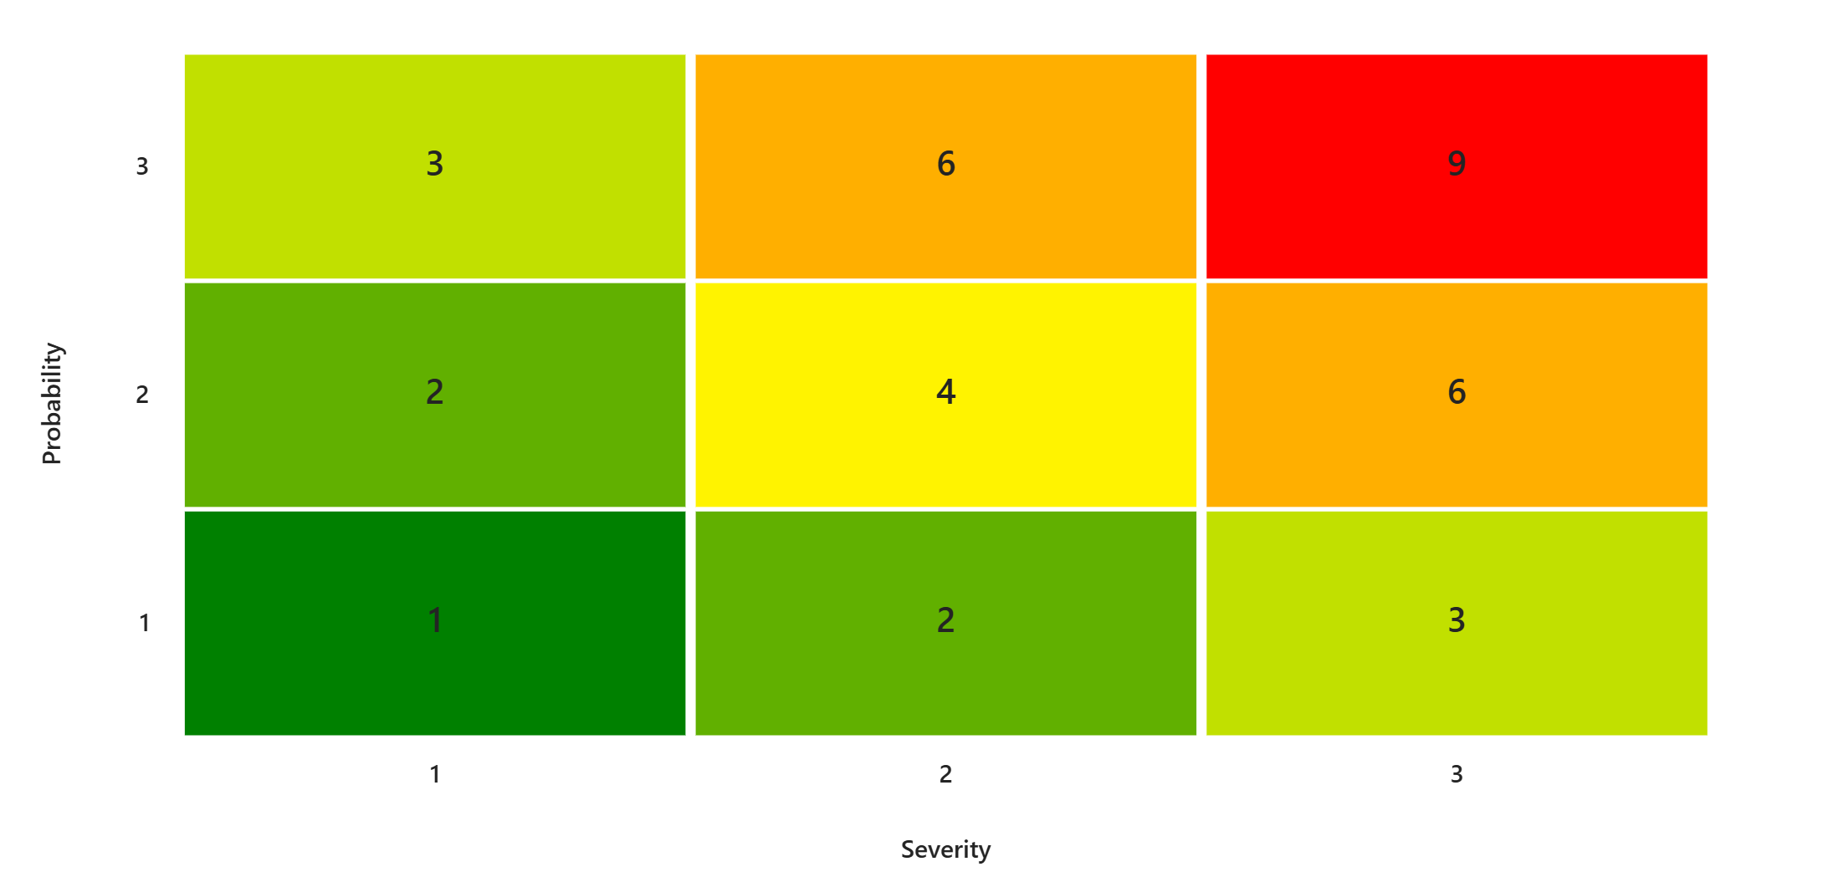
AI Risk Assessment
Probability × Severity

Slide 57
AI Risk Assessment
Probability × Severity
Technology risk: Vendor system downtime, integration failures
Data risk: Inaccurate or incomplete customer input
Bias risk: Potential for model bias in triage recommendations
Regulatory risk: Compliance with state/federal insurance regulations
Vendor risk: Dependency on ClaimPilot Technologies, Inc. for support and updates

Slide 58


Slide 59
Executive AI Governance Committee
What’s your vote? Assess Risk.
Data Management.
Model Validation.
Vendor Diligence.
Transparency.
Reporting.

Slide 60


AutoSnap Claims: Fast, Simple, and Secure Auto Damage Claims. Right from Your Phone!
Take control of your auto claim with AutoSnap Claims, the mobile app designed for personal lines customers with vehicle damage. Just snap photos of your car, enter a few details, and let our smart technology create a repair estimate in minutes.
Review and accept your estimate instantly, then direct payment straight to your account, all from the palm of your hand!

Slide 61
Identify and classify the internal and external risks and contributing factors (ex: technology risk, all data provided by the technology might not be accurate, there may be bias involved):
What validation activities have been performed on the AI model?
Please describe the tests, audits, or evaluations conducted to ensure the model’s accuracy, reliability, and fairness.
What documentation or evidence (e.g., validation reports, test results, third-party assessments) has been provided to support these validation activities?
Given the purpose of the AI and potential consequences of its use, at what points is a human required as part of the decision process?
What are the considerations in the human review process?

Slide 62
Identify and classify the internal and external risks and contributing factors (ex: technology risk, all data provided by the technology might not be accurate, there may be bias involved):
Technology Risk: Outages, bugs, or integration failures delaying claim processing.
Data Accuracy Risk: Photos uploaded by claimants may be unclear, incomplete, or manipulated.
Process Risk: Relies on complete and accurate information from the claimant for an accurate estimate.
Bias Risk: Inconsistent estimates for similar damage due to insufficient training data or unaddressed bias in historical claims.
Regulatory Risk: Failure to comply with insurance regulations regarding claims handling, data privacy, or payment processes.
Security Risk: Unauthorized access to claimant data or payment information due to vulnerabilities in the app or cloud infrastructure.
Vendor Risk: If third-party services (e.g., payment processors, cloud hosting) experience downtime or breaches, claims and payments may be delayed or compromised.

Slide 63
AI Risk Assessment
Probability × Severity
Technology Risk: Outages, bugs, or integration failures delaying claim processing.
Data Accuracy Risk: Photos uploaded by claimants may be unclear, incomplete, or manipulated.
Bias Risk: Inconsistent estimates for similar damage due to insufficient training data or unaddressed bias in historical claims.
Regulatory Risk: Failure to comply with insurance regulations regarding claims handling, data privacy, or payment processes.
Security Risk: Unauthorized access to claimant data or payment information due to vulnerabilities in the app or cloud infrastructure.

Slide 64



Slide 65
Executive AI Governance Committee
What’s your vote? Assess Risk.
Data Management.
Model Validation.
Vendor Diligence.
Transparency.
Reporting.

Slide 66
You’re ready.

Slide 67
Compliance.
Transparency.
Notice.
Explanation.
“Ensures consumer awareness in use of AI systems through disclosures, policies, and procedures for consumer notification.” AIS Evaluation Tool

