Slide 1


Bridging the Gap
Serving Underserved Communities in
Insurance & Consumer Protection
WWW.OID.OK.GOV
Liana Bortoto
Community Outreach Coordinator

Slide 2
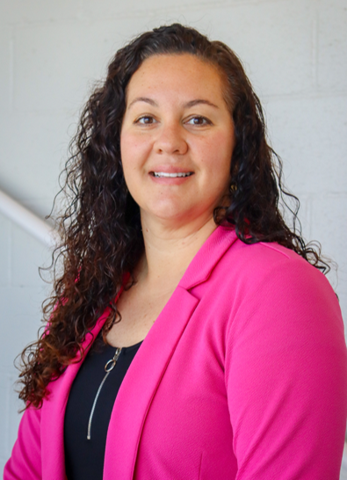
WWW.OID.OK.GOV
I serve as a Community Outreach Coordinator for the Oklahoma Insurance Department, and I am responsible for community outreach efforts across the state.
I speak four languages, which helps me to connect with underserved and minority populations ensuring they are educated on all types of insurance and the services provided by the Department. I meet with diverse groups to build and grow community relationships and provide resources and services that will benefit their communities.
I am originally from Brazil, and I live with my daughter Giovanna in Oklahoma City, Oklahoma.

Slide 3
COMMUNITY AFFAIRS DIVISION
WWW.OID.OK.GOV
Building trust with civic leaders and community groups including Rotary Clubs, Chambers of Commerce, Lions Clubs, and Fire Departments
Planning and participating in community events such as weekly Lunch & Learns
Hosting Coffee with the Commissioner for licensed producers, brokers,
and agents statewide, spending full days in the communities around the state
Engaging with underserved populations such as American Indian, Asian, Black, Hispanic, and rural communities to strengthen relationships
Educating Oklahomans about all forms of insurance and department services
Creating and providing educational materials to agencies, chambers, libraries, nonprofit organizations, and across social media

Slide 4
COMMUNITY OUTREACH TO UNDERSERVED POPULATIONS
WWW.OID.OK.GOV
Role and Responsibilities – Engage directly with communities across the state to build trust and foster strong relationships
Building Trust and Breaking Barriers – Consistently attend events in underserved communities to establish presence and credibility
Engagement Strategies – Invest time and resources into meaningful, long-term community connections
Mapping and Targeting Communities – Visit towns across the state to provide education and outreach
Cultural Approaches – Tailor outreach efforts to each community, recognizing unique cultural perspectives and potential hesitations toward state agencies
Internal Collaboration – Coordinate with internal divisions to ensure accurate and timely responses to community questions

Slide 5
CHAMBERS OF COMMERCE INVOLVEMENTS
WWW.OID.OK.GOV
American Indian Chamber of Commerce Oklahoma – OKC Chapter Luncheon once a month, a fast-paced “networking with purpose” with Indian community leaders, executives, and entrepreneurs
Asian Chamber of Commerce – Leadership Latte, Coffee & Connect, Business After Hours, and Annual luncheons
Black Chamber of Commerce – Breakfast Networking Fresh Start, Annual Awards Luncheon, Co-Working Wednesdays
Hispanic Chamber of Commerce – Monthly coffee meetings and Annual Luncheon to connect with business leaders, community partners, and decision-makers to celebrate leadership
Rural Communities – Monthly visits with the Commissioner (See map)

Slide 6
ALL–DAY MEETINGS WITH THE COMMISSIONER
WWW.OID.OK.GOV
Organize and attend monthly, full-day visits in selected communities
Meet with local agents and brokers in the area to share about updates in the Marketplace and operations of the Department
Join in a lunch meeting with a key community group (e.g., Rotary Club, Chamber of Commerce, Lions Club)
Meet with the Fire Chief, the Mayor, and the City Manager to discuss how fire protection ratings can help lower insurance premiums
Connect with a business networking group over afternoon coffee or visit a signature destination within the community
Photos are taken and shared on our social media platforms with tags of the groups we meet

Slide 7
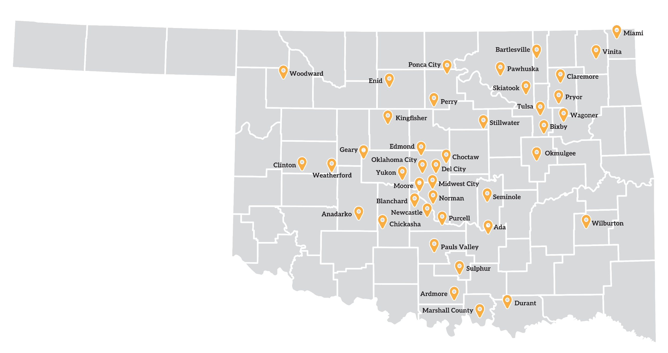
TOWNS VISITED BY THE COMMISSIONER
WWW.OID.OK.GOV
40+ communities visisted since 2022

Slide 8
WEEKLY LUNCH & LEARNS
WWW.OID.OK.GOV
OID is a member of the Mix and Mingle Business Networking Group, connecting business professionals with the community
Members of this group are driven professionals fostering collaboration and growth among like-minded individuals
This group has 15 chapters statewide, each hosting 35-70 attendees
Focuses on building genuine relationships, giving back, and strengthening local communities, encouraging collaboration between organizations and information sharing
Provides an opportunity to highlight OID resources and direct consumers to the appropriate division

Slide 9
MONTHLY CALLE DOS CINCO CIVIC GROUP MEETINGS
WWW.OID.OK.GOV
Attend monthly meetings with Calle Dos Cinco Civic Group to connect with Latino property owners, commercial tenants, and community partners who are deeply connected to the Hispanic community
The organization is led by a diverse board and partners with the City of Oklahoma City
Its mission supports Capitol Hill as a hub of Oklahoma history and Latino culture
It facilitates development in the Historic Capitol Hill Business District
It focuses on preserving history, culture, and community
Regular attendance helps build trust and visibility
This ongoing engagement has proven to be one of the most effective and influential approaches for reaching and serving the Hispanic community

Slide 10
IN PERSON OR ONLINE PRESENTATIONS
WWW.OID.OK.GOV
We receive online requests to present at various events
Requestors include agencies, chambers of commerce, libraries, nonprofit organizations, and other community partners
Presentation topics cover who we are and the services we provide, what we do, and the role of insurance
We explain what insurance is and why it is important for consumers
Having adequate coverage can help protect their well-being and financial stability
Presentations are tailored to each audience based on age (Teens/adults/seniors)
Sessions are delivered in person or via Teams, depending on location
Educational materials are provided to expand insurance education statewide

Slide 11
OID INFORMATIONAL BOOTH
WWW.OID.OK.GOV
Receive and coordinate requests at community events including:
Hispanic Chamber Annual Luncheon
Oklahoma City Black Chamber of Commerce Annual Event
Diabetes Advocacy Day at the State Capitol
Senior Resource Fairs
Oklahoma Traffic Safety Summit
MARCs (Multi-Agency Resource Centers) to assist homeowners and communities impacted by disasters
Provide educational materials to support insurance education
Engage directly with consumers to answer questions and connect them with available OID services

Slide 12
OID’S MAIN RESOURCES SHARED WITH THE COMMUNITY
WWW.OID.OK.GOV
Consumer Assistance Division to support consumers with insurance questions
Life Insurance Policy Locator to assist with locating lost life insurance policies
Home Inventory to protect what consumers own and its value
EAGLE Mediation Program to assist both parties to settle insurance conflicts
OK Ready - Strengthen Oklahoma Homes to help residents reinforce their homes
Insurance & Financial Resource Guide explains a simple five steps path to success
Health Insurance Resource Guide to help consumers choose the right health coverage
2026 Legislative Policy Updates to strengthen Consumer Protection

Slide 13
CONSUMER ASSISTANCE DIVISION
WWW.OID.OK.GOV
Investigates complaints against insurance companies, agents and adjusters submitted by Oklahoma consumers
Answers general insurance questions on all lines of insurance
This division receives over 15K calls annually
10M dollars recovered and returned to consumers
File a complaint with OID. Your complaint will be assigned to a claim's analyst, and we will contact the company. By law, the company has 20 days from receipt of our letter to respond
EAGLE Mediation is a free service helping resolve disputes instead of going to court when a consumer and insurer are unable to reach an agreement (Ending Arguments Gently, Legally and Economically) Please note: This is a voluntary program, not mandated for participation

Slide 14
LIFE INSURANCE POLICY LOCATOR
WWW.OID.OK.GOV
Free online tool to connect families with lost or unclaimed life insurance benefits
Policy locator requests are free, secure and confidential, and companies are responsible for contacting beneficiaries if any matches are found
OID helped reclaim over $200M in unclaimed life insurance benefits
The funds remain with the insurance company until the deceased would have reached age 100, and are then transferred to the State Treasurer’s Office as unclaimed property
Visit oid.ok.gov and enter life insurance policy locator in the search box

Slide 15
HOME INVENTORY
WWW.OID.OK.GOV
Understand the importance: A home inventory helps you know what you own and its value, making insurance claims faster and easier
Choose an organization method: List items by room, category (e.g., furniture, electronics), value, or purchase date
Document your belongings: Write descriptions and take photos or videos to support your inventory
Use available tools: Take advantage of checklists, downloadable forms, or mobile apps to create and maintain your inventory
Store it safely: Keep your inventory and important documents in a secure location away from your home and maintain backup copies
OID offers a free NAIC Home Inventory app for iPhone and Android devices

Slide 16
EAGLE MEDIATION PROGRAM
WWW.OID.OK.GOV
The EAGLE Mediation Program is a free, voluntary way to resolve insurance disputes without going to court.
It helps consumers and insurers reach agreements through mediation.
The program is certified by the Oklahoma Supreme Court.
It aims to resolve conflicts early and avoid lawsuits.
It supports the Oklahoma Insurance Department goal of reducing litigation costs.
Mediation often leads to higher satisfaction than court cases.
The department promotes mediation as a preferred way to resolve disputes.
Parties can still go to court if mediation fails.
Please note: This is a voluntary program, not mandated for participation

Slide 17
OK READY – STRENGTHEN OKLAHOMA HOMES
WWW.OID.OK.GOV
OKReady offers a grant up to $10,000 per approved household
Approved construction strengthens homes to the IBHS FORTIFIED Home standard (Insurance Institute for Business & Home Safety)
Grant funds are paid directly to contractors once the IBHS FORTIFIED certification is received
OKReady has completed over 300 houses and plans to issue 1,000 grants in 2026
Applications are open statewide
Stronger Roof = safer home, fewer claims, and less hassle
Grants may not cover the full cost of roof replacement
Open to eligible homeowners with a Homestead Exemption
Homeowners may qualify for insurance premium discounts (varies by carrier)

Slide 18
INSURANCE & FINANCIAL RESOURCE GUIDE
WWW.OID.OK.GOV
Establish Goals: Identify what matters most to you when planning for major life goals like buying a home, retirement, family, or your legacy
Assess Your Situation: Review your finances, including savings, investments, insurance, assets, and any debts
Identify Gaps: After reviewing your finances, a professional can help identify areas that need attention
Map it Out: Make financial decisions that address gaps while aligning with your goals, timeline, and risk
Maintain and Optimize: A financial strategy requires ongoing adjustments to stay aligned with priorities and goals

Slide 19
HEALTH INSURANCE RESOURCE GUIDE
WWW.OID.OK.GOV
Identify the coverage pathway that applies to you: Marketplace (HealthCare.gov), employer-sponsored or self-funded plans, Medicare, short-term plans, or association plans
Compare at least three plans based on total annual cost (monthly premium plus expected out-of-pocket expenses)
Review key details carefully, including provider networks, covered medications, prior authorization requirements, and coverage for services you regularly use (such as specialists, maternity care, or mental health services)
Enroll during the Open Enrollment period or determine if you qualify for a Special Enrollment Period
Keep all plan documents for your records and understand your rights: appeal processes are available, including external review options through the Oklahoma Insurance Department (OID) and the Centers for Medicare & Medicaid Services (CMS)

Slide 20
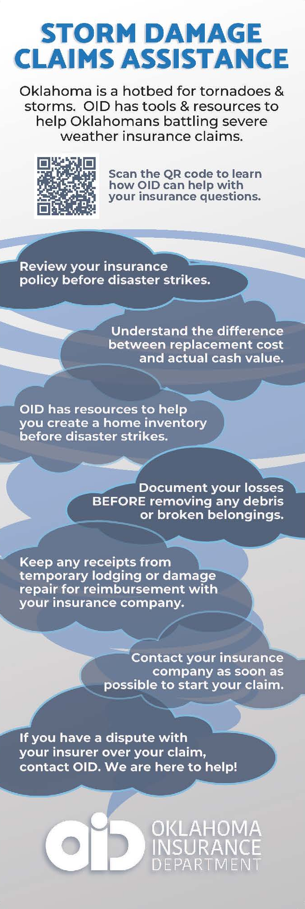
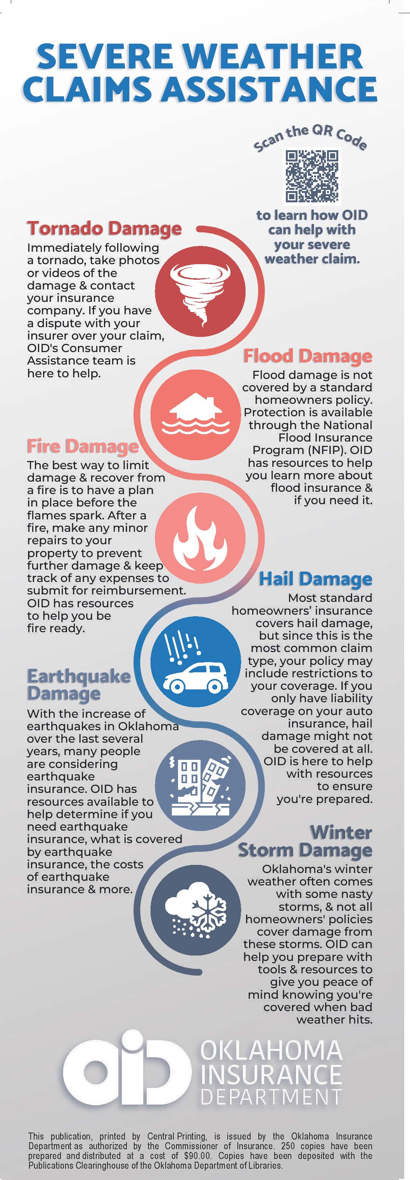
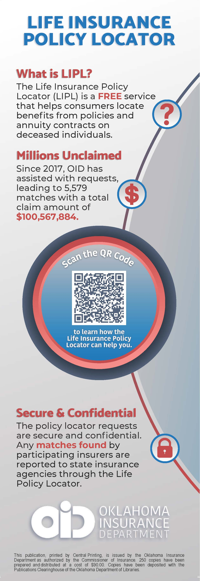
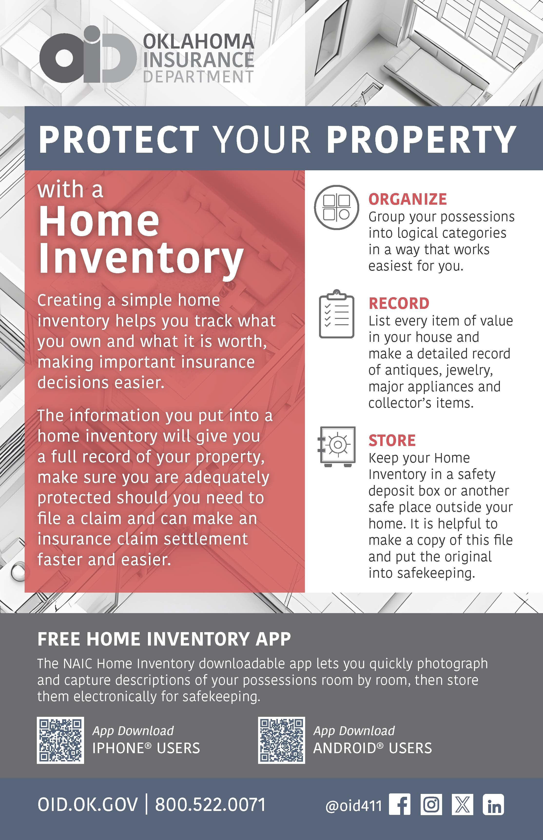
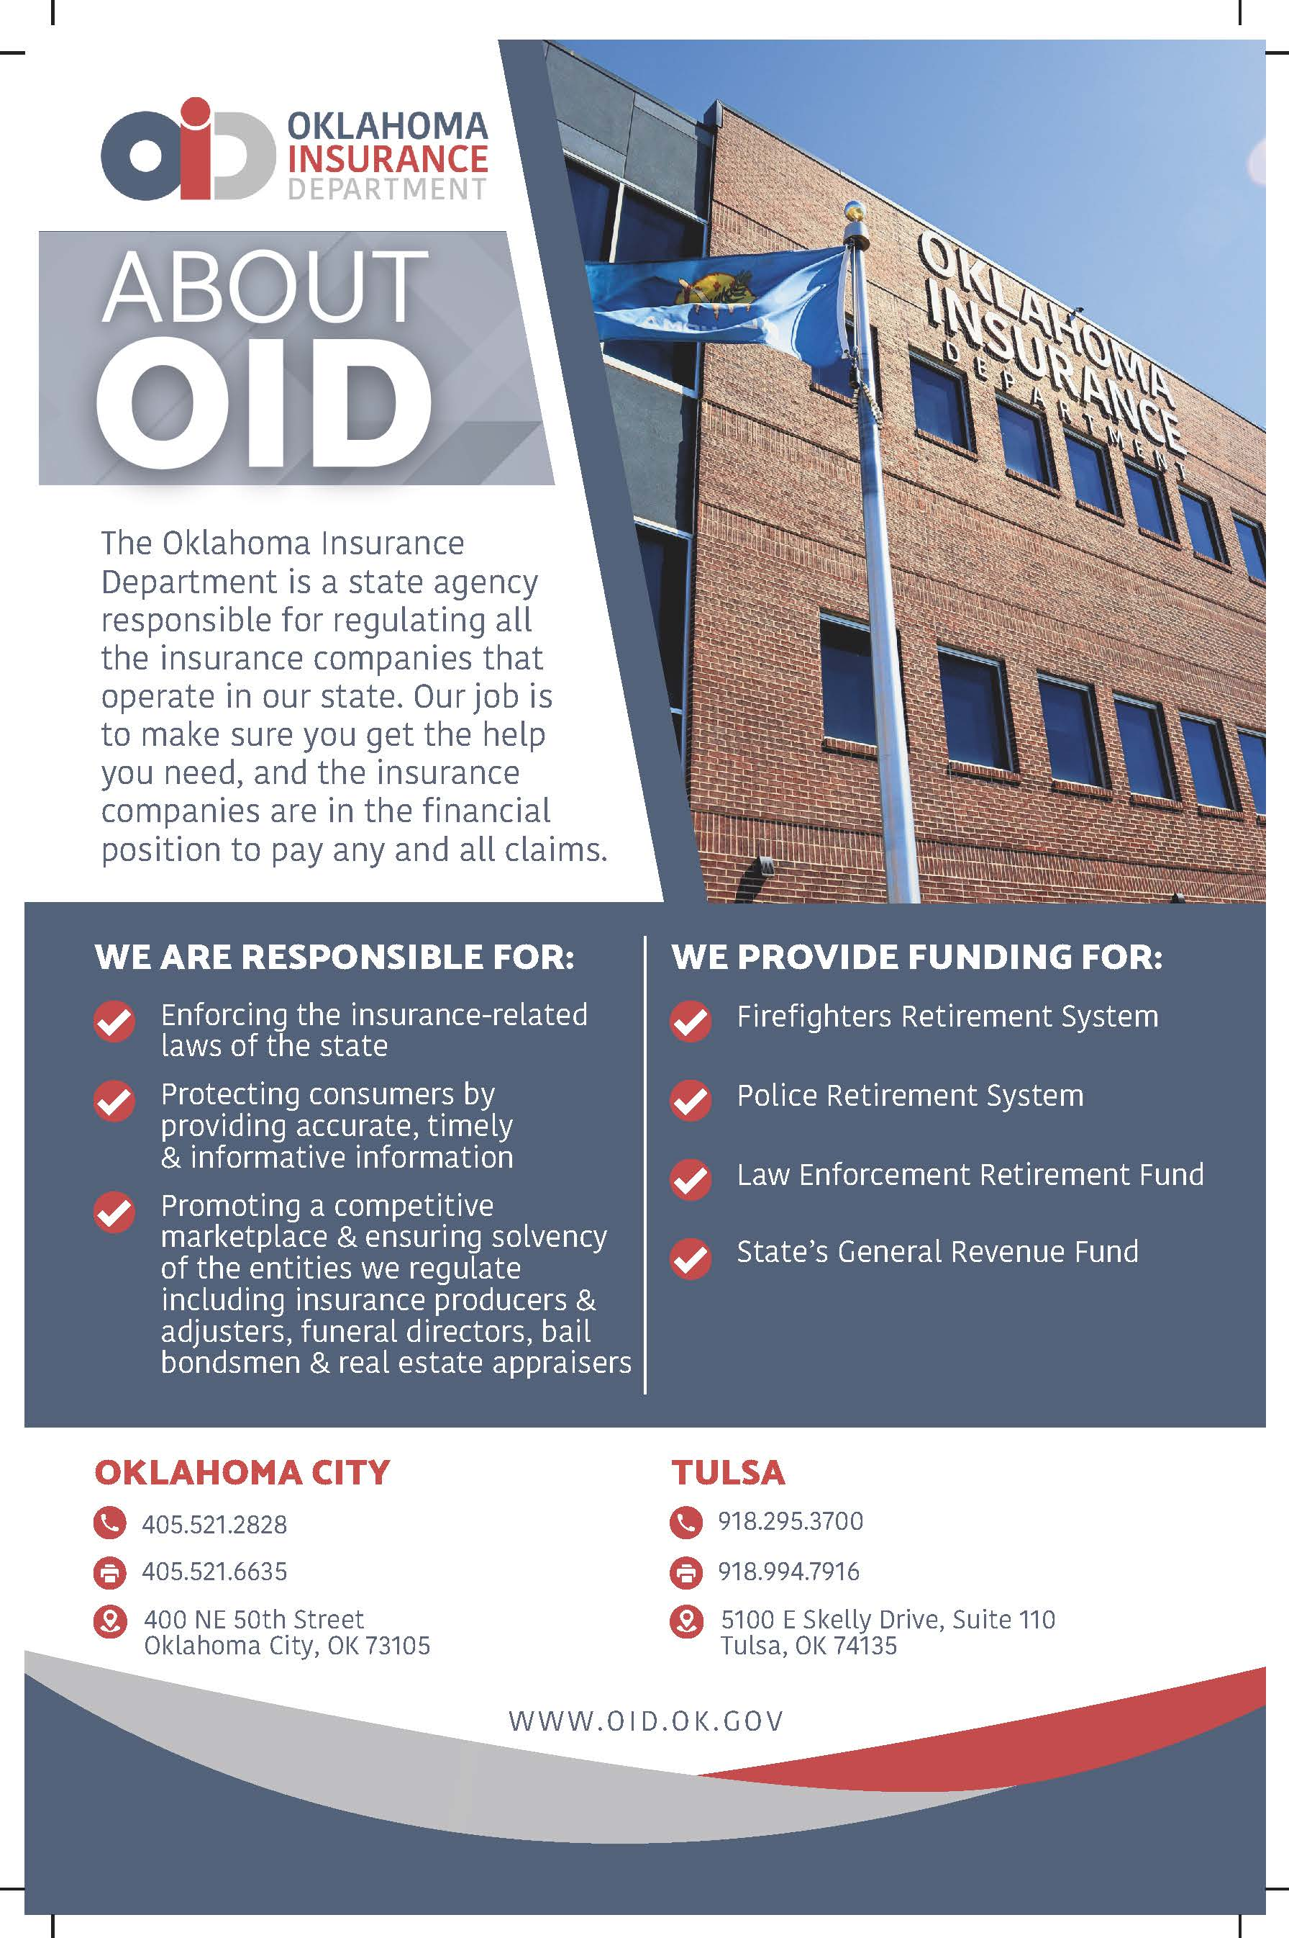
EDUCATIONAL MATERIALS
WWW.OID.OK.GOV
Handouts are distributed based on the audience and seasonal risks to provide
consumers with the most relevant insurance information.
About OID
Home Inventory
Life Insurance
Severe Weather
Storm Damage

Slide 21

WWW.OID.OK.GOV

Slide 22






WWW.OID.OK.GOV
THANK YOU
800-522-0071
@oid411
www.oid.ok.gov
@oid411
Oklahoma Insurance Department
Oklahoma Insurance Department
Subscribe to OID News – www.oid.ok.gov/subscribe

