Slide 1
The Next Generation of Fraud
What Consumer Affairs Professionals Need to Know
Brent Walker, Director of Government Relations
September 22, 2026

Slide 2
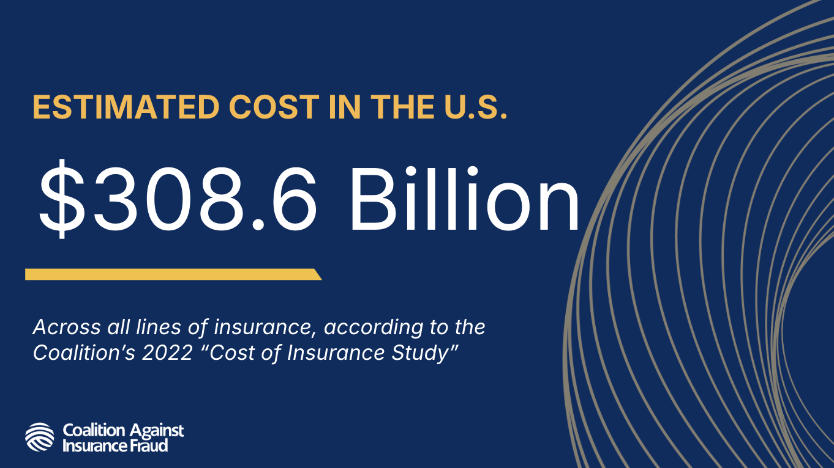

Slide 3
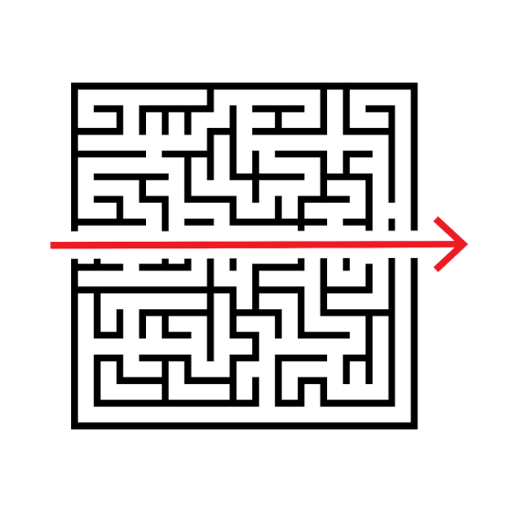
Insurance fraud used to be:
Opportunistic
Individual
Local

Slide 4
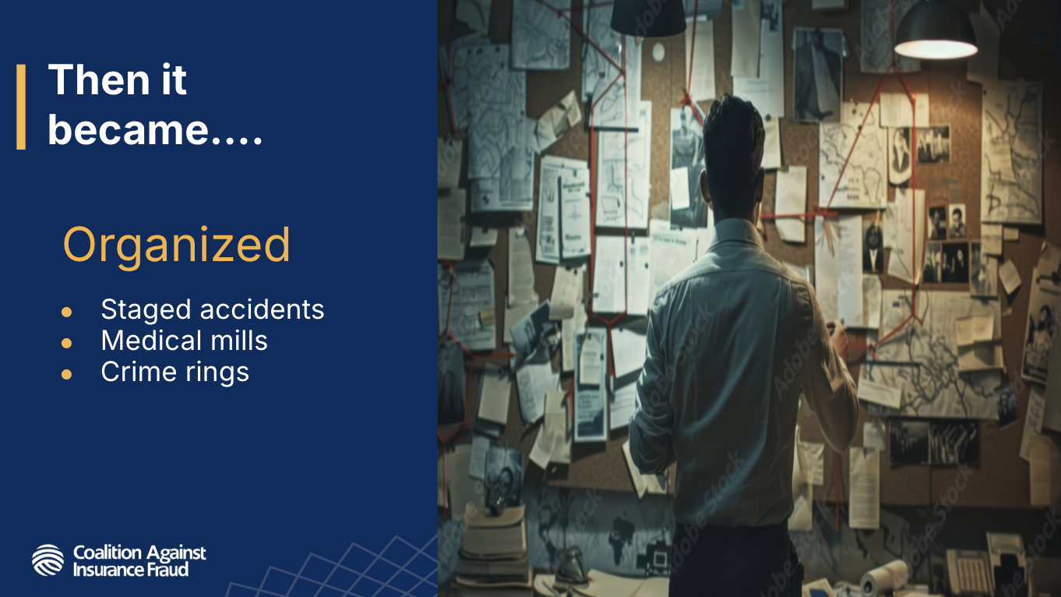

Slide 5
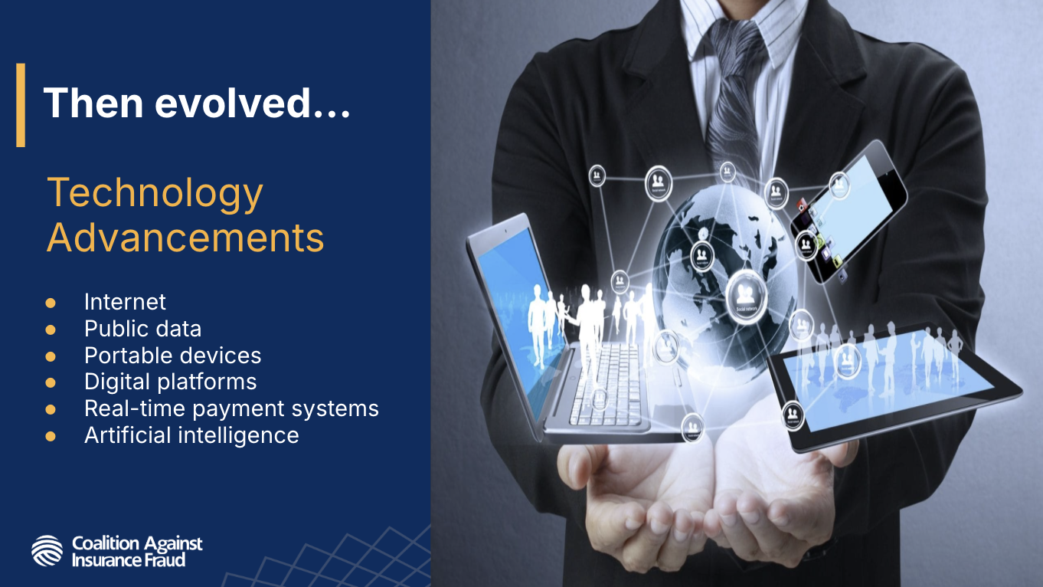

Slide 6

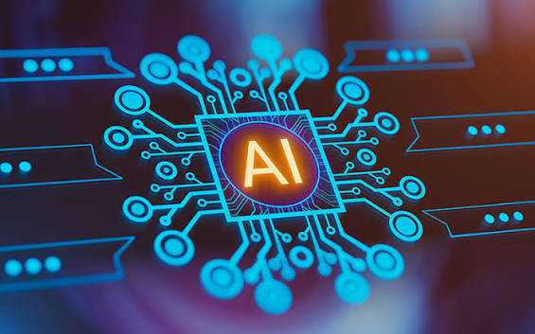

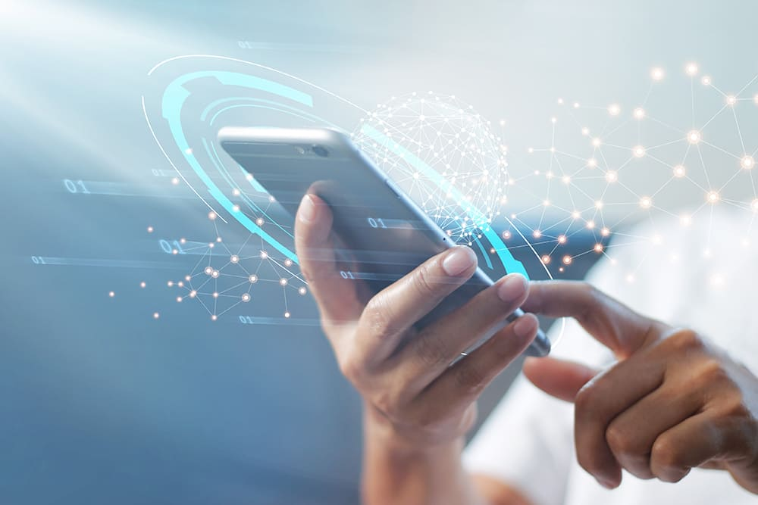
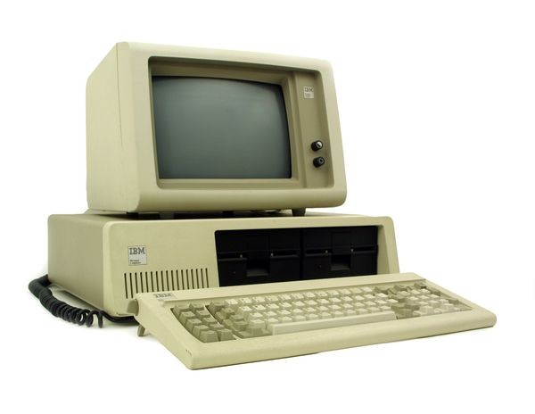
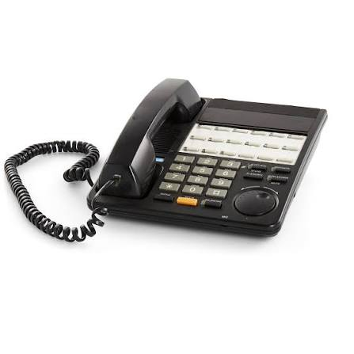
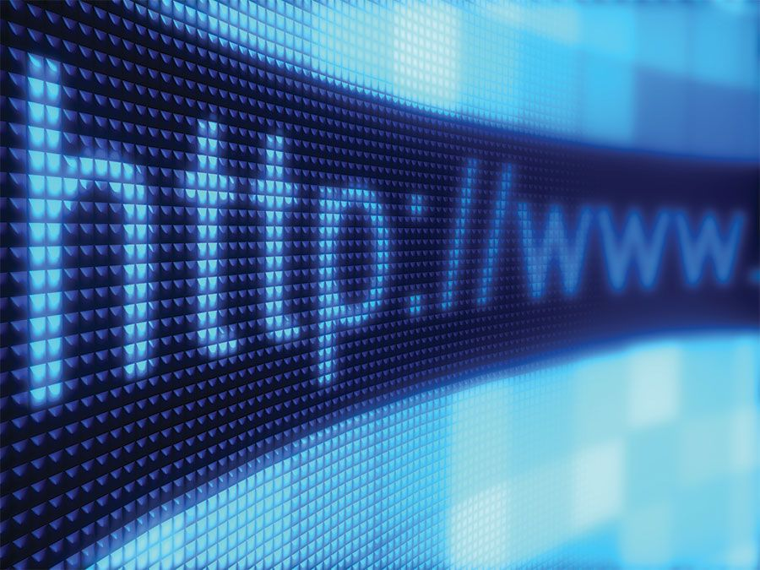
FRAUD HAS ALWAYS ADAPTED
Fraudsters exploit new technologies as quickly as they emerge.

Slide 7
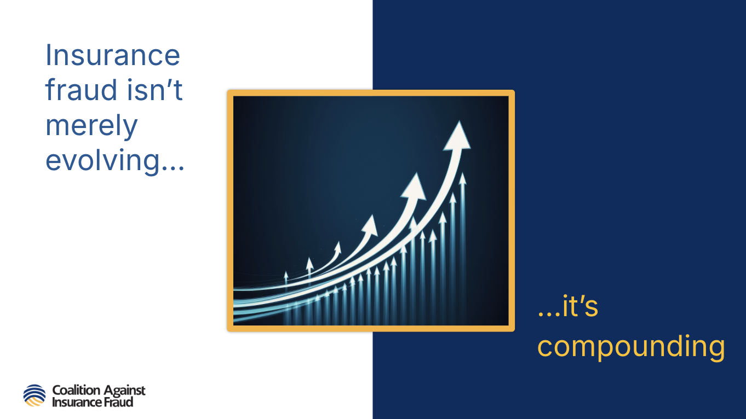

Slide 8
The Insurance Industry Is Up Against Something Unlike It’s Ever Seen
The Next Generation of Fraud

Slide 9
The Insurance Industry Is Up Against Something Unlike It’s Ever Seen
… and so are you
The Next Generation of Fraud

Slide 10
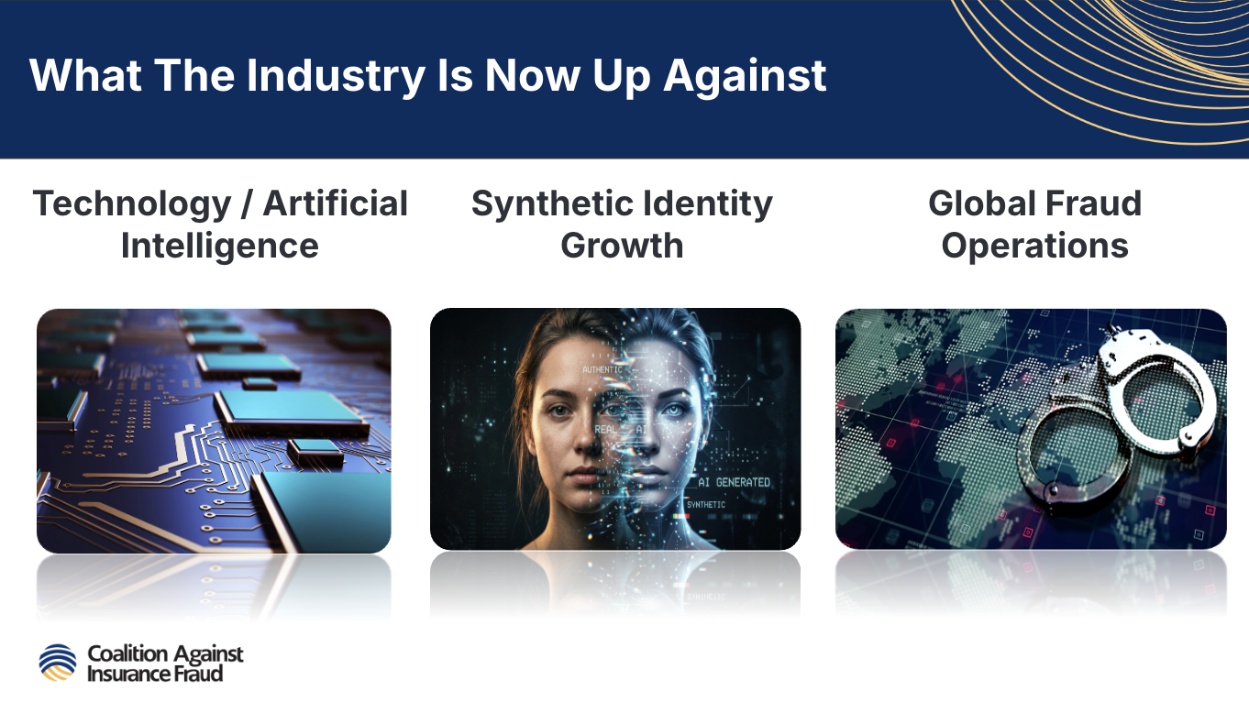

Slide 11
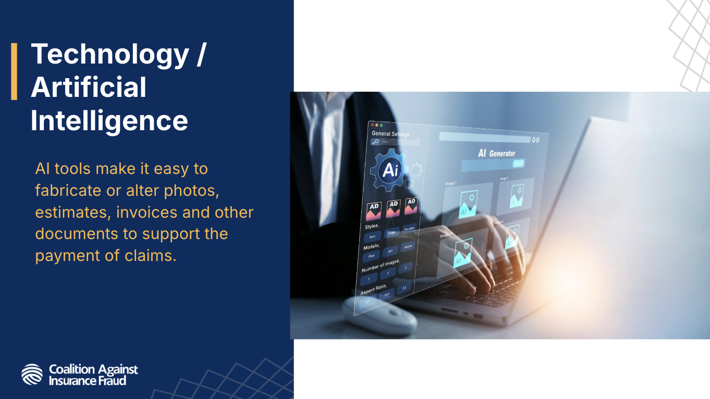

Slide 12
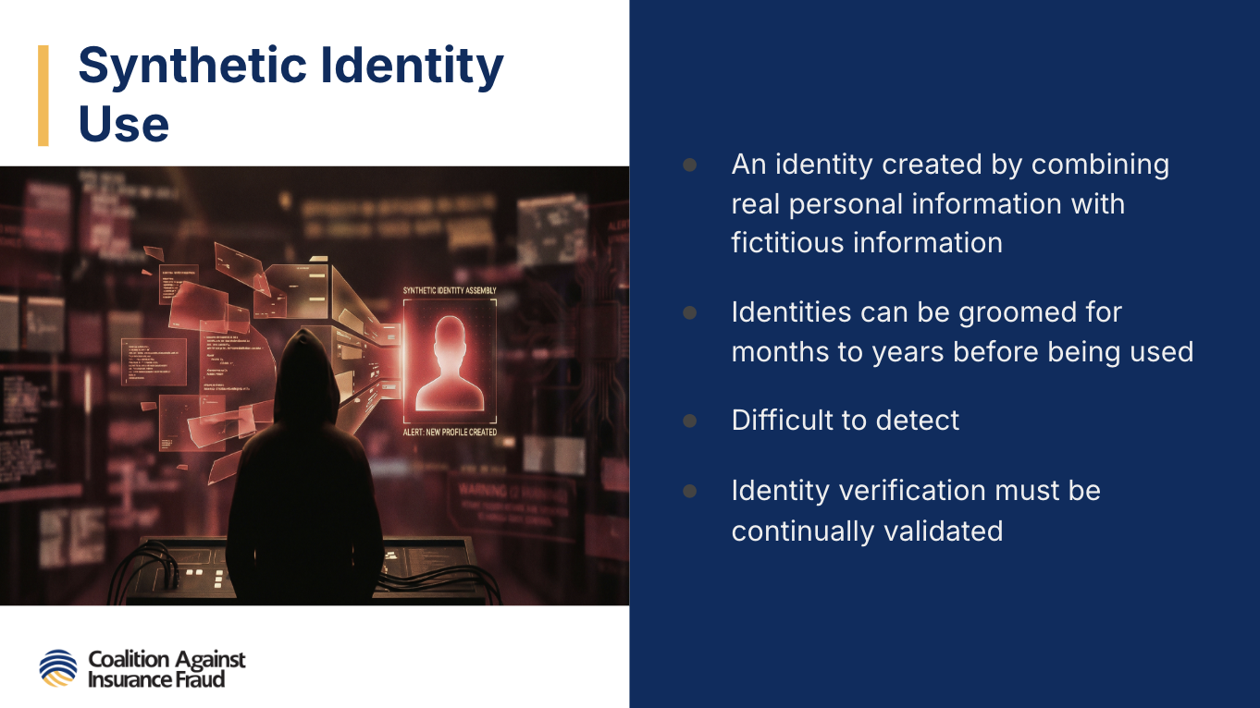

Slide 13
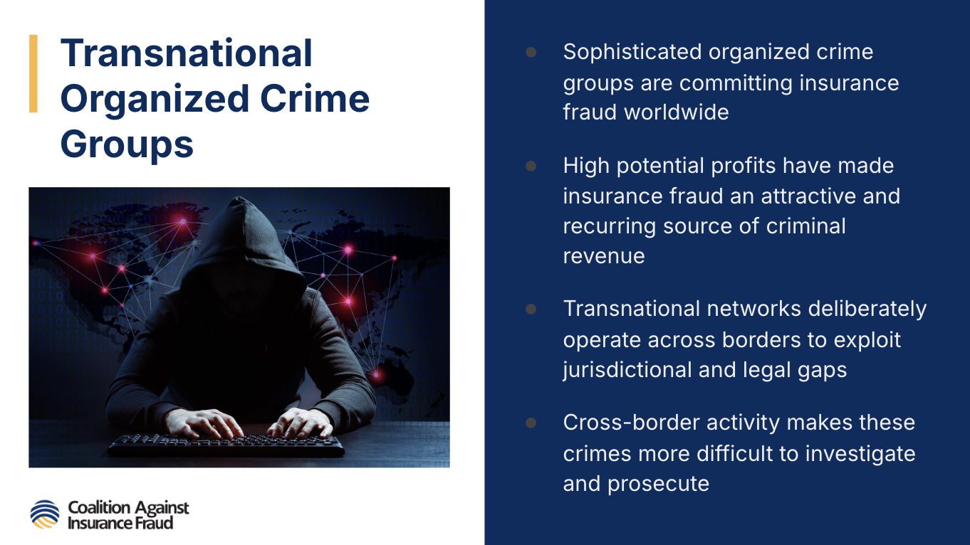

Slide 14
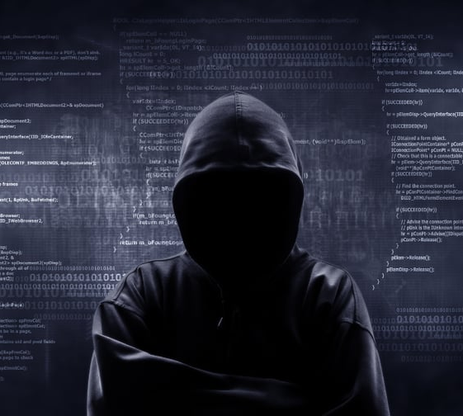
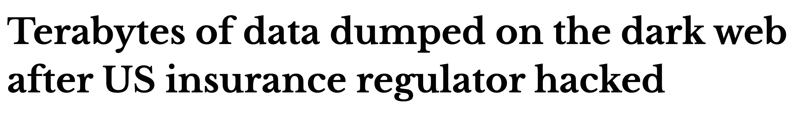
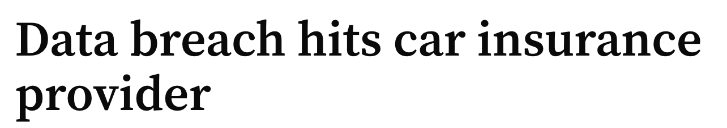
IT GETS WORSE…
Data breach at Department of Insurance exposed personal information
Hackers claim millions of patient records stolen during data breach at healthcare giant

Slide 15
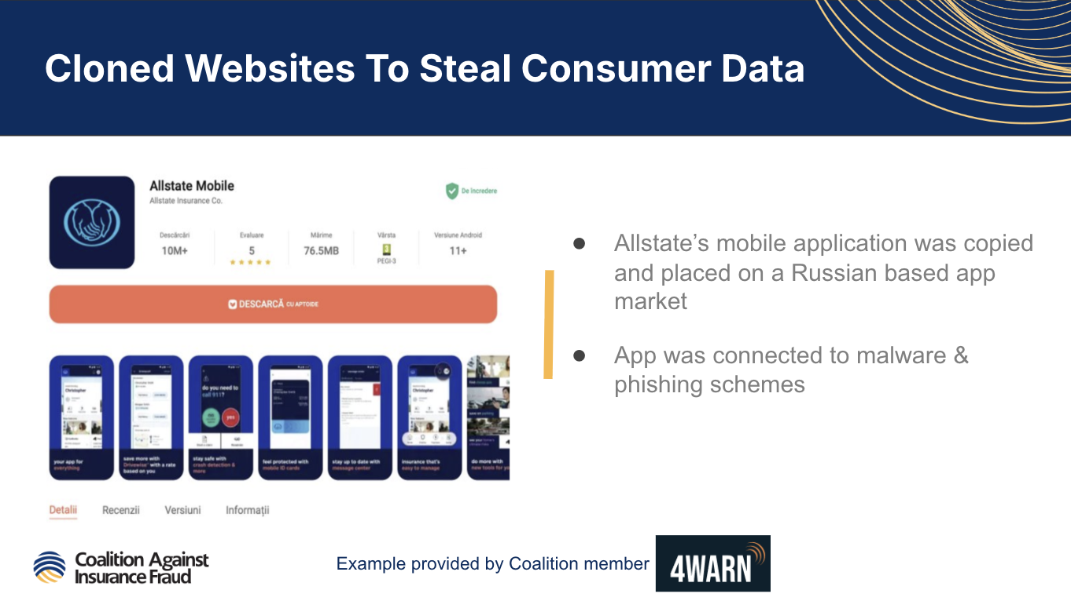

Slide 16
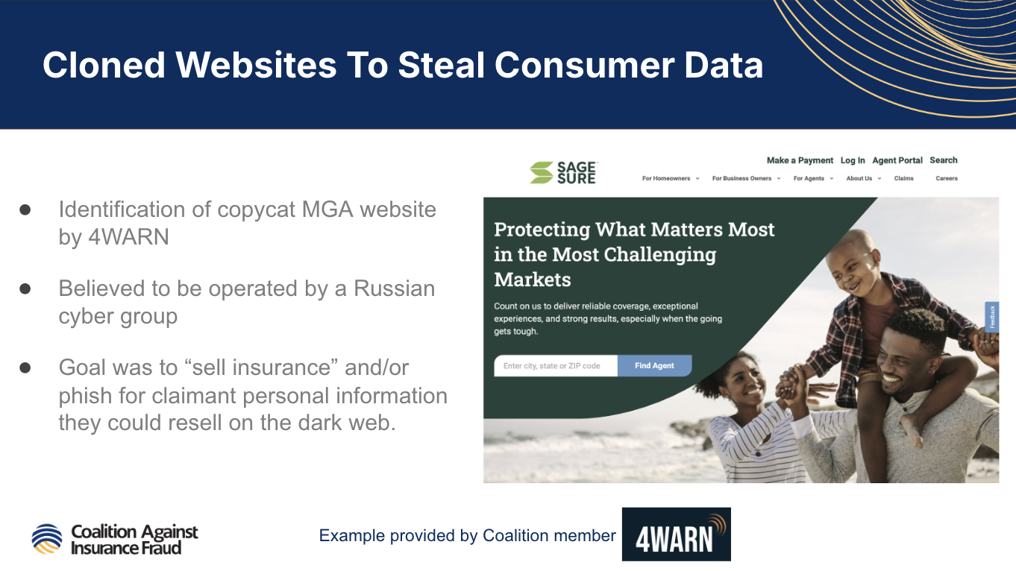

Slide 17
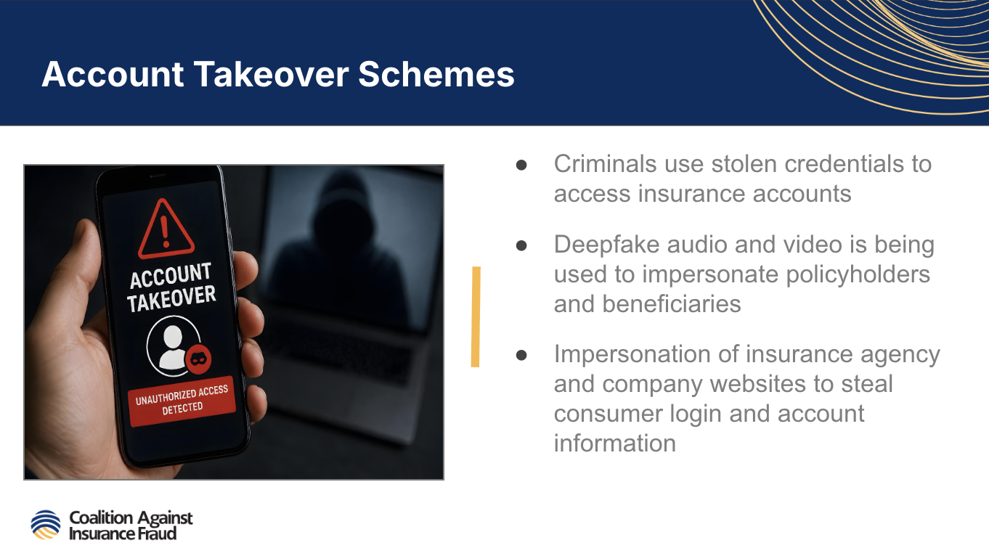

Slide 18
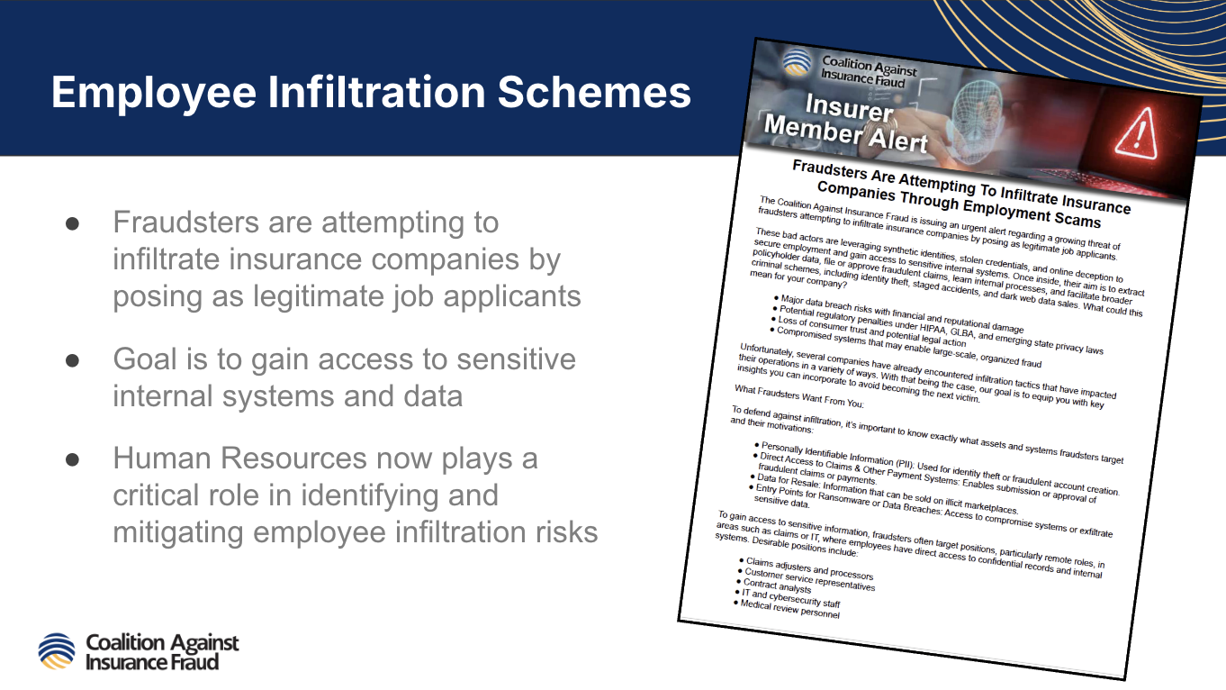
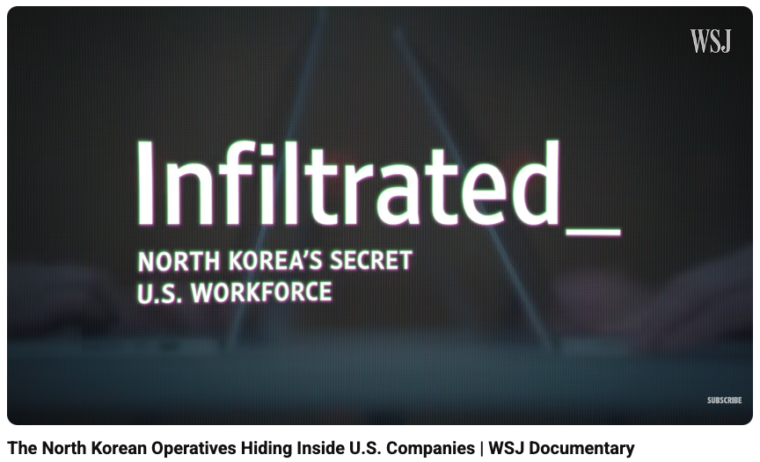
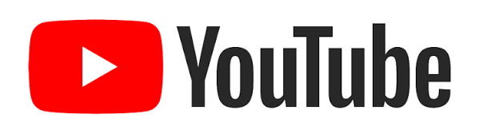
Notes:
https://www.youtube.com/watch?v=RUhdmIFpb-w

Slide 19
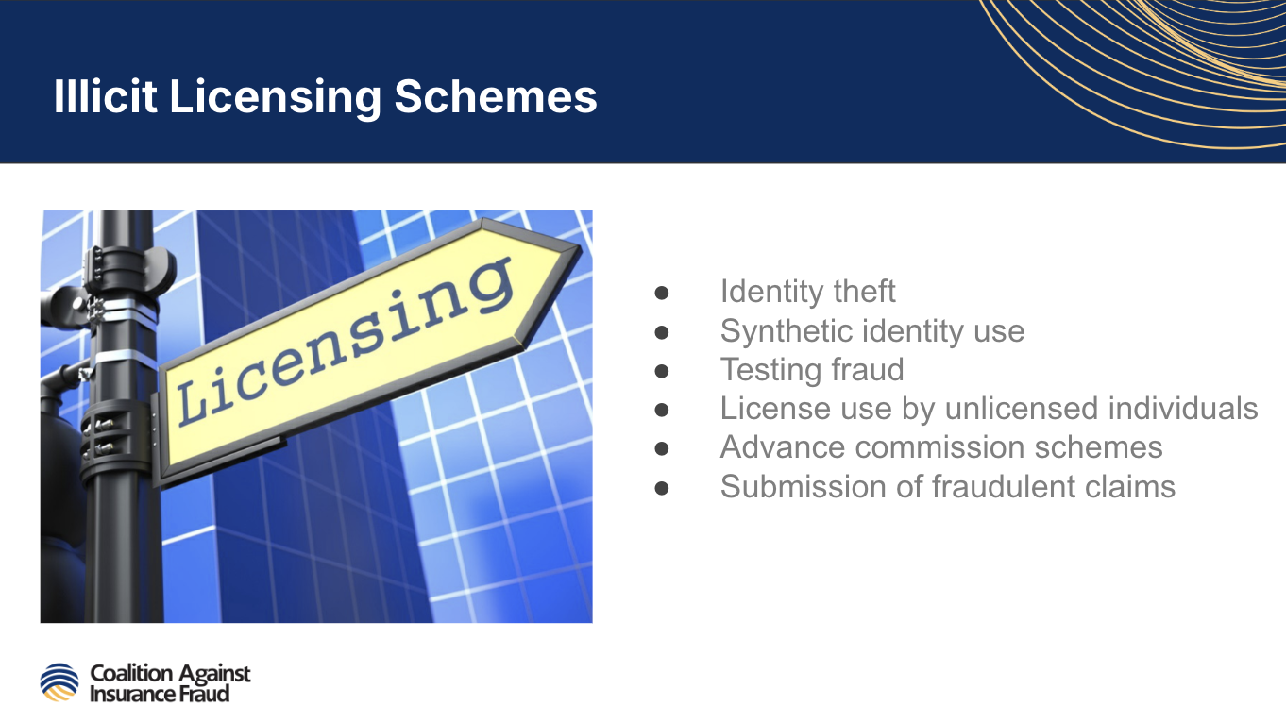

Slide 20
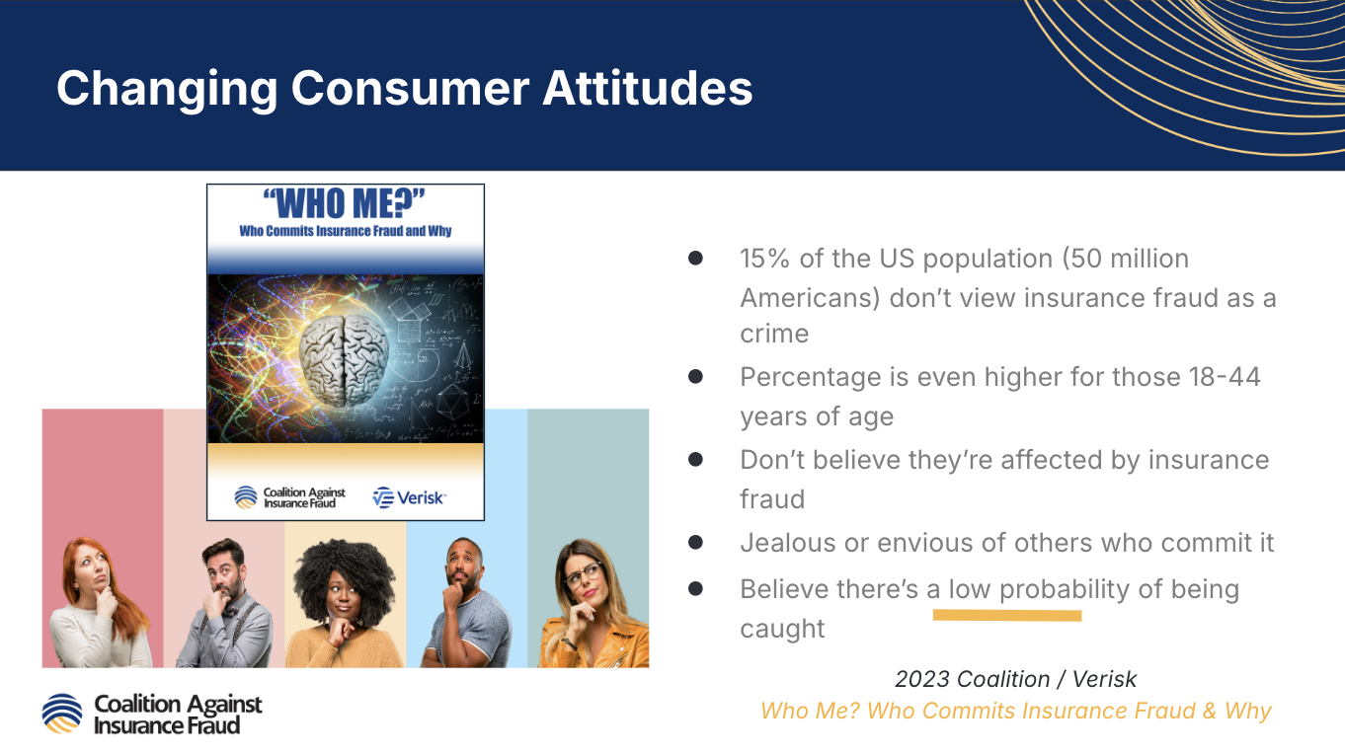

Slide 21
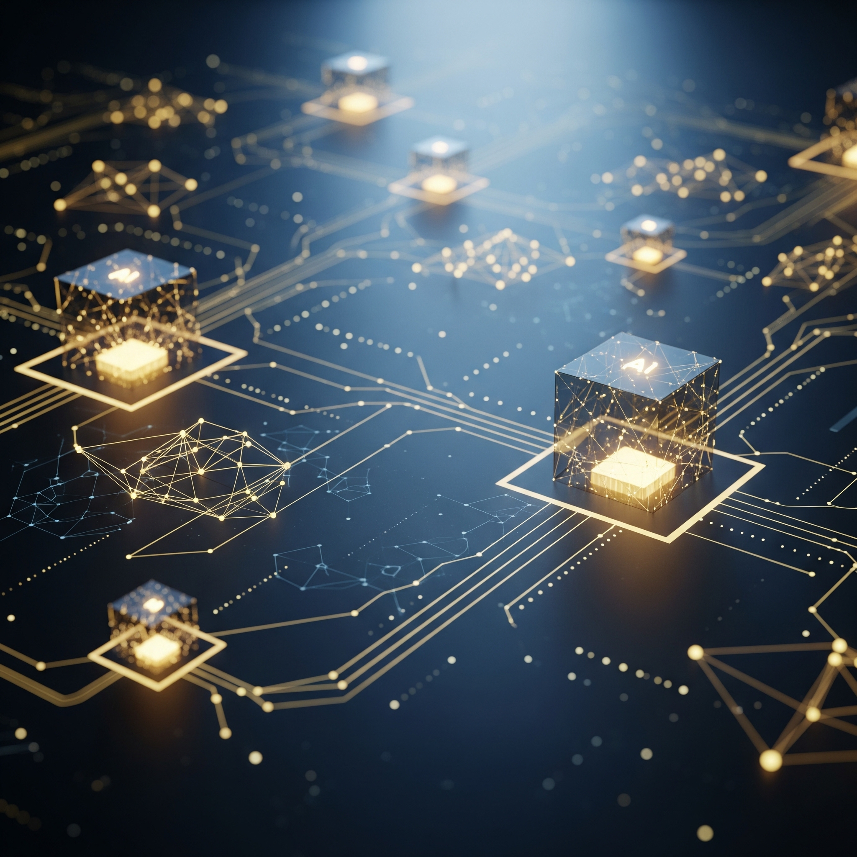
WHAT MAKES THIS THE
“NEXT GENERATION”?
SPEED
Automation can accelerate fraud from days to minutes.
SCALE
One fraudster can generate large volumes of activity, from anywhere.
AUTOMATION
Allows fraudulent activity to occur faster and at a greater scale, 24/7.
AUTHENTICITY
AI makes malicious or fraudulent activity appear legitimate.
Honest customers can get lost in the noise.

Slide 22
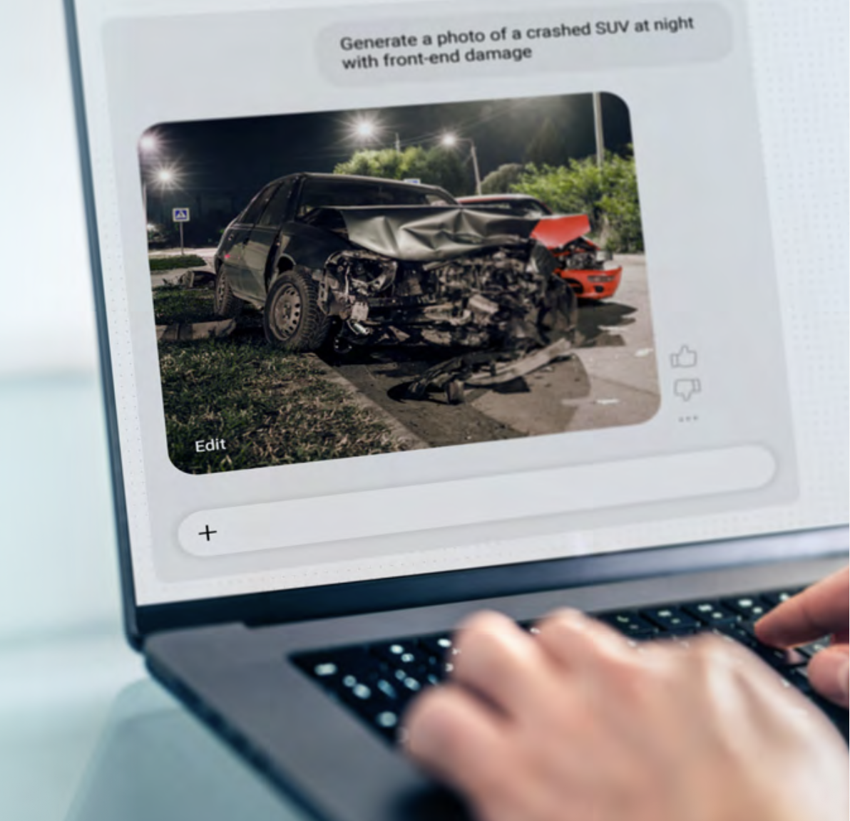
WHAT DO WE TRUST?
Verisk Image

Slide 23
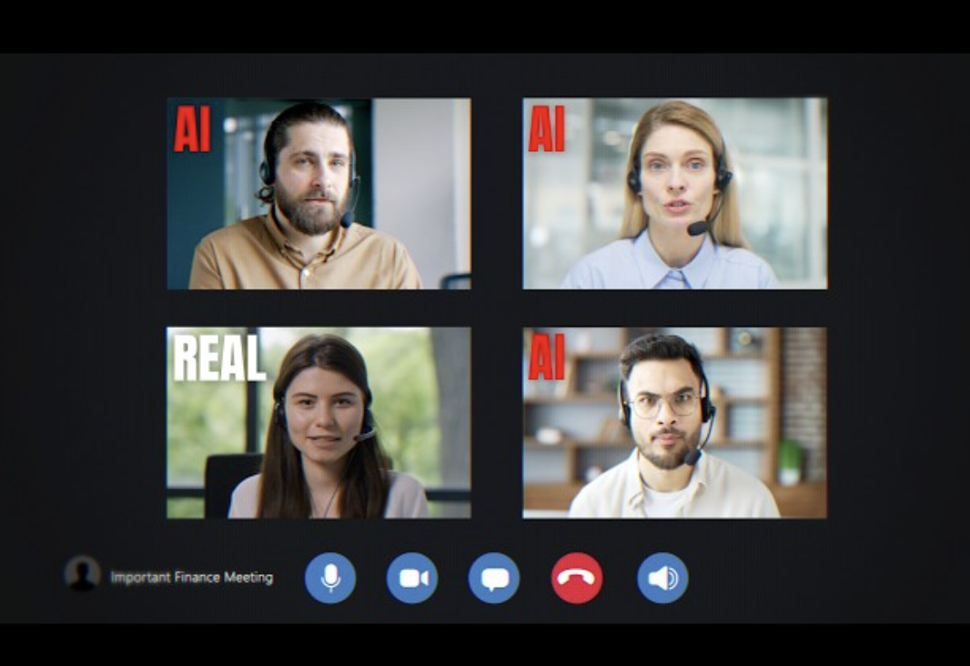
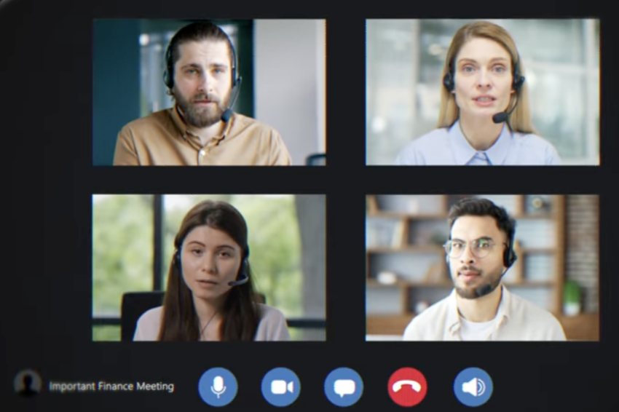
WHO DO WE TRUST?
Verisk Image
Notes:
The Deepfake AI Meeting That Stole $25 Million
In January 2024, a finance employee at global engineering and design firm the Arup Group received a suspicious email from the company's CFO, asking her to carry out a series of external transactions. Suspicious, she ignored the email. But when she received a video meeting invitation to clarify the situation, her suspicions went away. After all - everyone looked and sounded completely normal. Except...

Slide 24
WHO DO WE TRUST?
Verisk Image
Notes:
The Deepfake AI Meeting That Stole $25 Million
In January 2024, a finance employee at global engineering and design firm the Arup Group received a suspicious email from the company's CFO, asking her to carry out a series of external transactions. Suspicious, she ignored the email. But when she received a video meeting invitation to clarify the situation, her suspicions went away. After all - everyone looked and sounded completely normal. Except...

Slide 25
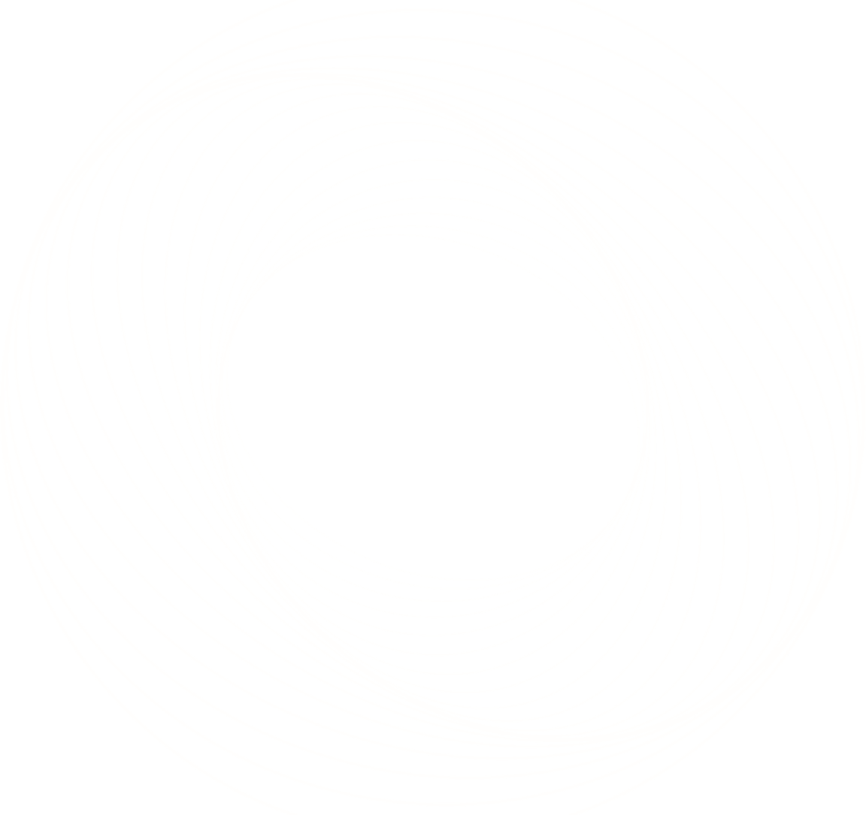
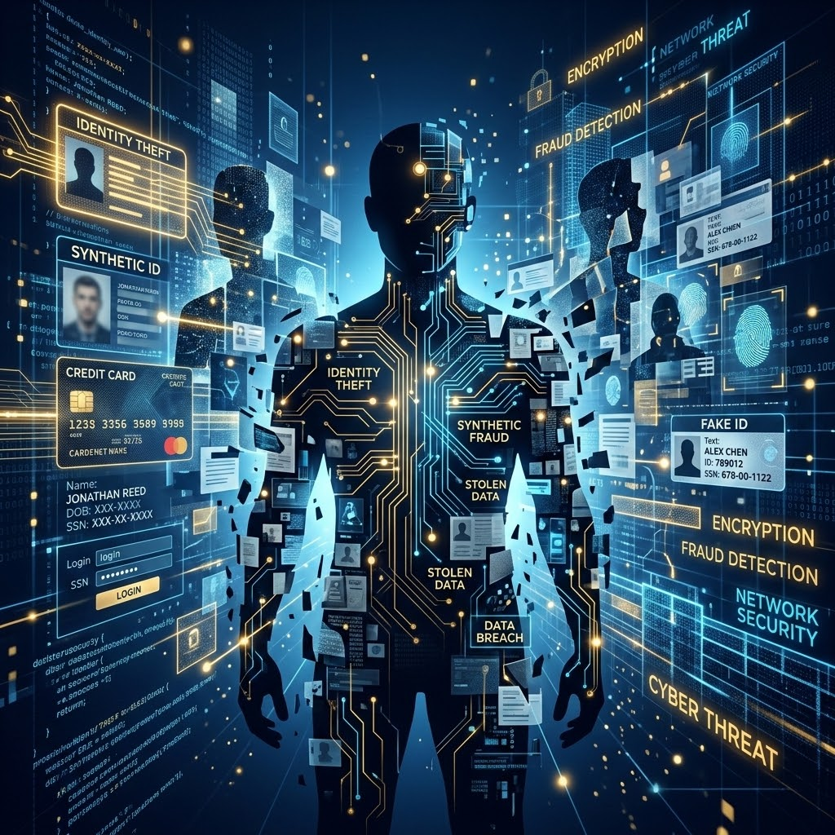
FRAUD CAN MOVE THROUGH
TRUSTED SYSTEMS
IDENTITY
Create or use a plausible identity or relationship.
ACCESS
Create or compromise an account.
ACTIVITY
Initiate transaction with stolen or believable data to test.
AMPLIFICATION
If successful, use automation or AI to increase activity.

Slide 26
Do not edit
How to change the design
What would make you question whether a digital interaction is legitimate?
The Slido app must be installed on every computer you’re presenting from

Slide 27
What this means for consumer complaints

Slide 28
KYC
Verisk Image

Slide 29
KYC = Know Your Customer
Verisk Image

Slide 30
KYC = Know Your Customer Consumer
Verisk Image

Slide 31
KYC = Know Your Customer Consumer, Complainant
Verisk Image

Slide 32
KYC = Know Your Customer Consumer, Complainant
Trust starts with knowing who you're dealing with.
WHO IS THIS PERSON?
Establish the identity behind the interaction.
WHO DO THEY REPRESENT?
Determine whether they are acting for themselves or someone else.
WHAT IS THEIR RELATIONSHIP?
Understand why they are submitting the complaint.
DOES IT MAKE SENSE?
Look for inconsistencies, anomalies or connections..
Verisk Image

Slide 33
Do not edit
How to change the design
Who can file a complaint in your state?
Select all that apply.
The Slido app must be installed on every computer you’re presenting from

Slide 34
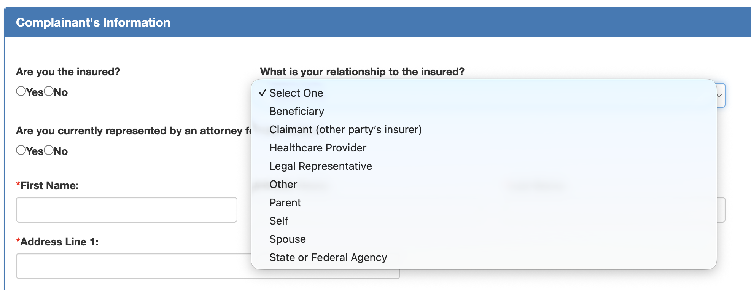
Different states handle it differently…
Notes:
Alabama

Slide 35
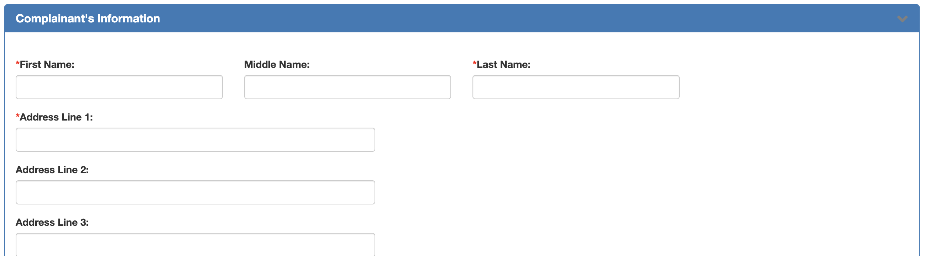
Different states handle it differently…
Notes:
Arkansas, Delaware, Idaho

Slide 36
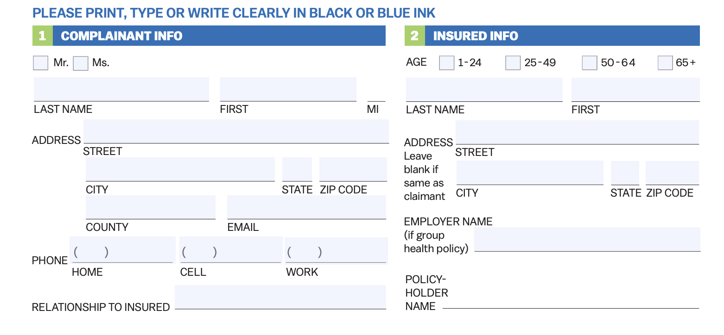
Different states handle it differently…

Slide 37
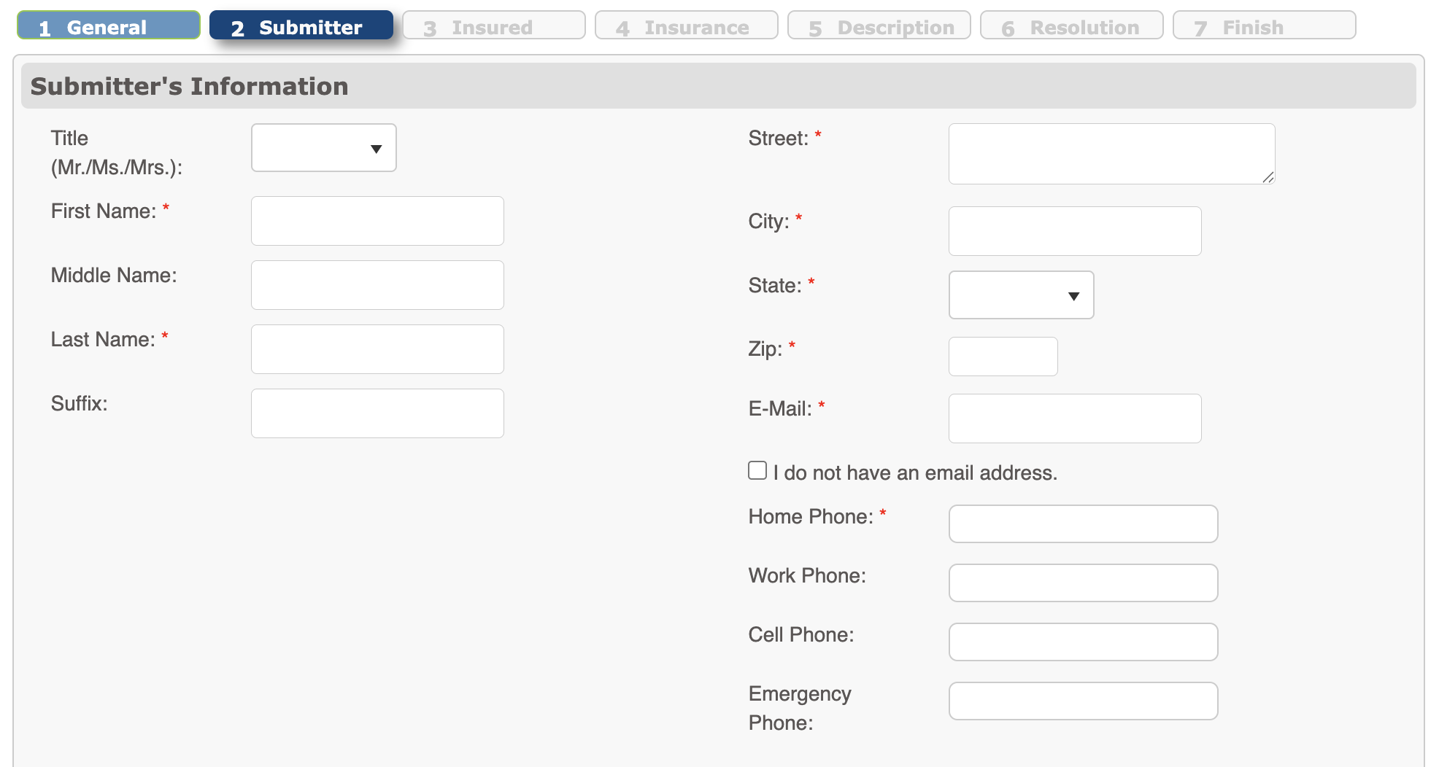
Different states handle it differently…
Notes:
Louisiana

Slide 38
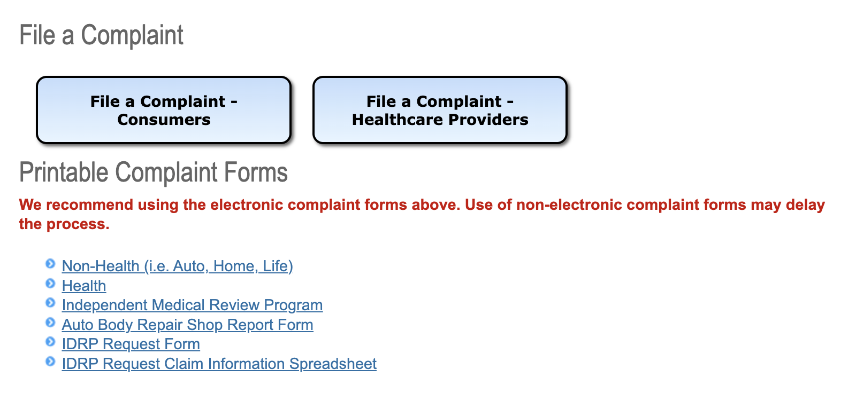
Different states handle it differently…
Notes:
California

Slide 39
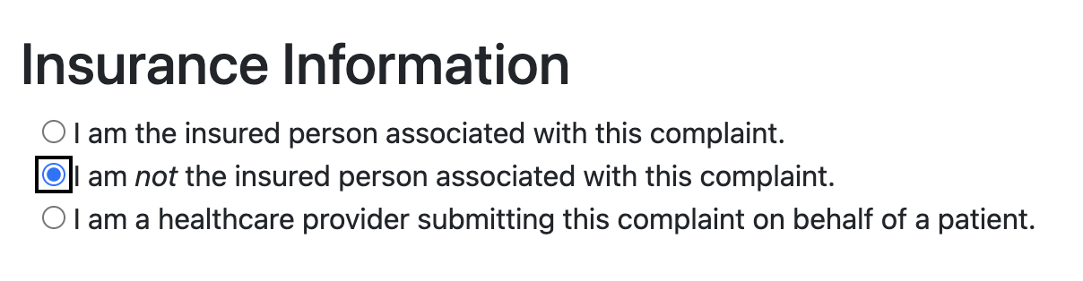
Different states handle it differently…
Notes:
Ohio

Slide 40
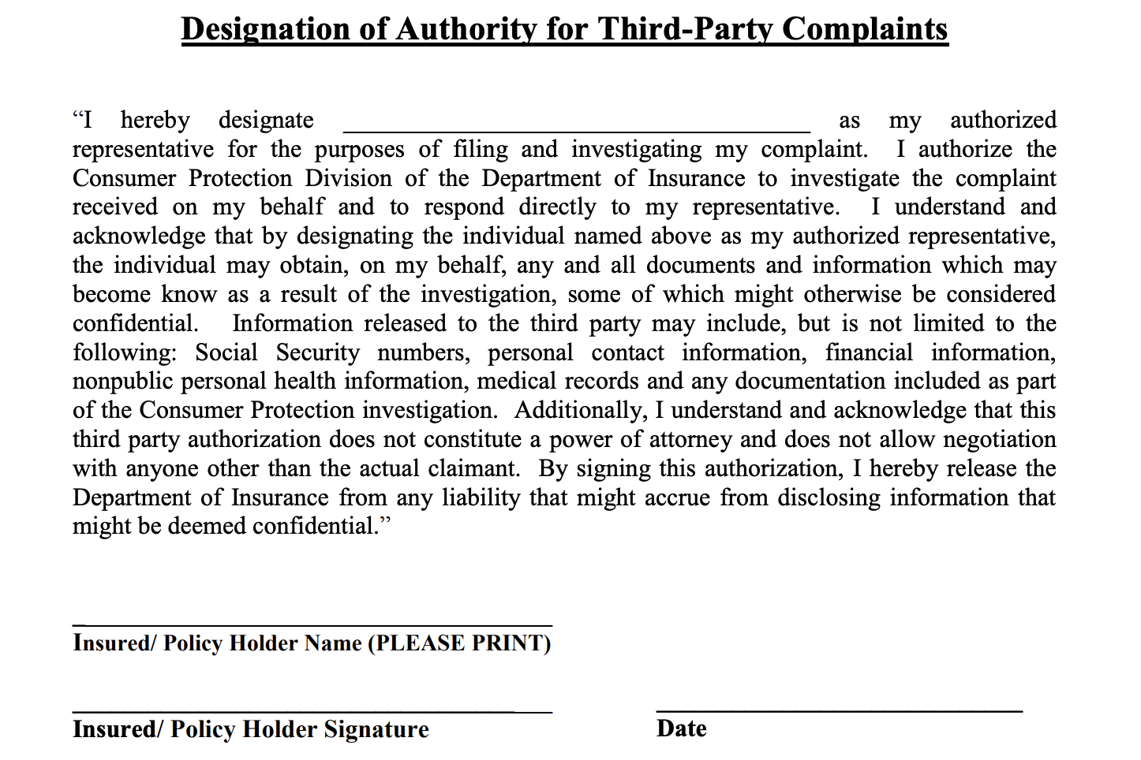
Different states handle it differently…
Notes:
Kentucky

Slide 41
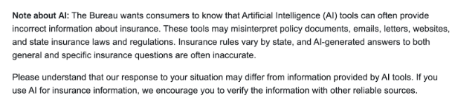
Different states handle it differently…
Notes:
Ohio

Slide 42
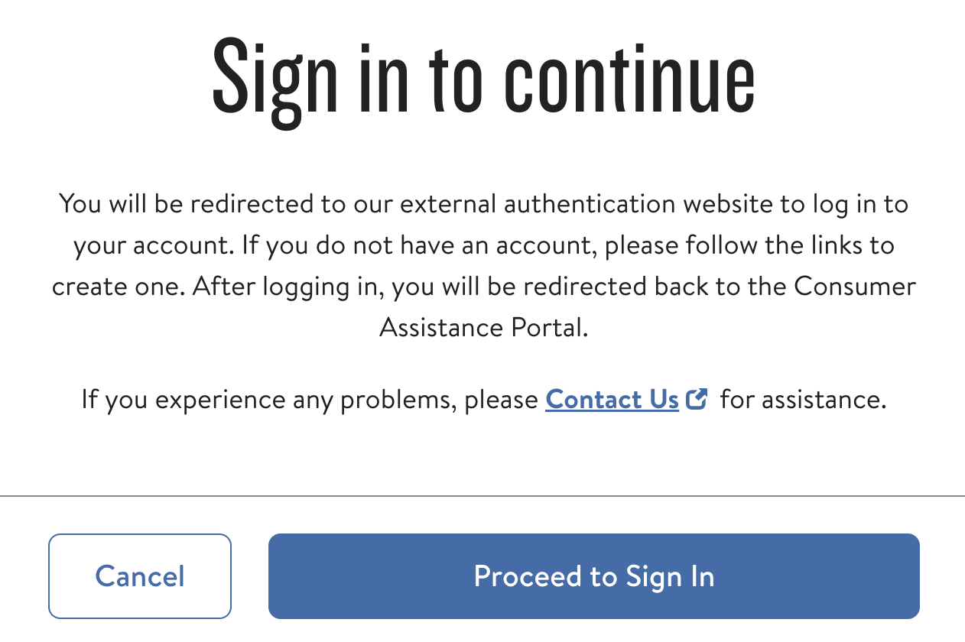
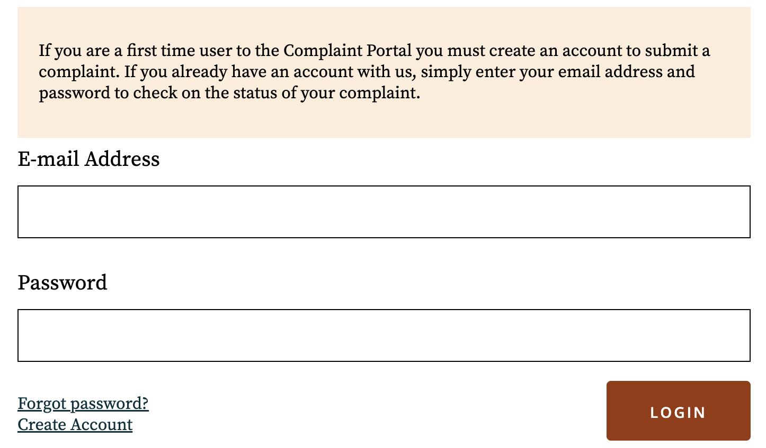
Different states handle it differently…
Notes:
Florida, Georgia

Slide 43
Current Safeguards
Varies by state:
Create an account on portal
Use of AI notice
Provider path
Role/Relationship question
Require authorization form
CAPTCHA tests

Slide 44
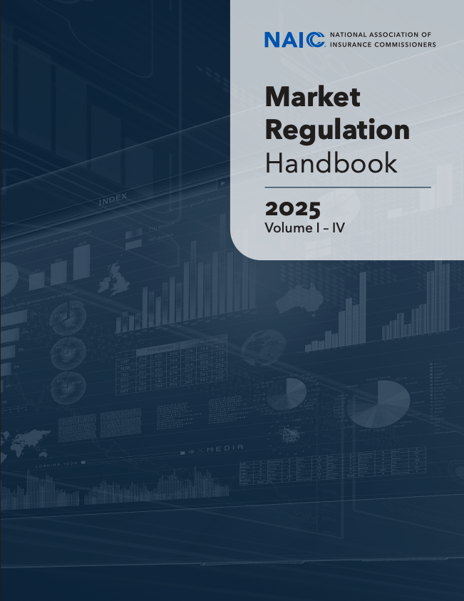
THE CONSUMER COMPLAINT
IS MORE THAN JUST A COMPLAINT
Complaint
Someone reports a concern or suspected problem.
Intake
The complaint is captured and evaluated.
Data
Individual complaints can become useful information.
Patterns, Trends, Intelligence
Aggregated data can point to recurring problems.
Regulatory Response
Insights can trigger market conduct exams or other responses.
Notes:
The NAIC framework recognizes the regulatory value of complaint information, but the Handbook does not appear to establish a uniform national standard for who may submit a consumer complaint or what relationship the complainant must have to the consumer.

Slide 45
Do not edit
How to change the design
Have you seen impersonation or malicious activity in consumer complaints?
The Slido app must be installed on every computer you’re presenting from

Slide 46
Think like an investigator…
Same identifiers or attributes across multiple complaints…
  IP address
  Device ID
  Email
  Phone

Slide 47
Think like an investigator…
Same identifiers or attributes across multiple complaints…
  IP address
  Device ID
  Email
  Phone
… linked to multiple accounts or complainants
… submitted within a short time window
… about the same insurer

Slide 48
Think like an analyst…
What data will you need?
  The basics (date, time, name)
  Role/relationship
  IP address
  Device ID
  Email
  Phone
  Account ID
  Details

Slide 49
What would you do with this data?
One complaint may tell you about one consumer.
Connected complaints can tell you something more.
The goal isn't to question every consumer… or complaint.
It's to recognize when something deserves a closer look.

Slide 50
Thank You

